Slide 1
rapid-prototyping of rapid-prototyping machines
Volume scanning
Prof Phil Withers
Manchester X-ray imaging Facility
University of Manchester

Slide 2
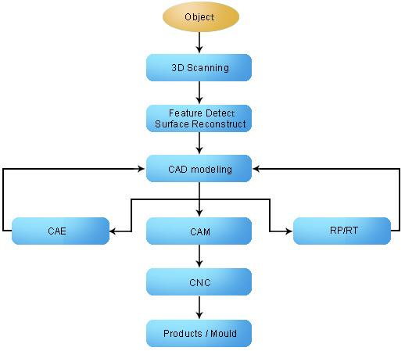
From 3D object to 3D copy

Slide 3
3D scanning
The first thing is to acquire a 3D virtual model of the item to be reproduced.
There are many different ways of scanning the object:
Contacting scanners
Non contact scanners

Slide 4
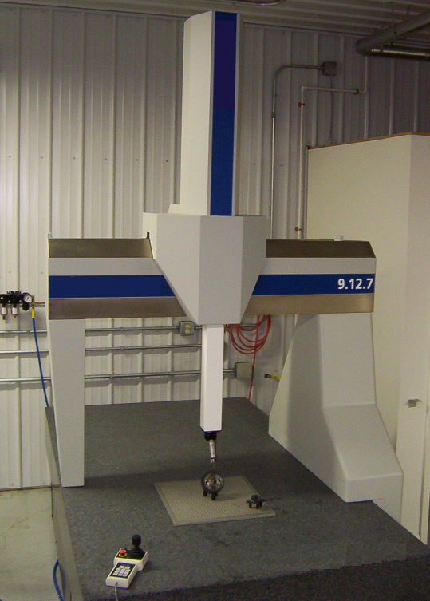
3D scanning (Contacting)
Coordinate measurement machines
Very accurate
Can damage delicate samples
Very slow

Slide 5
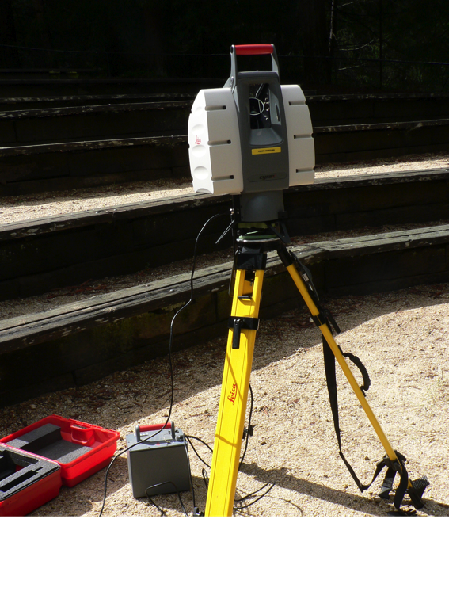
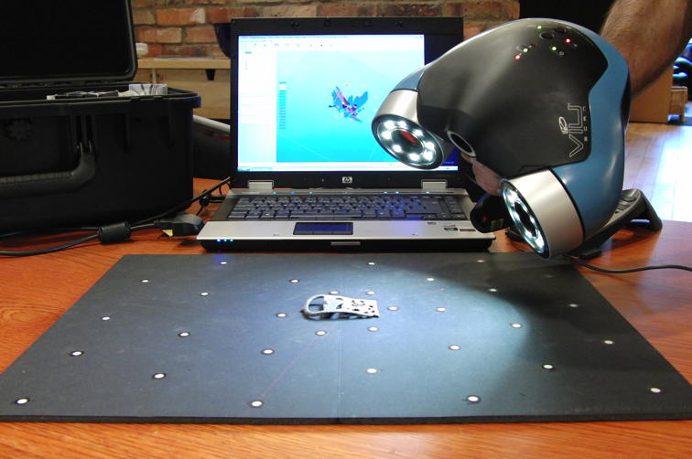
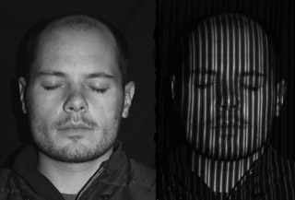
3D scanning (non contact)
Time-of-flight 3D laser scanner uses laser light to probe the subject. A laser is used to emit a pulse of light and the amount of time before the reflected light is seen by a detector is timed.
10,000~100,000 points every second
operating over very long distances (km)
Good for buildings
mm accuracy
Triangulation 3D laser scanners use laser to shine light on subject; exploits camera to look for the location of laser dot.
limited range (few meters)
accuracy is relatively high (~10microns).
Hand-held laser scanners create a 3D image through triangulation
Structured-light 3D scanners project structured pattern of light on subject and look at deformation of pattern on the subject.
Instead of scanning one point at a time, can scan entire field of view at once

Slide 6
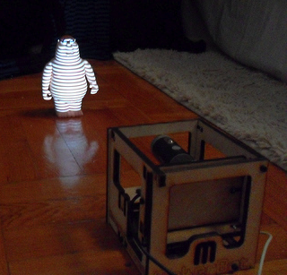
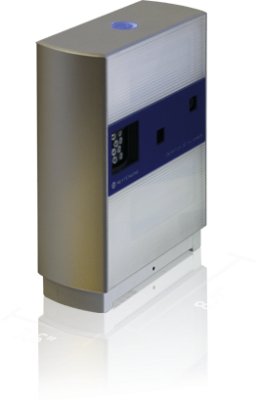
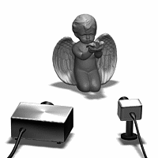
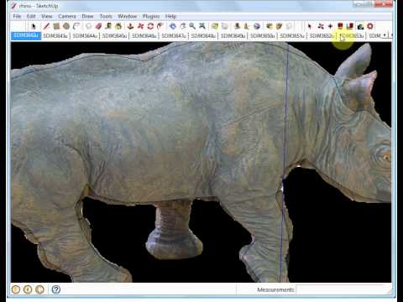
Cheap 3D scanners
Makerbot 3d Scanner - nice little kit allowing you to use a normal consumer pico projector and webcam or other camera to make 3d scans of small objects
NextEngine – ~$3000, it does amazingly accurate scans, and is simple to use.
David 3D Scanner - uses a webcam and a handheld laser to allow you to scan in objects. The kit currently runs at about ~$1000.
Tgi3D PhotoScan – a software-based 3D scanning method using any digital camera to get your 3D model. You just take pictures of your object from different angles and use the software for 3D modeling with Google SketchUp.

Slide 7
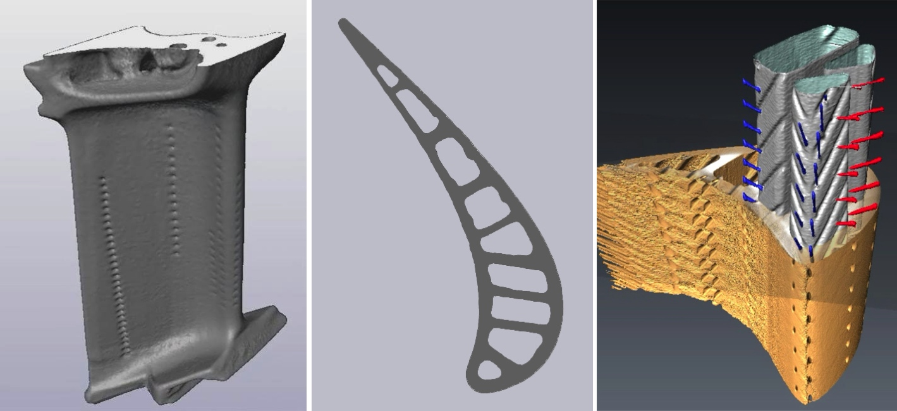
Volume Scanning
All the light based methods scan only the exterior envelope of the sample
X-ray Computer Tomography (CT)
The great advantage of computer tomography is that not only do you get the external surface geometry you capture any internal features as well.
The principle is simple; namely to collect a series of radiographs (projections) acquired from different angles from which an image of the original 3D volume can be reconstructed using a computer algorithm
Range of resolutions from mm to tens of nanometers

Slide 8
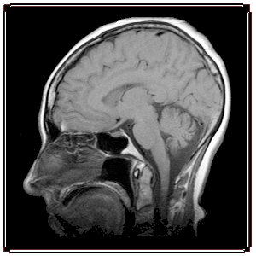
Volume Scanning
Magnetic resonance Imaging
Similar to x-rays but provides greater contrast for soft tissue
mm resolution

Slide 9
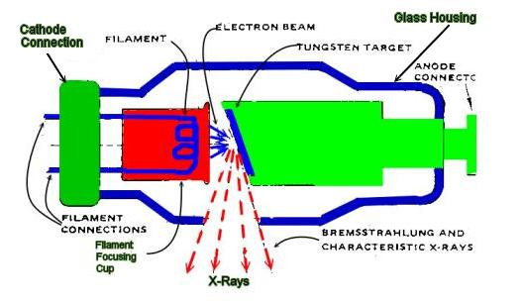
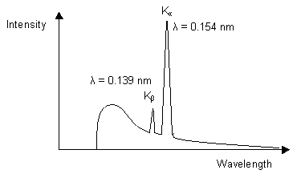
X-ray CT sources
Laboratory x-rays
Characteristic x-rays and broad spectrum

Slide 10
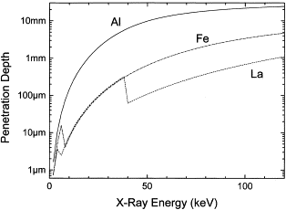
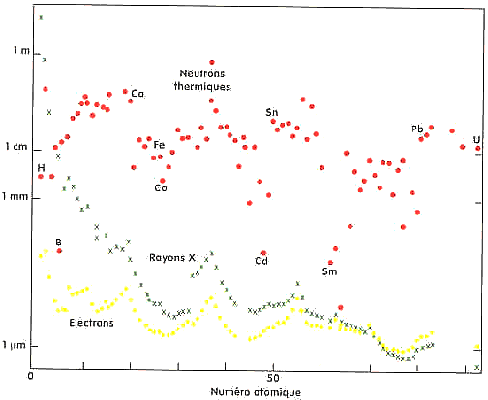
X-ray sources
Broadly speaking X-ray penetration increases with energy to the 3rd power
Broadly speaking X-ray penetration decreases with atomic number

Slide 11
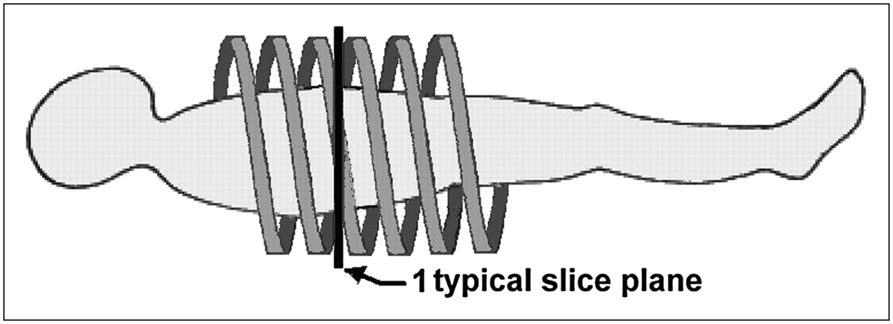
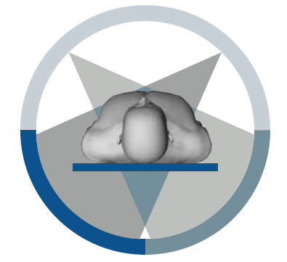
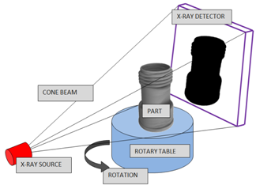
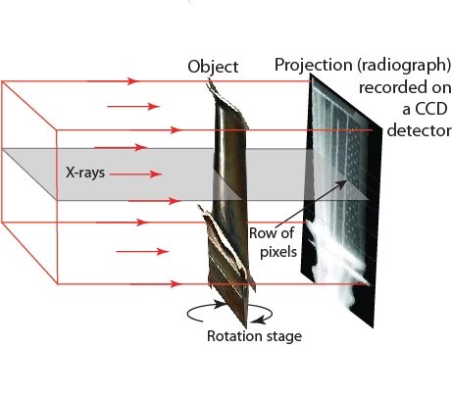
X-ray Geometries
Spiral
Cone beam
Parallel beam

Slide 12
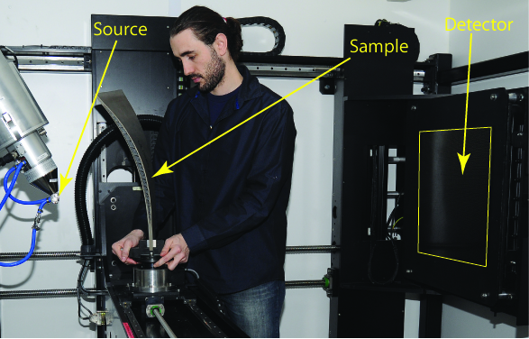
Lab X-ray cone CT system

Slide 13
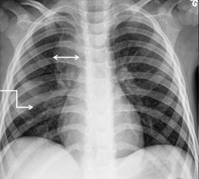
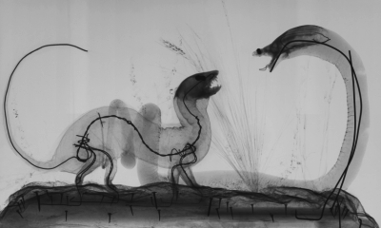
Contrast mechanisms (attenuation Contrast)
Let us consider the contrast in a 2D radiograph.
If the source is incoherent then features are recorded on the radiograph according to the attenuation of the x-rays along the travelled path
Consequently elements of high atomic number (e.g. Ca containing bones) attenuate more than those of low atomic number (e.g. C, H, O in soft tissue)

Slide 14
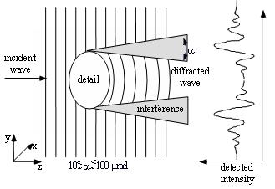
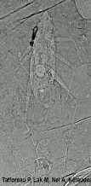
Contrast mechanisms (phase Contrast)
For low contrast features illuminated by coherent x-rays the phase change can be more significant than the attenuation change
By imaging at increasing sample to detector distances can increase the phase contrast.
Attenuation contrast
Phase contrast
Good for low contrast objects – e.g. fossils in amber, plastic objects, etc

Slide 15
CT tomography
Generally collect many projections (ideally ~ 1 for every 2 pixels across the detector)
i.e. for 2000 pixel detector use >1000 projections (radiographs) over 180° degrees
For complete solution need to capture whole width of sample in every image
Otherwise incomplete data (region of interest methods)
Pixellated detector
Spatial resolution usually >1pixel
If object completely within detector
Sample resolution ~width/No of pixels

Slide 16
CT Reconstruction
Once we have a set of projections we use a reconstruction algorithm to infer the 3D geometry of the object.
99% of images are recovered using filtered back projection

Slide 17
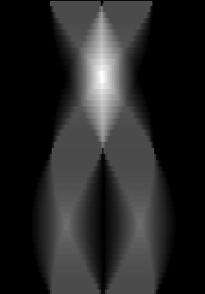
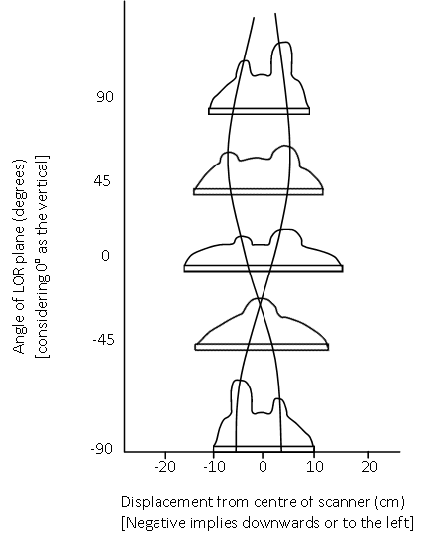
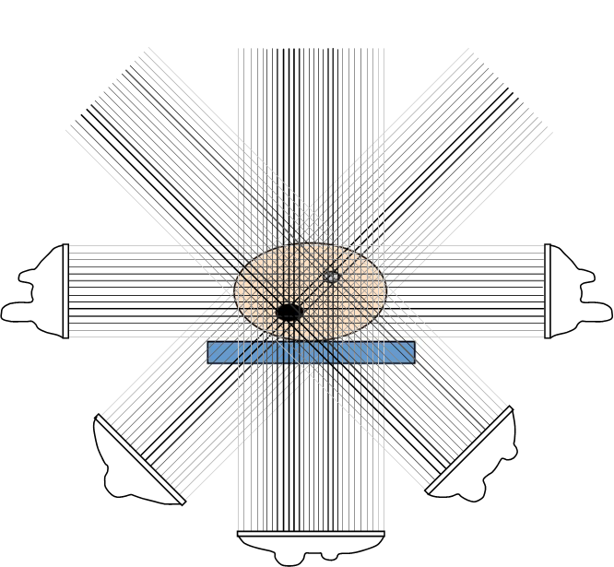
CT Reconstruction (filtered back projection)
(Parallel beam geometry)
Each row of the sinogram (right) is the line of response (a pixel row on the detector) for a given projection (left)

Slide 18
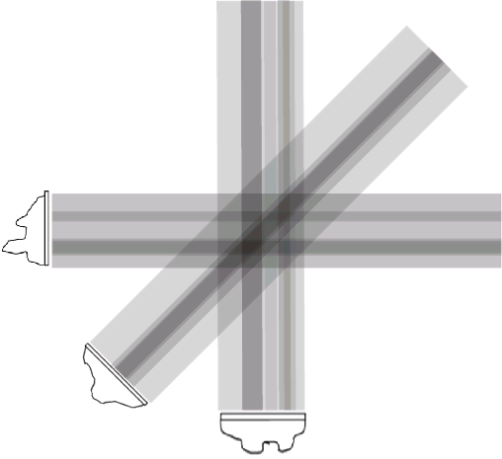
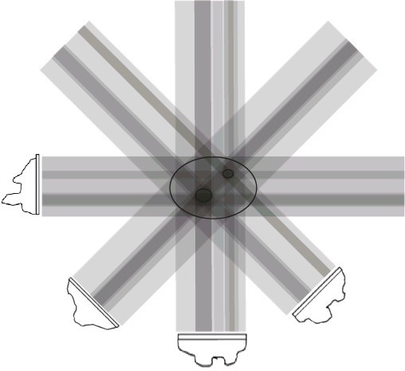
CT Reconstruction (filtered back projection)
By projecting the projections back at the angle for which they were collected you build up an image of the original slice – the more projections the better the image

Slide 19
CT Reconstruction
Reconstruction of a metamorphic rock sample
Attenuation of X-rays by the sample as a function of rotation
Midsection of sample imaged with a planar fan beam
Sinogram
Horiz. – Detector channel
Vert. – Rotation angle
Brightness corresponds to extent of X-ray attenuation
Each row of the sinogram is first convolved with a filter, and projected across the pixel matrix along the angle at which it was acquired
http://serc.carleton.edu/research_education/geochemsheets/techniques/CT.html

Slide 20
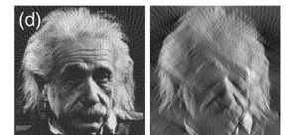
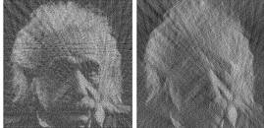
CT tomography
The more projections the better the reconstructed image
Restricted angles 60 projections
Only +/-60° (1 every 2°)
90 projections (1 every 2°)
Restricted angles 24 projections
Only +/-60° (1 every 5°)
36 projections (1 every 5°)

Slide 21
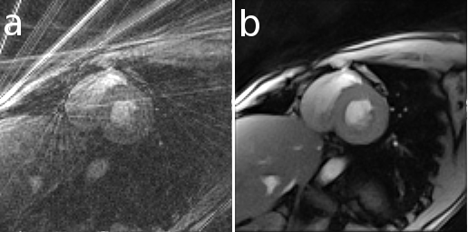
Iterative reconstructions
Direct reconstruction
of real-time MRI of heart
Iterative reconstruction
Reconstruction of a 3D image from 2D image is an inverse problem.
Often not possible to exactly solve the inverse problem directly.
Iterative algorithms approach the correct solution using multiple iteration steps, allowing a better reconstruction at the cost of a higher computation time.
Large variety of algorithms, but each
starts with an assumed image,
computes projections from the image,
compares the original projection data and
updates the image based upon the difference between the calculated and the actual projections.

Slide 22
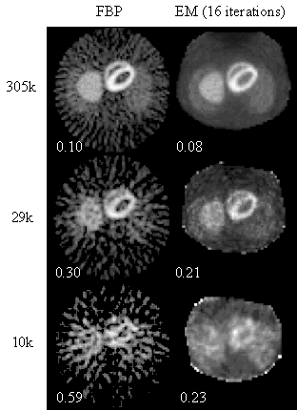
Iterative reconstructions
There are typically five components to iterative image reconstruction algorithms:
A model of the object
A model of the measurement system/geometry
A statistical model of the noise.
A cost function that is to be minimized
An algorithm, usually iterative, for minimizing the cost function, including some initial estimate of the image and some stopping criterion for terminating the iterations.
Comparison of FBP & iterative scheme for different total counts for image of liver. Note particular the streaking and noise appearance at low counts using FBP.

Slide 23
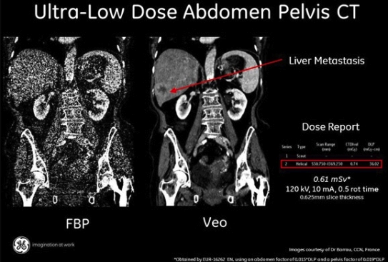
Iterative reconstructions
Advantages:
Lower dose (nosier data)

Slide 24
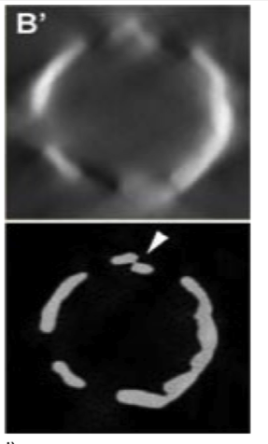
Iterative reconstructions
Advantages:Phase segmentation (much better if wanting to extract a 3D solid model): use the number of phases as prior information (discrete tomography)

Slide 25
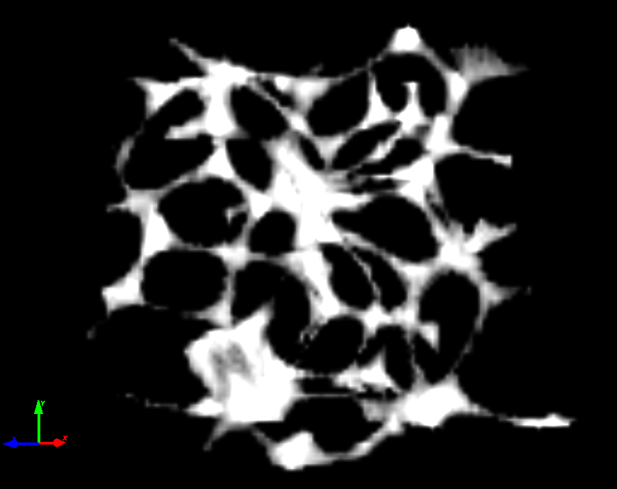
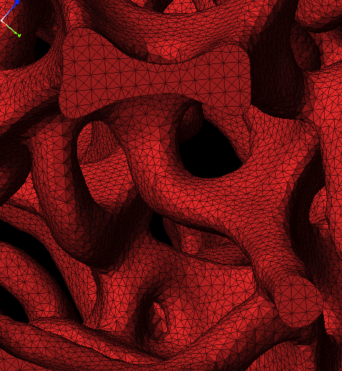
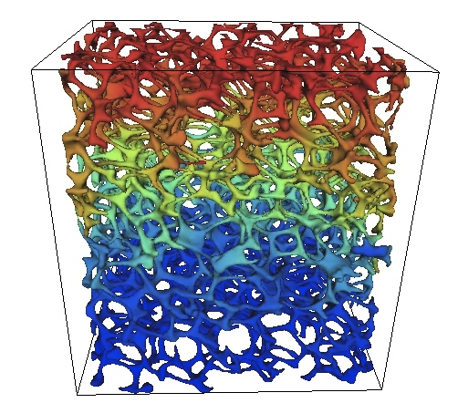
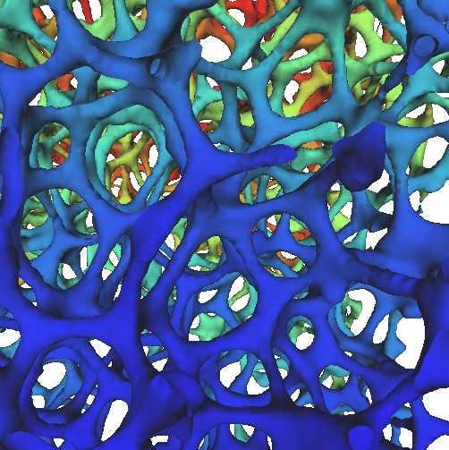
From tomograph to 3D model
Usually use thresholding to determine the boundaries of the geometry for the 3D solid model
Often the most difficult step is putting 3D model into CAD – can end up with models which are too complex and noisy and needs rationalising
SCAN
MESH
PREDICT
IMPROVE

Slide 26
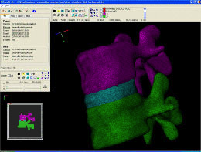
Images to CAD
Many products for taking 3D models and importing into CAD, e.g. simpleware:

Slide 27
Preparing a scanned model for printing
The measured data alone, usually represented as a point cloud, lacks topological information
It must be processed and modeled into a more usable format such as a triangular-faced mesh, a set of NURBS surfaces, or a CAD model.
You need to clean up a model and fix it to be printable. There are a couple tools that are great for model cleaning.

Slide 28
Preparing a scanned model for printing
Cleanup with Blender
Blender supports a TON of import and export formats. You'll want to export your final object as STL for printing though.
Remove duplicate vertices
Remove non-manifold points are points that just don't make sense in the real world. These can be hanging points, internal surfaces, holes, zero-thickness walls, etc.
Clean STL file with netfabb www.netfabb.com - alternative to blender easy automated tool-
netfabb studio basic is free
netfabb is an easy automated way to fix manifold and other mesh errors quickly.

Slide 29
Sending the image to a 3D printer
Here is an example:
ReplicatorG, which is available at http://replicat.org/ and can be used to control printers such as makerbot
Once you have a 3D model, you need to run it through a slicer (e.g. skeinforge) to generate GCode, which is the file format that you send to the printer that tells it exactly what it needs to do in order to build your object.
Run the printer to create your 3D model layer by layer
Remove from substrate and finish off

Slide 30
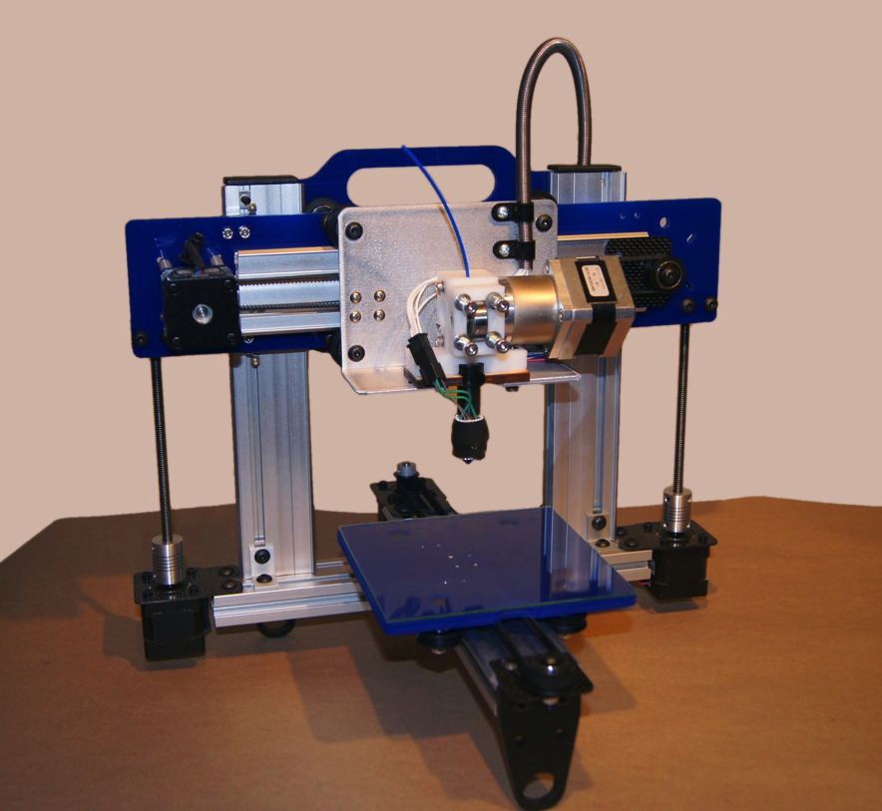
From 3D image to 3D object
Additive
Subtractive
3D machining
3D printing

Slide 31
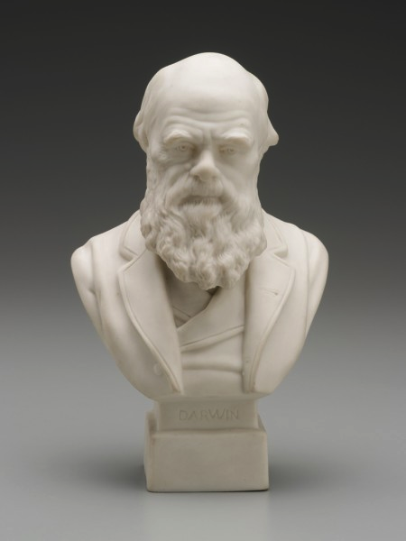
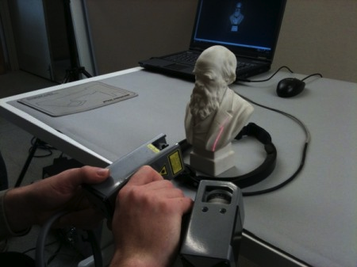
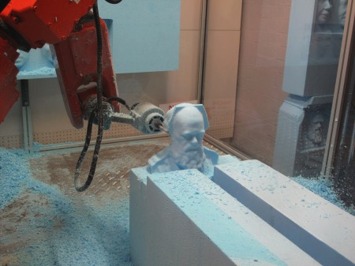
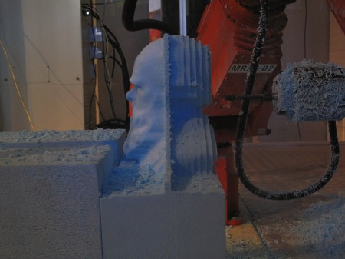
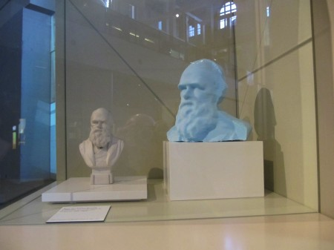
Case study
http://www.powerhousemuseum.com/collection/blog/index.php/2010/08/double-darwin-3d-scanning-and-rapid-prototyping-robot/

Slide 32
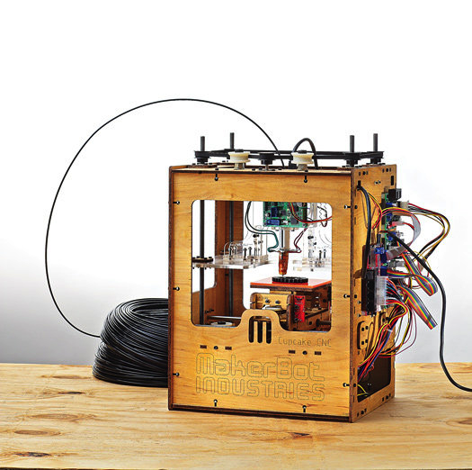
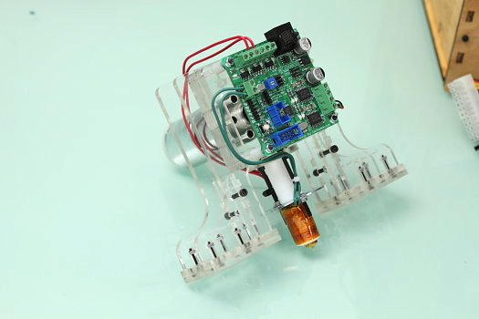
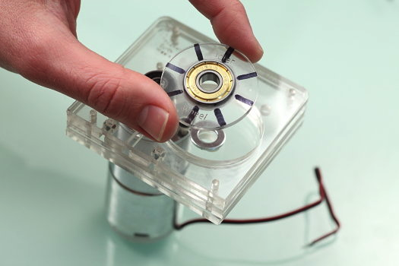
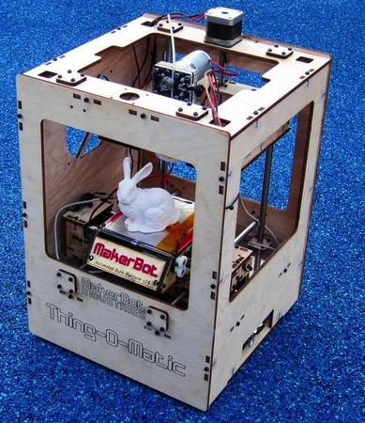
Case study
Maker-bot : a DIY 3D printing system

Slide 33
Further reading
http://wiki.makerbot.com/makerscanner
http://www.david-laserscanner.com/
http://www.mxif.manchester.ac.uk/

