Slide 1
Optimizing Rate of Hormone Clearance to Maximize Channel Capacity in the Bloodstream
Abubakar Abid
Prof. Neil Gershenfeld MAS.862 Final Project

Slide 2
Hormones act as messengers in the circulatory system
In molecular communication,
Hormones are secreted at some rate, F, at TX.
The presence of molecule above a threshold, T, at RX = 1
The absence of a molecules (or below threshold T) at RX = 0
Transmitter organ/cell
Receiver organ/cell

Slide 3
Hormones are transported by diffusion, advection, and absorption
Diffusion
Advection
Clearance
Transmitter organ/cell
Receiver organ/cell

Slide 4
Hormones are transported by diffusion, advection, and absorption
Diffusion
Advection
Clearance
Transmitter organ/cell
Receiver organ/cell

Slide 5
Hormones are transported by diffusion, advection, and absorption
Diffusion
Advection
Clearance
Transmitter organ/cell
Receiver organ/cell

Slide 6
Hormones are transported by diffusion, advection, and absorption
Diffusion
Advection
Clearance (absorption)
Transmitter organ/cell
Receiver organ/cell

Slide 7
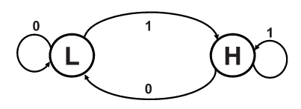
Channel capacity is determined by amount of time needed to switch states
Transmitter organ/cell
Receiver organ/cell

Slide 8
Channel capacity is determined by amount of time needed to switch states
Transmitter organ/cell
Receiver organ/cell

Slide 9
Channel capacity is determined by amount of time needed to switch states
Transmitter organ/cell
Receiver organ/cell
Noisy molecule positions make the transition hard to distinguish

Slide 10
Because it is a closed system, “noise floor” is a result of remnant molecules
Transmitter organ/cell
Since it eliminates remnant molecules, clearance may play an important factor in setting the channel capacity!
Receiver organ/cell

Slide 11
Prior Work
What is the channel capacity of a diffusion-based molecular system? No unified theory, but:
State-space approach to model information in molecular comm. (Fekri) [1]
Memory and noise from a thermodynamic perspective (Akyildiz) [2]
Approximating noise as Gaussian to use classic Shannon (Goldsmith) [3]
How to estimate channel capacity of the bloodstream?
Models probability distribution of CO₂ in different physiological conditions to come up with entropy and information limits (Yamamoto)
No discussion of clearance-limited noise floor in prior literature. Is the clearance relevant to channel capacity? Is the clearance optimized to maximize channel capacity in biological system?

Slide 12
Problem 1: Cellular Transport
If the bloodstream is treated as 1D, and a transmitter cell releases a unit impulse of molecules, what will the distribution of molecules look like when it arrives at a receiver cell a distance L down the bloodstream? Assume that clearance occurs at a very different time scale than diffusion. How does the peak concentration change (approximately) if instead of an impulse initial condition, there is instead a short rectangular pulse of time 𝝉, with a rate (amplitude) F? Specify any assumptions you use.

Slide 13
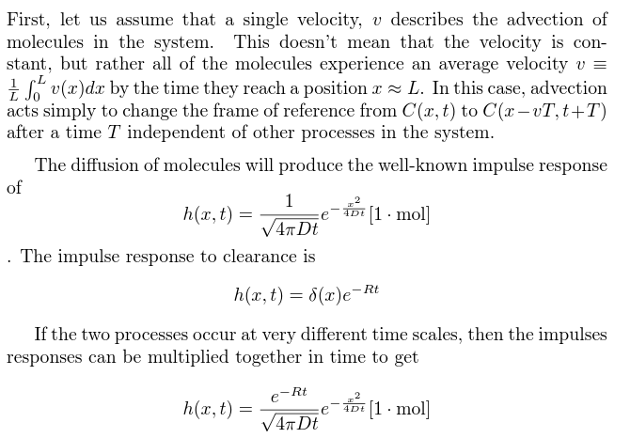
Solution 1: Cellular Transport
T = L/v

Slide 14
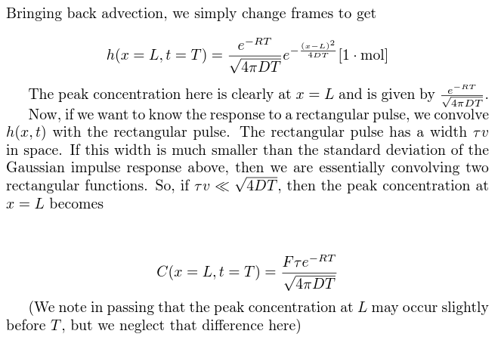
Solution 1: Cellular Transport

Slide 15
Problem 2: Equilibrium “Noise Floor”
The release of molecules is determined by cellular processes and biochemical feedback for the hormone of interest. Let us assume that the transmission happens at a frequency f (this could range from every few seconds to hours) in a pulsatile waveform of duration 𝝉 and amplitude F, what is the equilibrium concentration of molecules in the bloodstream, C₀?
F
𝝉

Slide 16
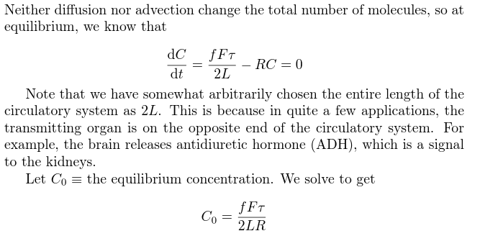
Solution 2: Equilibrium “Noise Floor”

Slide 17
Problem 3: Pulse Time Needed for State Transitions
If the equilibrium concentration of the molecules in the bloodstream is C₀, a reasonably sensitive receiver cell may decide to change states to “H” if it detects a hormone level of >2C₀ and may transition back to “L” if it detects a hormone level of ~C₀. If the cell can release hormones with a pulse amplitude F, what is the pulse release time 𝝉 required for a transition in both cases: L→ H and H → L?

Slide 18
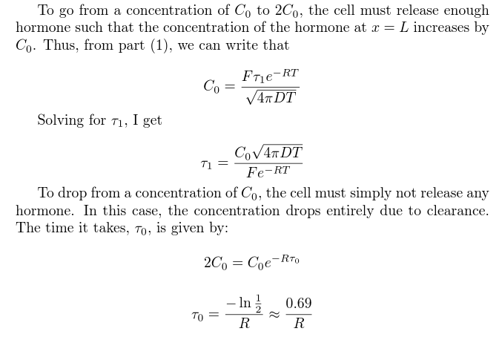
Solution 3: Pulse Time Needed for State Transitions

Slide 19
Problem 4: Channel Capacity
Assuming that (almost) all of the information is conveyed in the state transitions L → H and H → L which occur with equal probability, calculate the Shannon channel capacity for this channel.

Slide 20
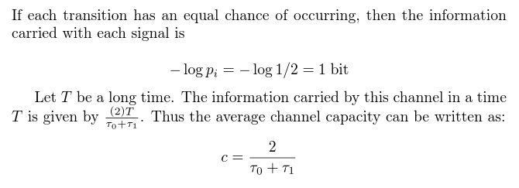
Solution 4: Channel Capacity

Slide 21
Problem 5: Optimizing the Clearance Rate
Plot the channel capacity as a function of R. For what value of R is the channel capacity maximized with the parameters below for for the antidiuretic hormone (ADH) [4]? How close is this to the value of R obtained from literature (see table)? Verify all of the assumptions made above hold for ADH.
mol → pg, cm → mL
Physiological Parameters for ADH in the Human Body
F [pg/sec] | 2.5 [4]
C_{o} [pg/cm*] | 0.033 [5,8]
D [cm²/sec] | 4.51×10⁻⁶ [6]
T [sec] | 30 [7]
R [1/sec**] | 0.012 [5,9,10]
* after multiplication by an average blood vessel area (1 mm²) to go from pg/mL to pg/cm **Converted from pg/sec to 1/sec by total volume of glomerulus

Slide 22
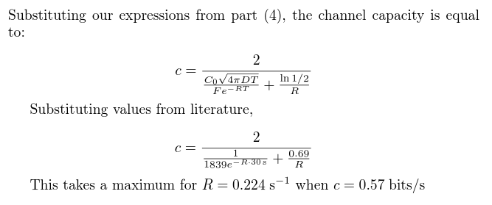
Solution 5: Optimizing the Clearance Rate

Slide 23
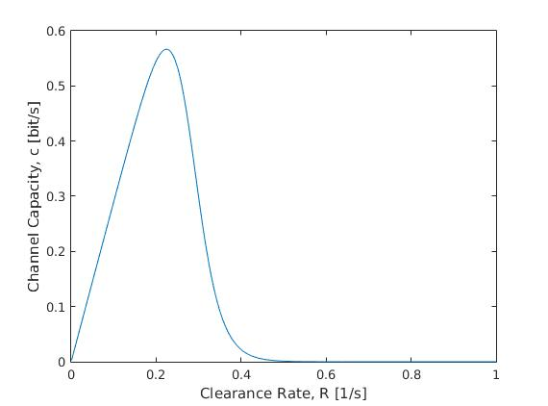
Solution 5: Optimizing the Clearance Rate
Slow clearance rate inhibits H → L transition
Fast clearance rate inhibits L → H transition

Slide 24
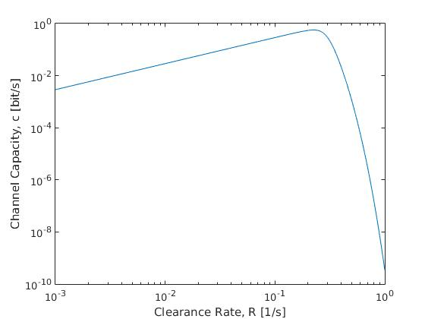
Solution 5: Optimizing the Clearance Rate

Slide 25
Implications and Future Plans
We have developed an analytical expression for the channel capacity of the bloodstream that is extendable to a variety of hormones and molecules based on available information. We show that clearance does significantly affect channel capacity
The clearance rate of ADH does not seem to be set to maximize channel capacity. However, for molecules that are part of faster biochemical feedback loops (like adrenaline, CO₂), the channel capacity may be closer to optimal. This should be verified for other molecules.
We should also verify the many cellular biology assumptions (concentration threshold for signal transduction, etc.)

Slide 26
Questions?
???
References
http://www.mit.edu/~beirami/papers/ISIT11-capacity.pdf
http://ieeexplore.ieee.org/stamp/stamp.jsp?arnumber=6305481
http://arxiv.org/pdf/1602.07757v1.pdf
http://ac.els-cdn.com/0304394086903083/1-s2.0-0304394086903083-main.pdf?_tid=eff0269c-1b18-11e6-9c48-00000aacb35d&acdnat=1463370640_271d92232e0c122c67b8c1c8dc7643f6
http://www.ncbi.nlm.nih.gov/m/pubmed/6467834/
http://onlinelibrary.wiley.com/doi/10.1021/js960503w/epdf
http://www.lbc.co.uk/how-long-does-it-take-for-blood-to-flow-round-the-body-47277
http://www.encyclopedia.com/topic/Blood_vessels.aspx
http://www.ias-iss.org/ojs/IAS/article/viewFile/631/534
http://ndt.oxfordjournals.org/content/24/8/2428.full.pdf+html

Slide 27
Backup Calculations
C₀ is 3.3 pg/mL according to [5]. If the average blood vessel size is taken to be 1mm², then the 1-dimensional concentration becomes C₀ = (1mm²/1cm²) 3.3 pg/mL = 0.033 pg/cm.
There are 1,000,000 glomeruli, with an average volume of 10⁷ um³ [9,10]. This gives a total volume of 10¹³ um³ which is 10mL. This means that the rate of absorption R must be 7.5 mL / 10 mL / 60 seconds = 0.012 1/sec if we use the rate of excretion from [5].

