Slide 1
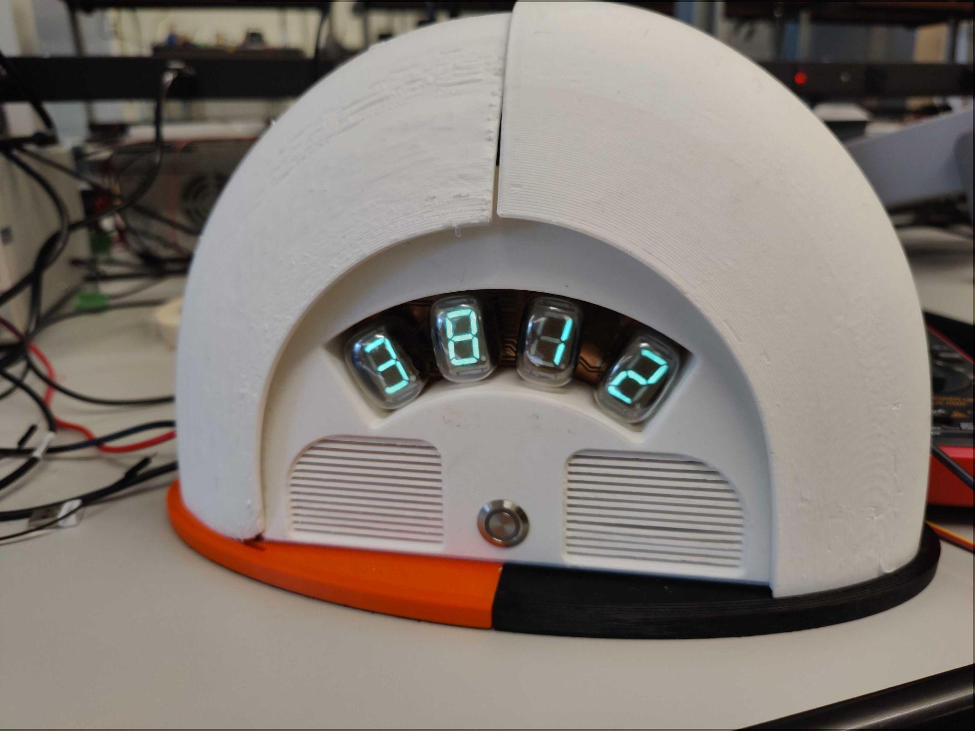
HTMA 2023 Final Project
Bowen Wu

Slide 2
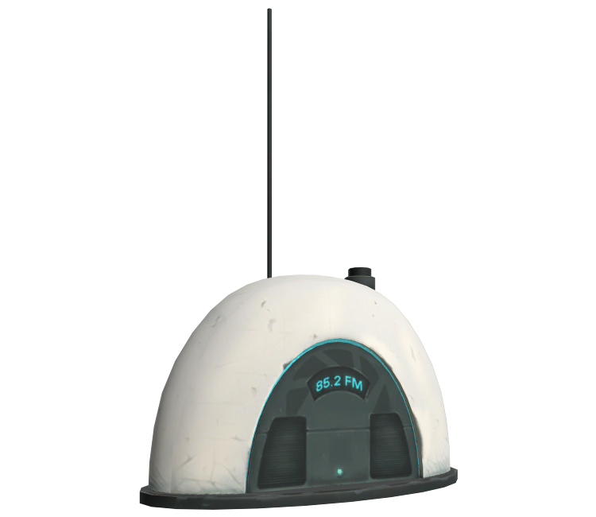
Conception
Initially I wanted to make a watch out of nixie tubes, but time constraints made me pivot to reusing my Vacuum Fluorescent Display tubes from week 6 for a clock project.
The clock is directly inspired by the radio you see at the beginning of the video game Portal (2007)

Slide 3
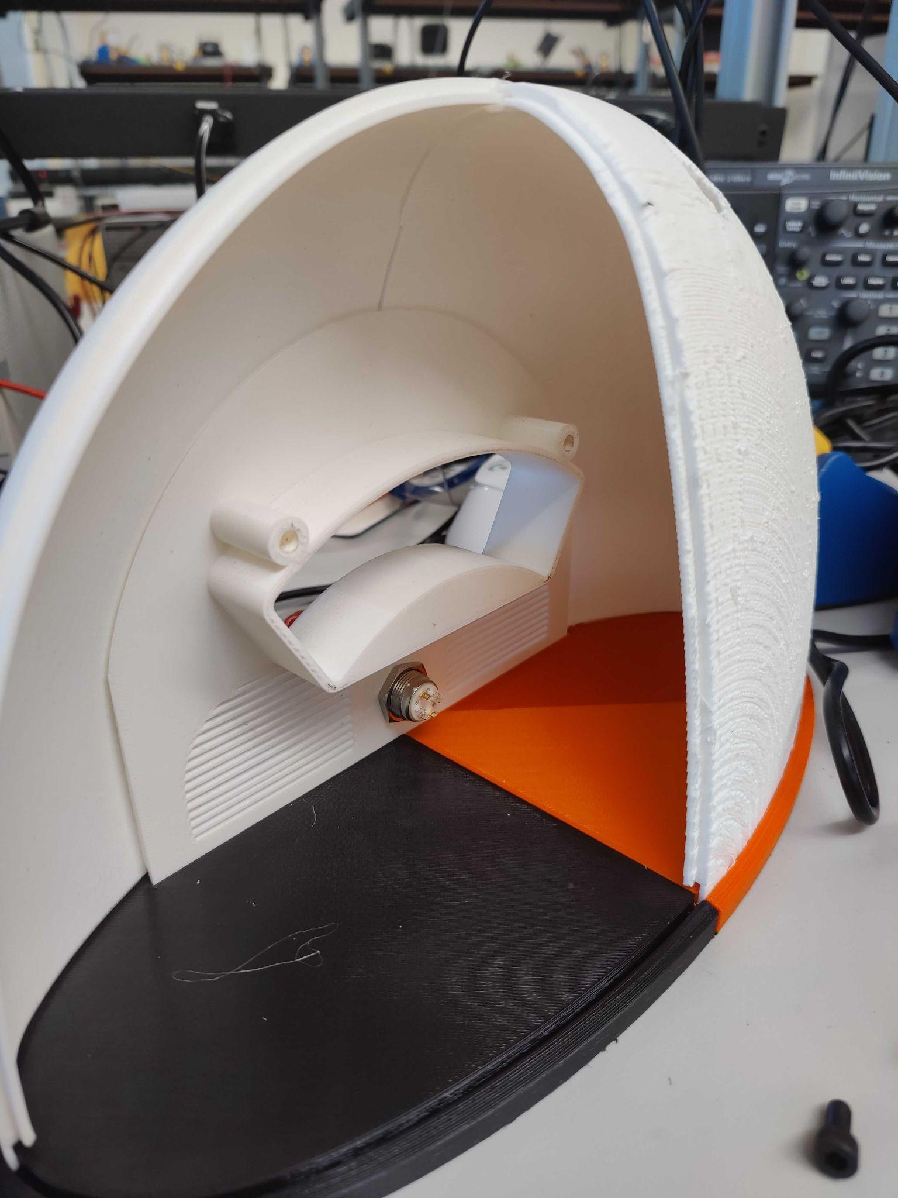
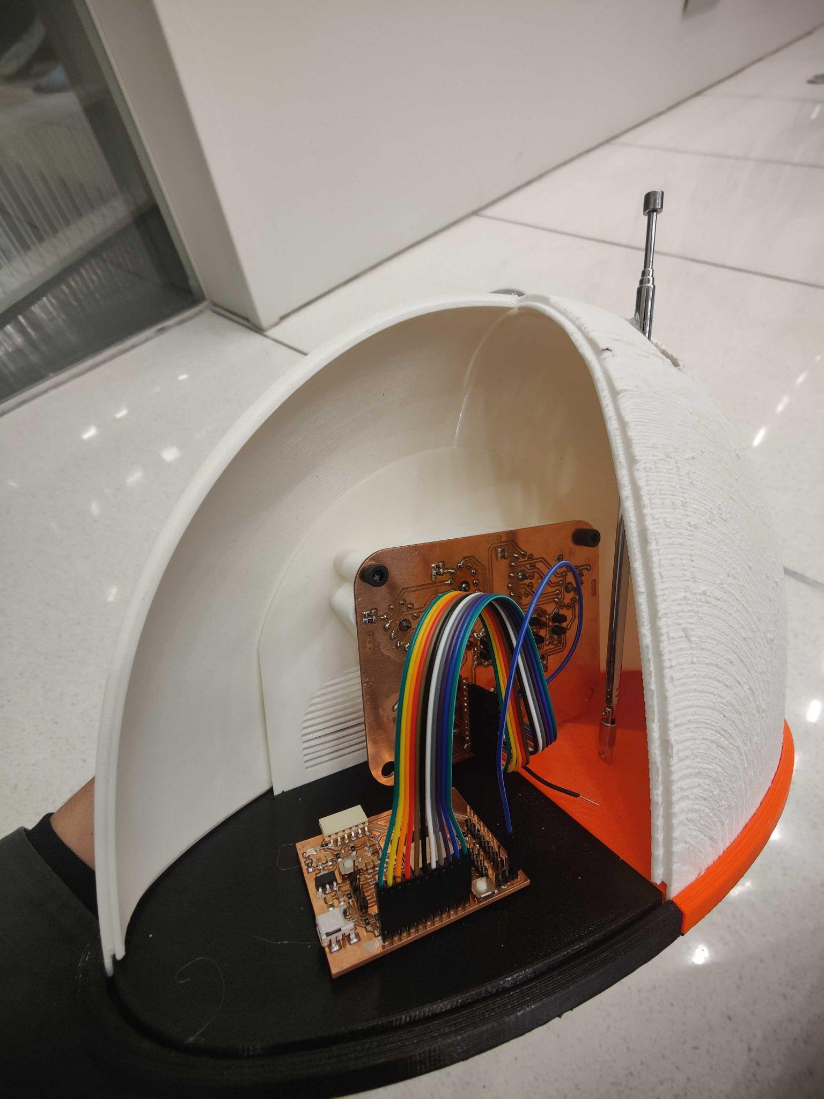
Construction
The housing is made crudely out of 3D printed parts
Time and resource constraints meant I had to print in lower quality and use whatever color filaments I had available, including PLA and ABS.
Circuit board were made in-house with the PCB mill, while parts were sourced from a mix of Digikey and the EECS section stock

Slide 4
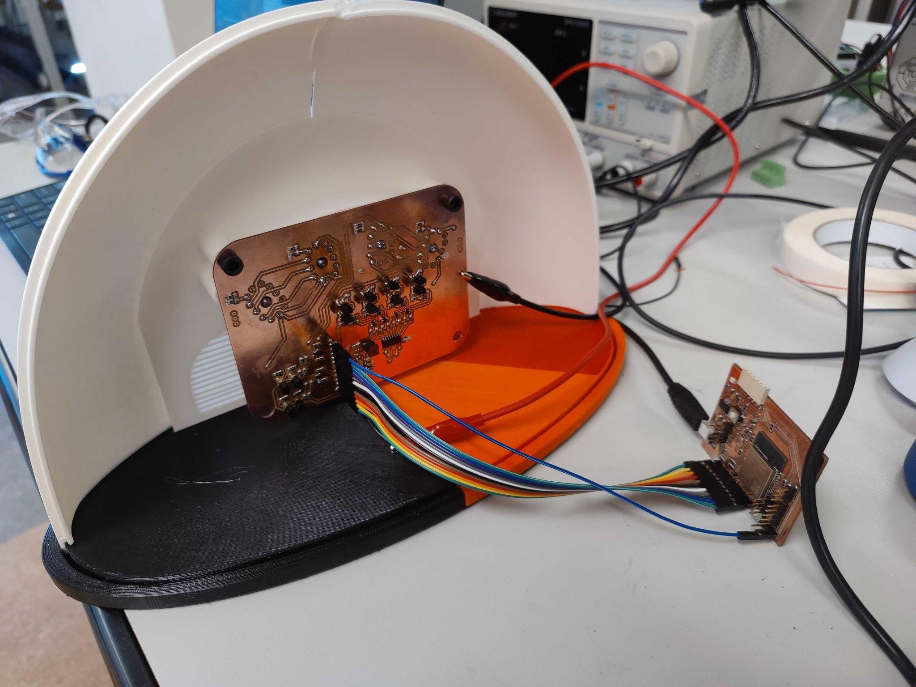
Operation
Multiplexed VFD display
Only one display is on at a time, but they’re strobed at a high frequency to appear as if they’re all on.
On-board 27V boost converter from 5V
*Not working, requires external 27V power supply
Retrieves time-zone accurate time from the internet

