Slide 1
Electronics

Slide 2
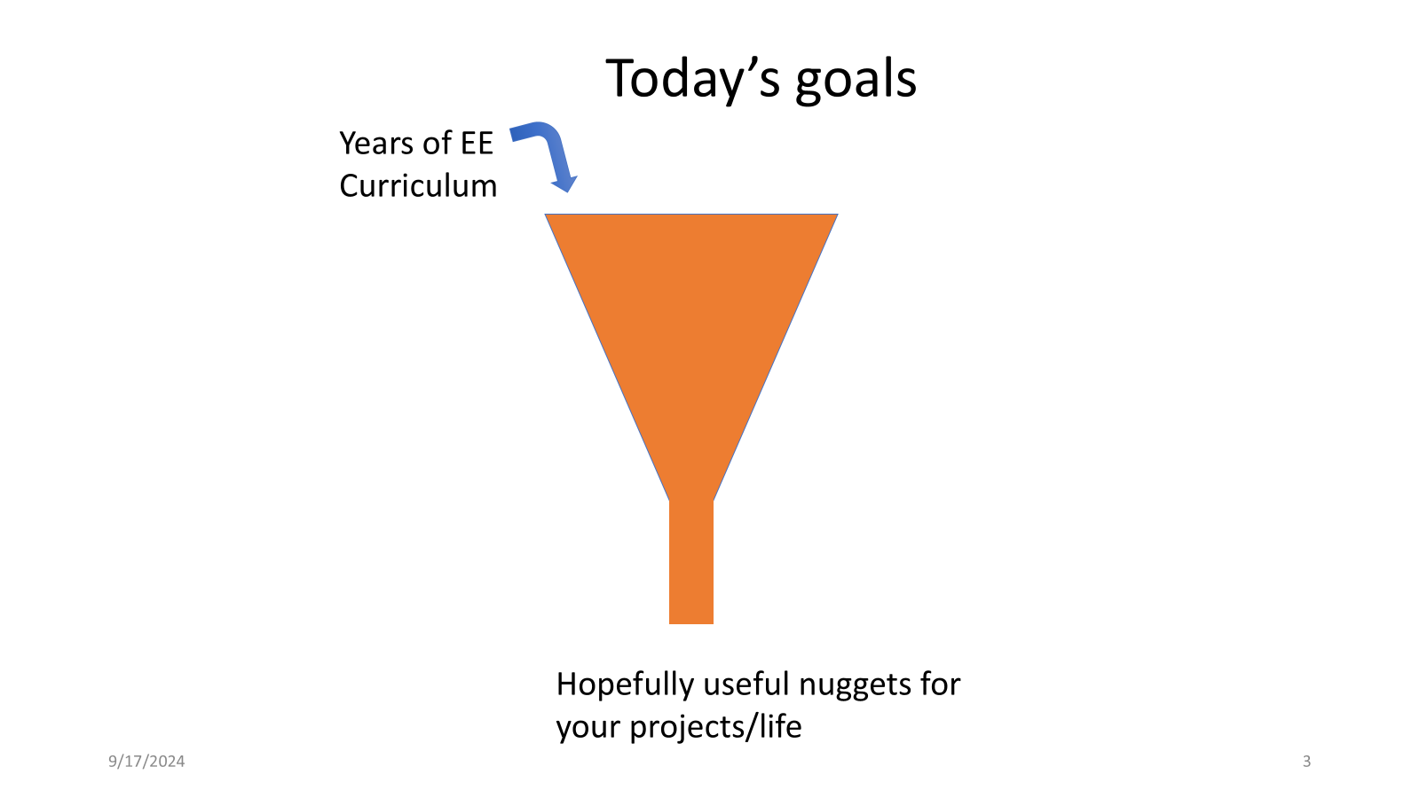

Slide 3
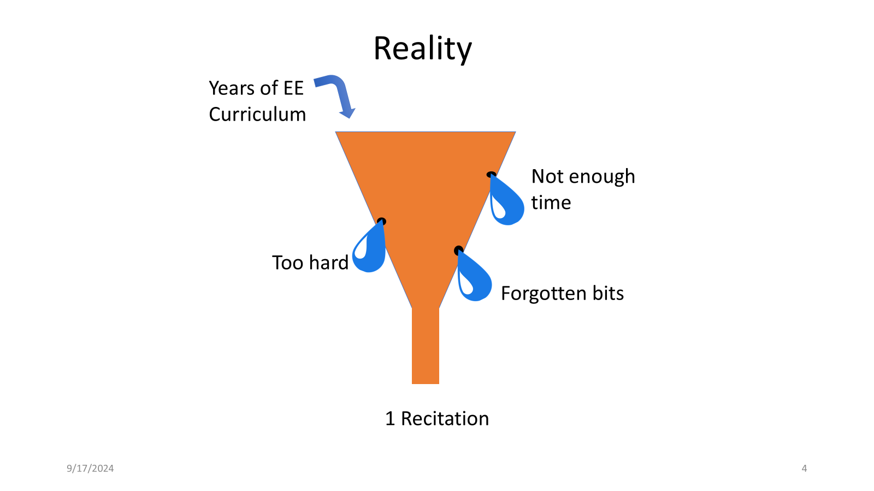
Notes:
Realistically when working with a course with such a non-gaussian distribution of students there really is no optimal way for us to have a discussion. We can’t focus on one side and skip the rest right?

Slide 4
The next few weeks have a simple task!
Learn (or recall) basic electrical engineering
Use it to design a custom circuit board in a new software program (EDA)
Mill/lase it and solder on all the parts properly
Program your board to do something

Slide 5
But where do we start?
Theory?
Practice?
Components?
Ideal models?
Hardware or software?
Can we even separate them?

Slide 6
In the spirit of this course let’s try looking at this through a lens that I’m going to dub “everything everywhere all at once.” We’ll focus on hardware and dip into theory as the components require it.
“the limits of my language mean the limits of my world” - Ludwig Wittgenstein

Slide 7
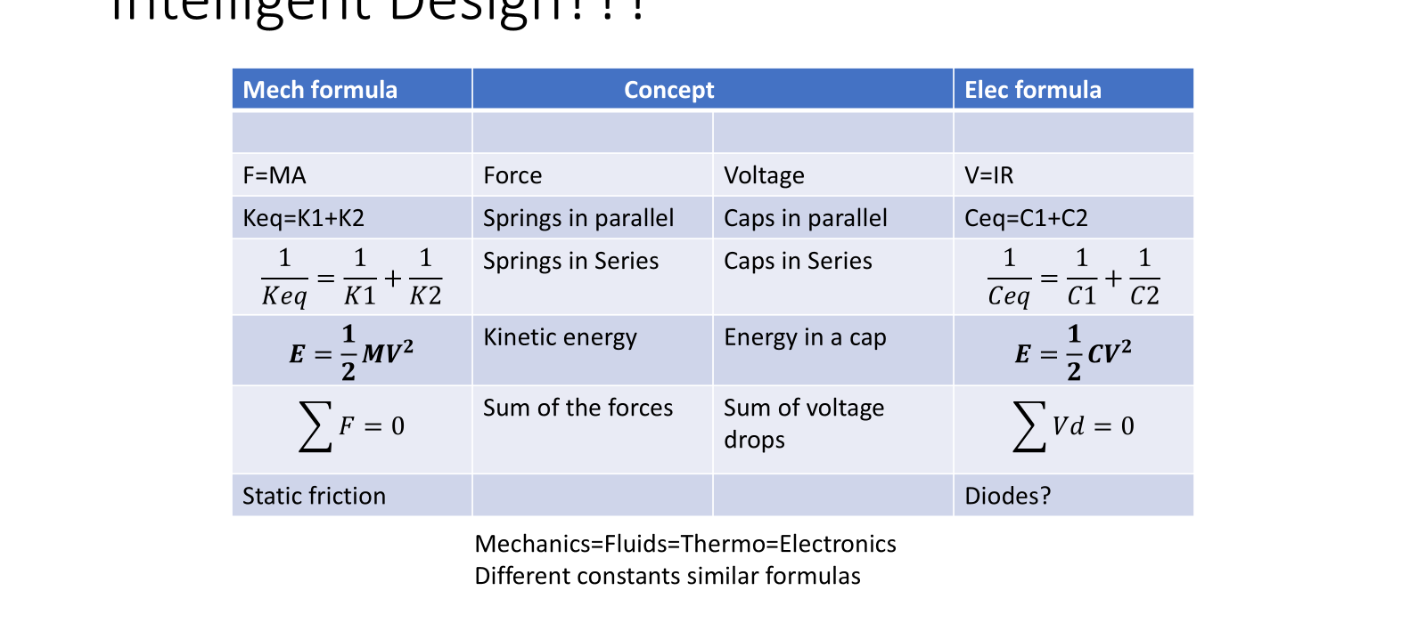
Parallels amongst other fields

Slide 8
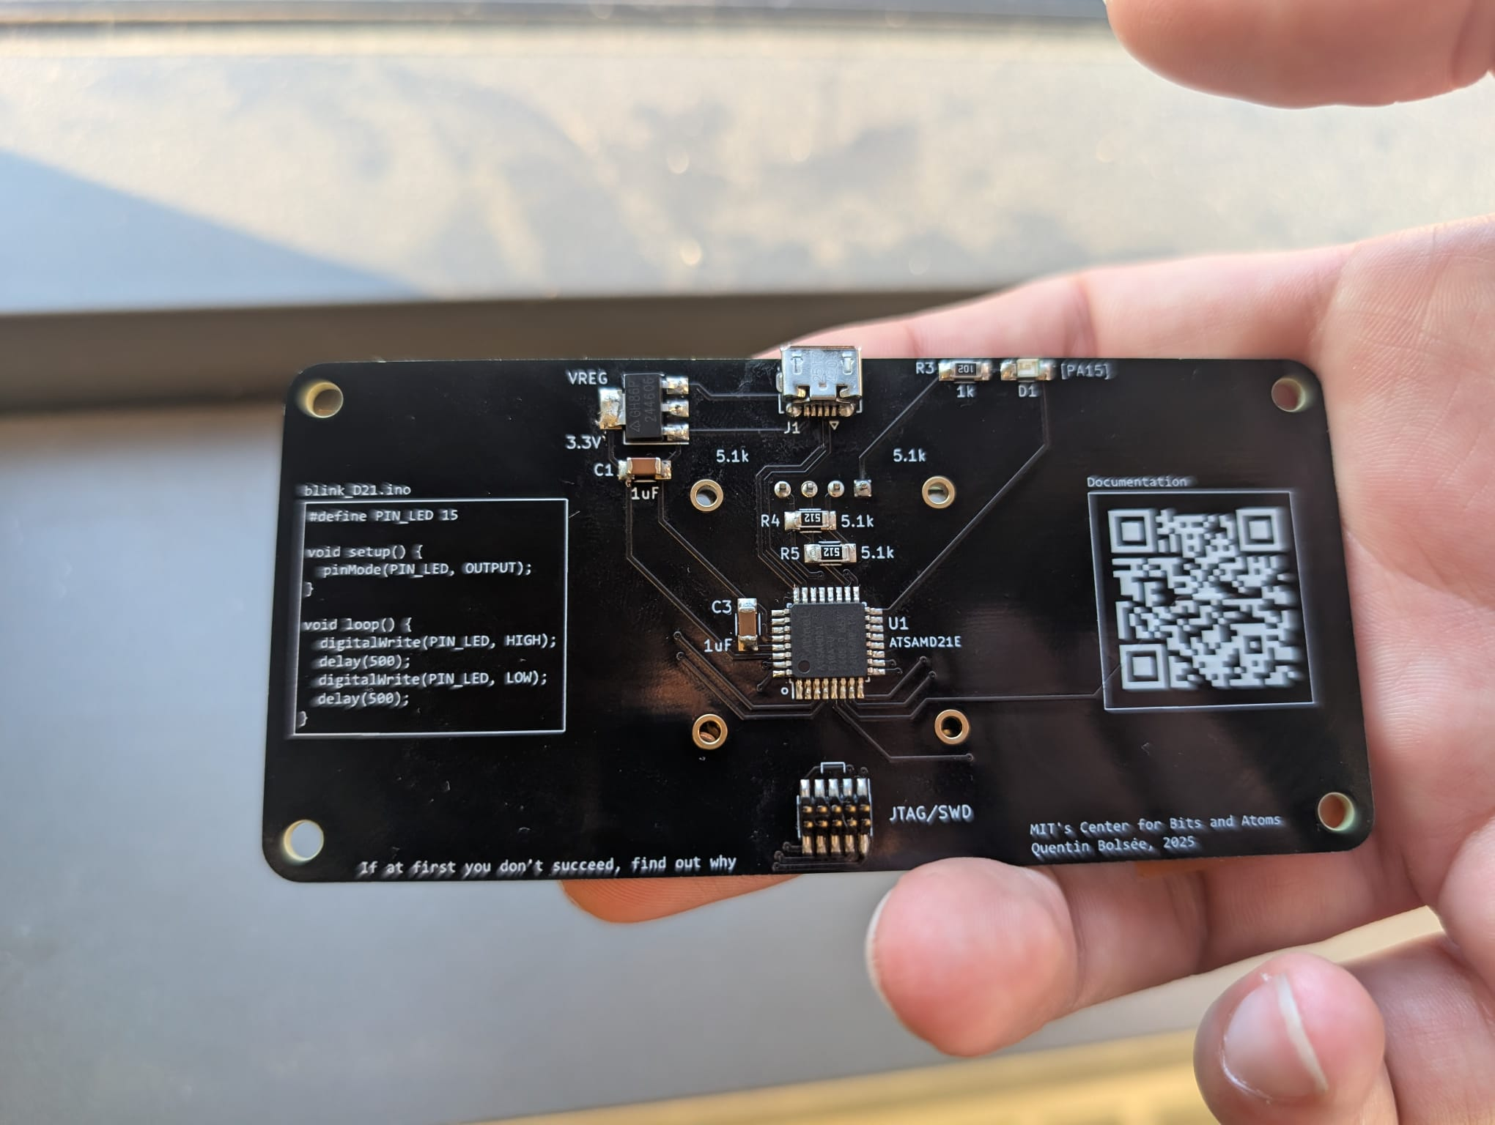
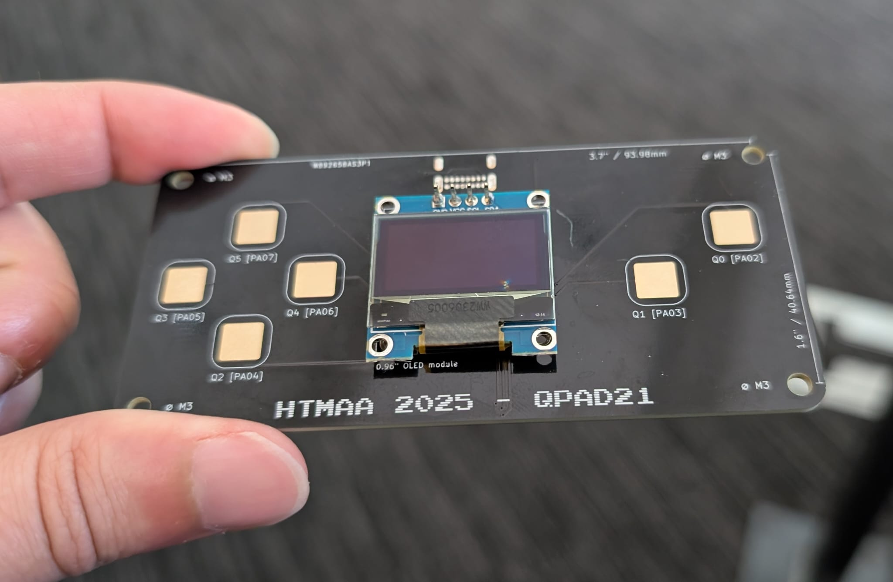
What you’re making this week

Slide 9
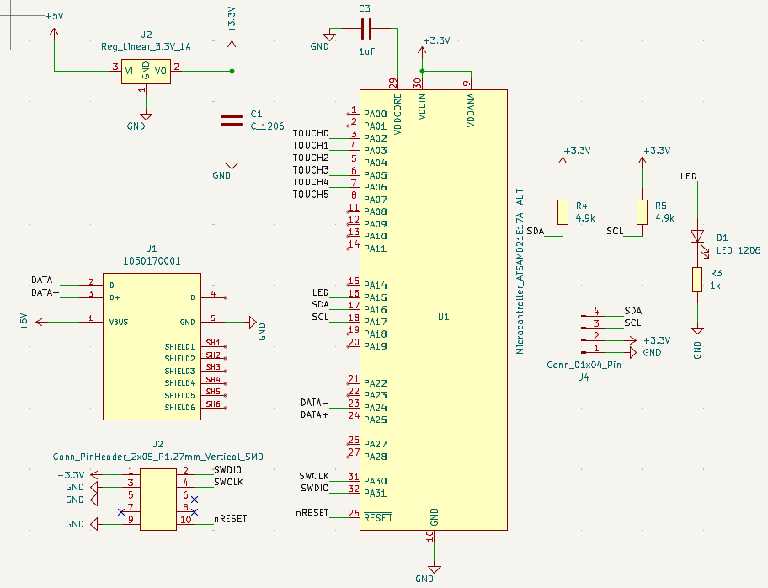

Slide 11
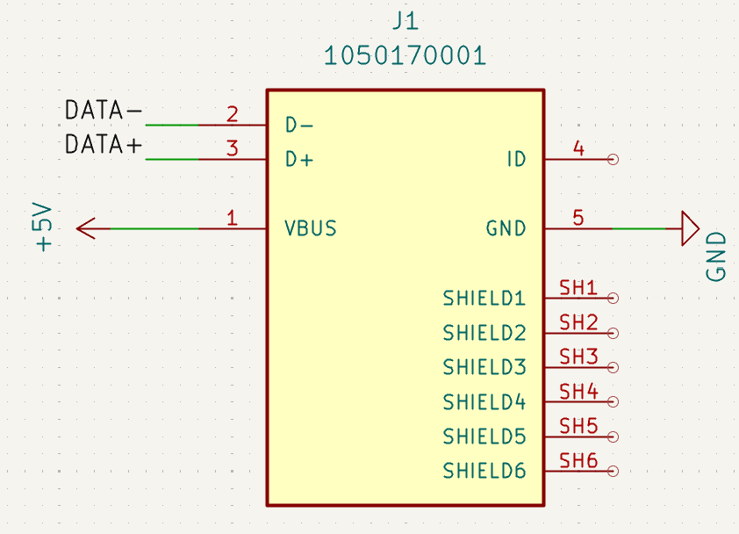
Micro USB connector
Provides 5V and ground connections
Data transfer for programming and debugging

Slide 12
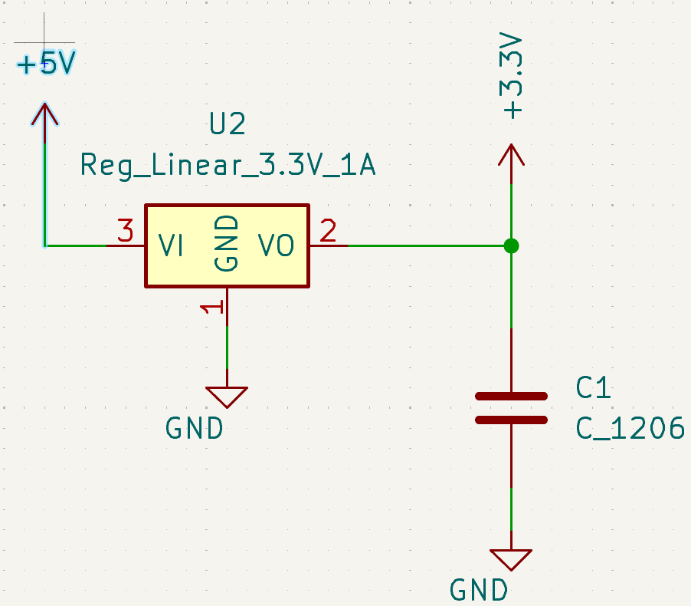
3.3 Volt regulator
Takes 5V in and turns it to 3.3V which our microcontroller needs

Slide 13
Capacitors store charge and reduce ripples
why?

Slide 14
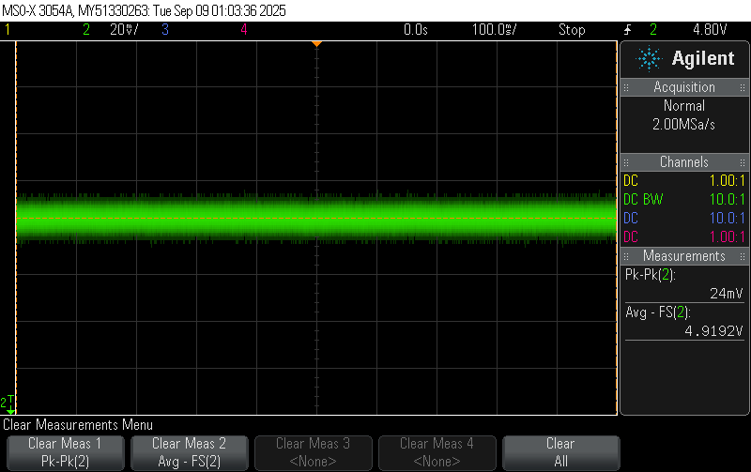
No Load
No Bypass
variance
average

Slide 15
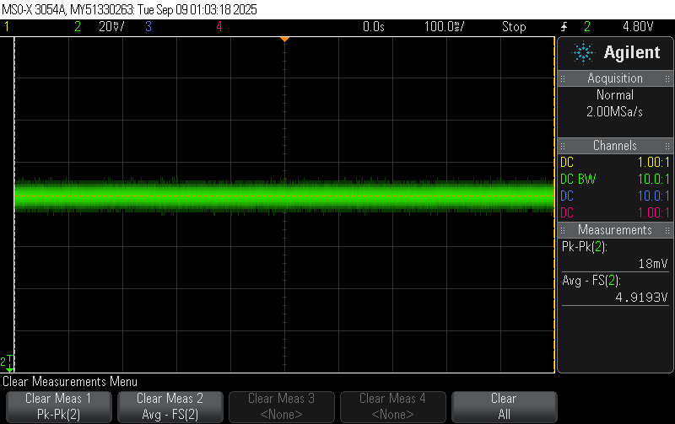
No Load
0.1uF Bypass

Slide 16
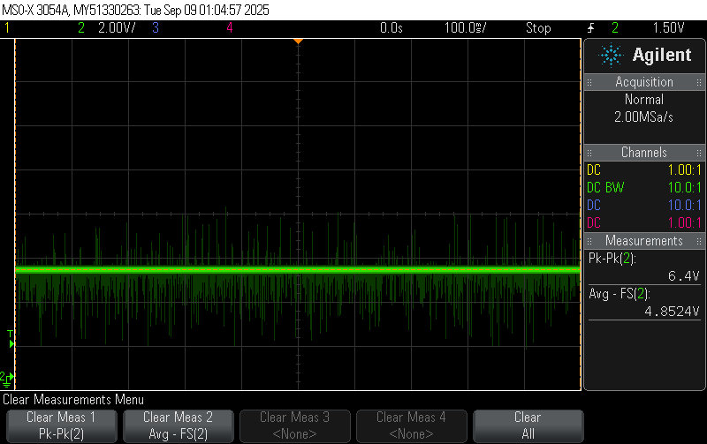
With Load
No Bypass

Slide 17
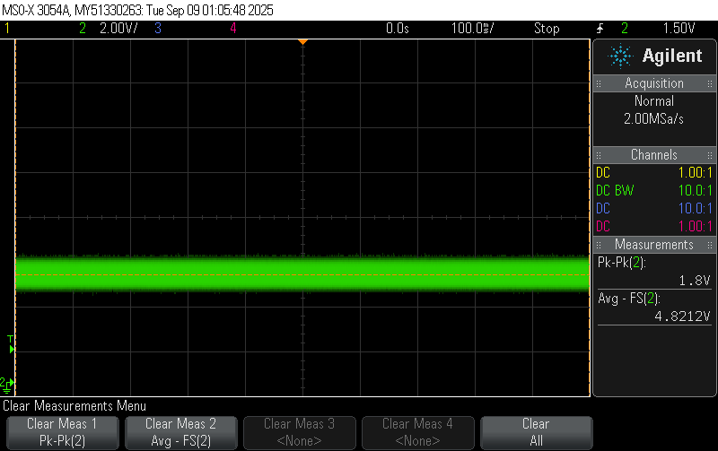
With Load
0.1uF Bypass

Slide 18
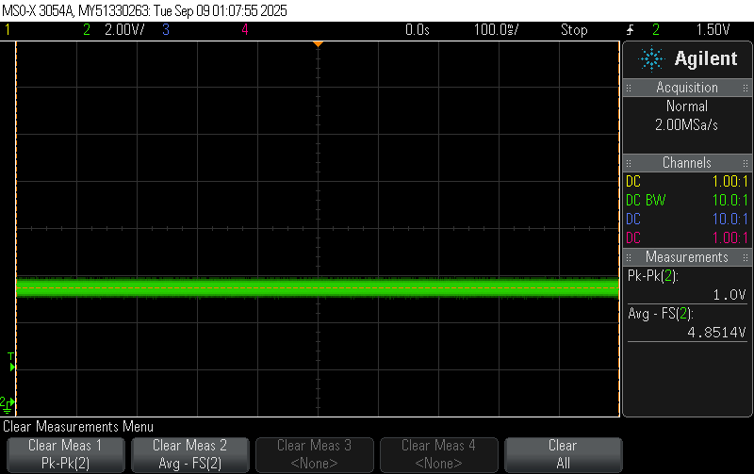
With Load
0.1 and 1uF Bypass

Slide 19
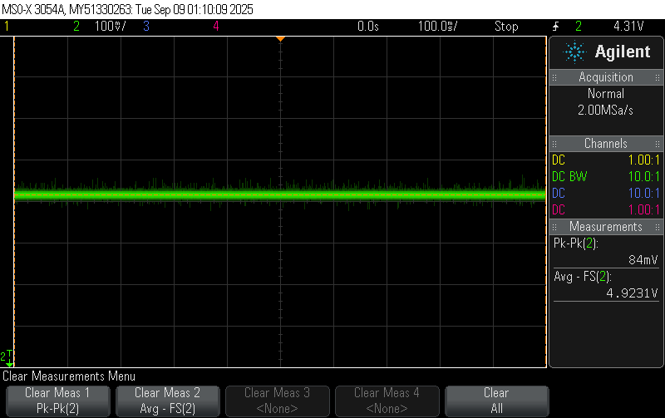
With Load
0.1, 1, and 10uF Bypass

Slide 20
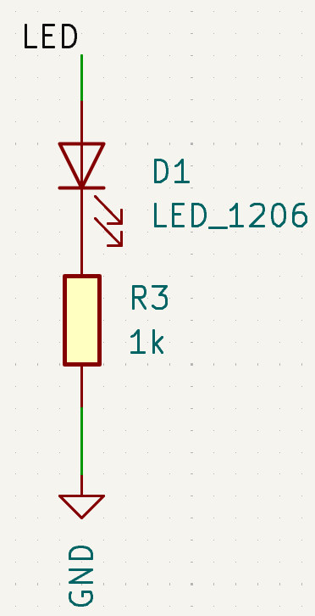
Resistors* reduce the flow of current
Light Emitting Diodes produce light when current flows through them

Slide 21
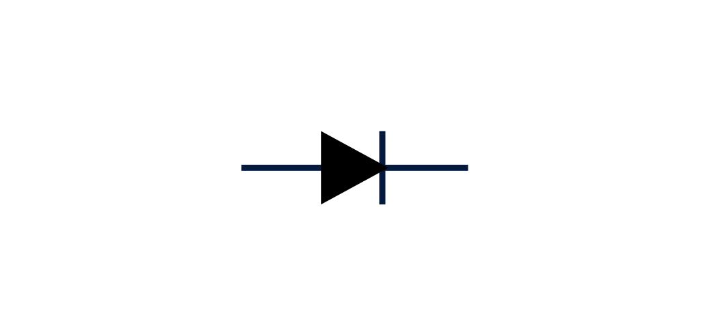
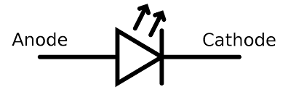
Diodes:
Notes:
Image from https://upload.wikimedia.org/wikipedia/commons/thumb/e/e5/LED_symbol.svg/1280px-LED_symbol.svg.png

Slide 22
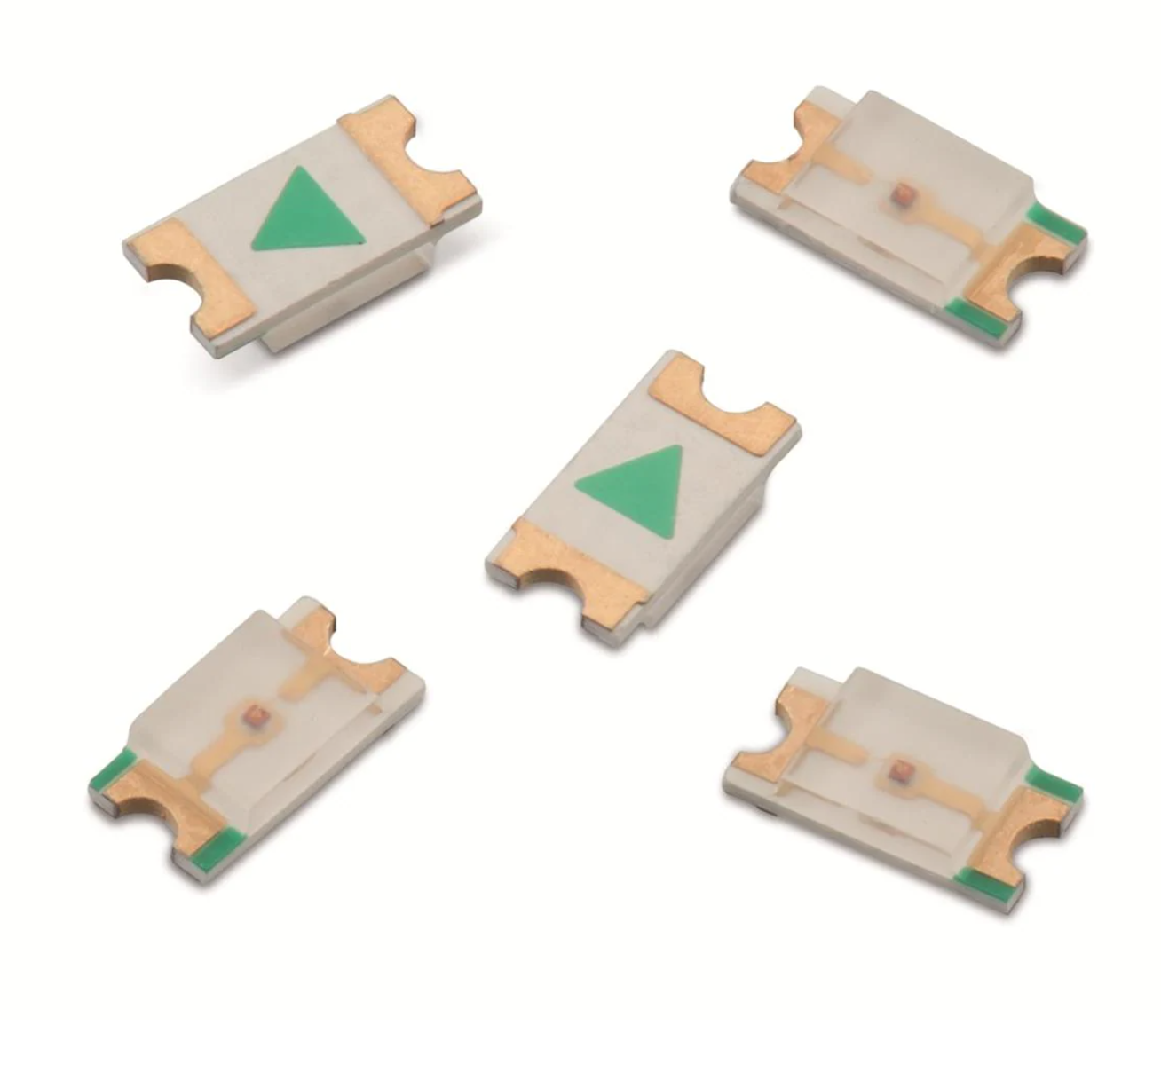
Diodes:
Light emitting diode (LED)

Slide 23
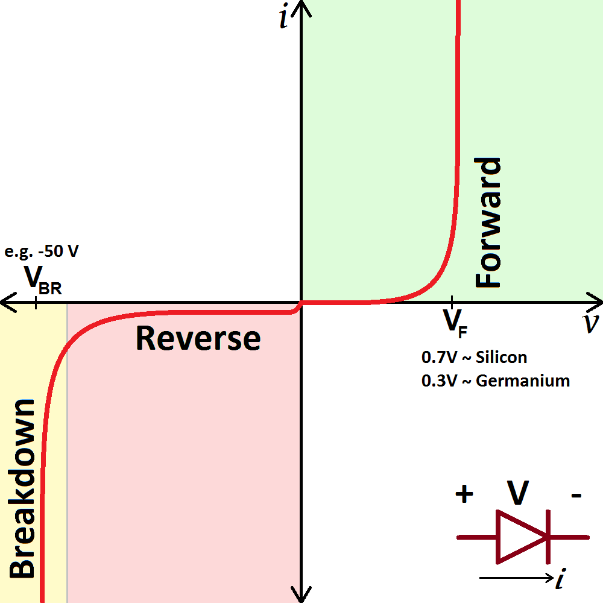
Diodes:
Very sensitive here
Current flows in one direction only*
Require a resistor to limit the current
No current - nothing happens
A little current - nice happy lights
Lots of current - fire, burnt parts, sadness
Img: https://cdn.sparkfun.com/assets/4/4/a/5/b/5175b518ce395f2d49000000.png
Notes:
Note about the happy region quickly progressing to the fire region

Slide 24


Slide 25
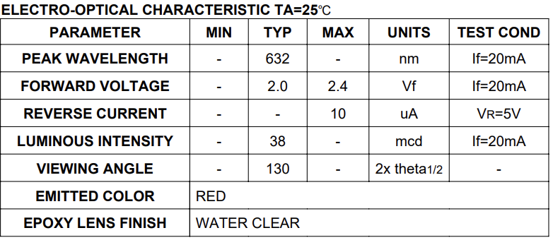
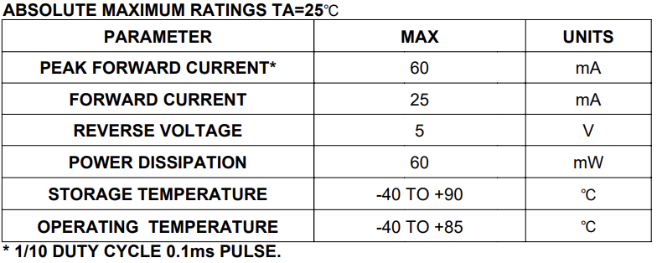
Current won’t flow* until voltage exceeds the forward voltage drop (Vfd) of the LED
Knowing max current of the LED lets us set an appropriate current limiting resistor
0.025A=(3.3-2)V/R
R=1.3/0.025=52 Ohms
I=(3.3-Vfd)/R
Notes:
But this is the minimum resistance for the brightest light possible. I usually like 1K ohms to keep it dim. The art of Engineering is knowing what to ignore

Slide 26
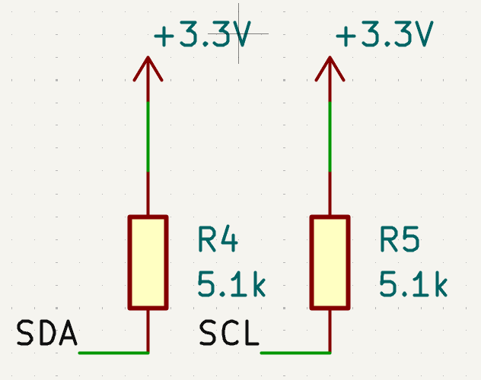
Resistors also define states
Usually coded so you can see the value
51*10^2 = 5.1K Ohms

Slide 27
What is the voltage of a wire that is just hanging out in space?

Slide 28
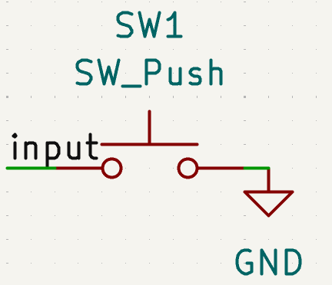
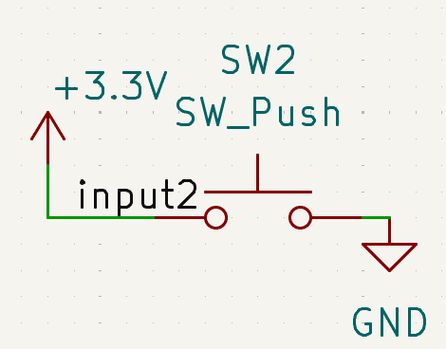
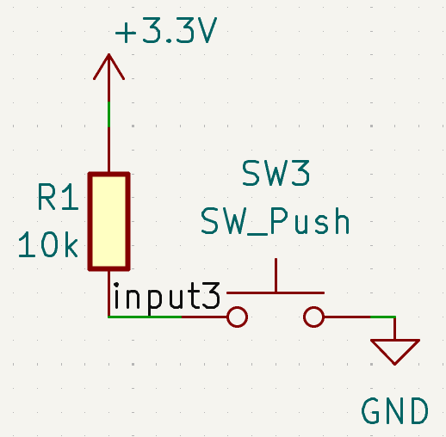
Scenario | Voltage at input when not pushed | Voltage at input when pushed
SW1
SW2
SW3

Slide 29
Scenario | Voltage at input when not pushed | Voltage at input when pushed
SW1 | ???
SW2
SW3

Slide 30
Scenario | Voltage at input when not pushed | Voltage at input when pushed
SW1 | ??? | Gnd (0 Volts)
SW2
SW3

Slide 31
Scenario | Voltage at input when not pushed | Voltage at input when pushed
SW1 | ??? | Gnd (0 Volts)
SW2 | 3.3V
SW3

Slide 32

Scenario | Voltage at input when not pushed | Voltage at input when pushed
SW1 | ??? | Gnd (0 Volts)
SW2 | 3.3V | 3.3/Gnd/
SW3

Slide 33
Scenario | Voltage at input when not pushed | Voltage at input when pushed
SW1 | ??? | Gnd (0 Volts)
SW2 | 3.3V | 3.3/Gnd/
SW3 | 3.3V

Slide 34
Scenario | Voltage at input when not pushed | Voltage at input when pushed
SW1 | ??? | Gnd (0 Volts)
SW2 | 3.3V | 3.3/Gnd/
SW3 | 3.3V | Gnd (0 Volts)
With a power dissipation of only 1mW

Slide 35
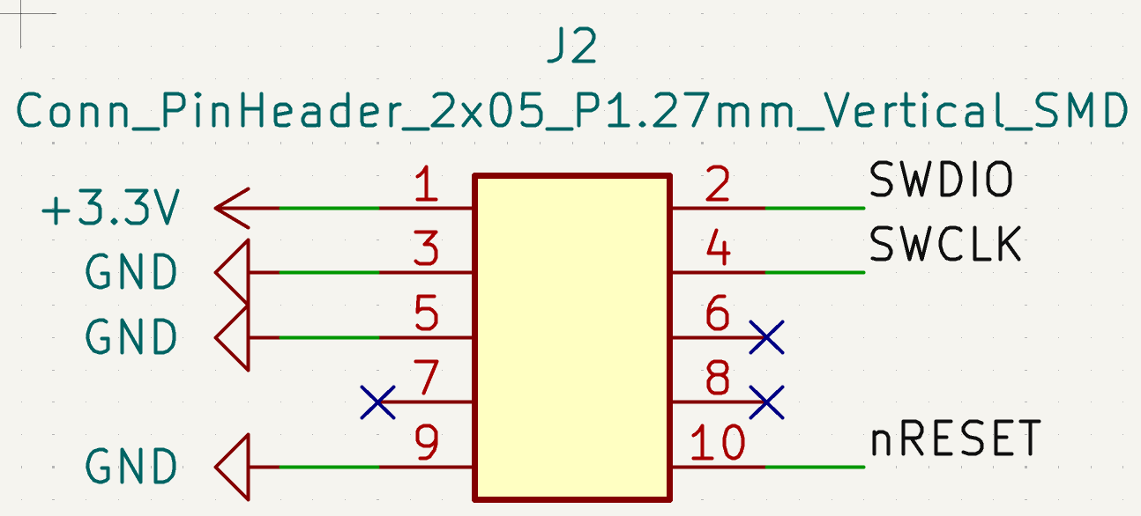
10 pin header
Just some convenient pieces of metal to plug wires into so our board can connect to the outside world

Slide 36
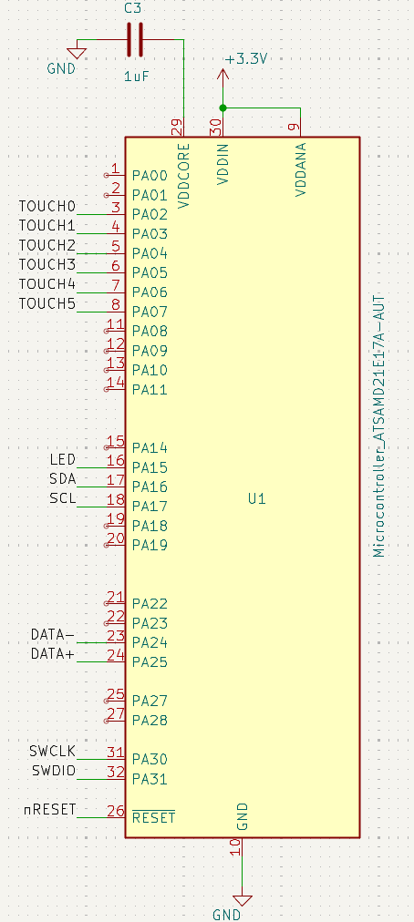
ATSAMD21E microcontroller
It does almost anything

Slide 38
Buttons?
OLED screen

Slide 39
How is that a button?
Capacitive sensing/step response is a bit of magic that can be employed in many different scenarios

Slide 40
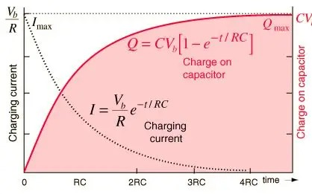
Either measure rise time
Or wait a fixed time and measure voltage

Slide 41
More components not used in this design
Mosfets
  Control large power devices with small power signals
  Incredibly useful
Inductors
Opamps
  Do math on signals
  Multiplication, division, integration, addition, subtraction, etc
Relays

Slide 42
Mosfets
Come in 2 flavors, N and P channel
  N channel conduct current when the Gate is high and go below the load
  P channel conducts current when the Gate is low and go above the load (less useful)
Allow microcontrollers to enable/disable very large loads - normally can only handle ~20mA ie 1 or 2 bright LEDs per pin.
Remember to include the pull-up/down resistor, current limiting resistor, and maybe a flyback diode!

Slide 43

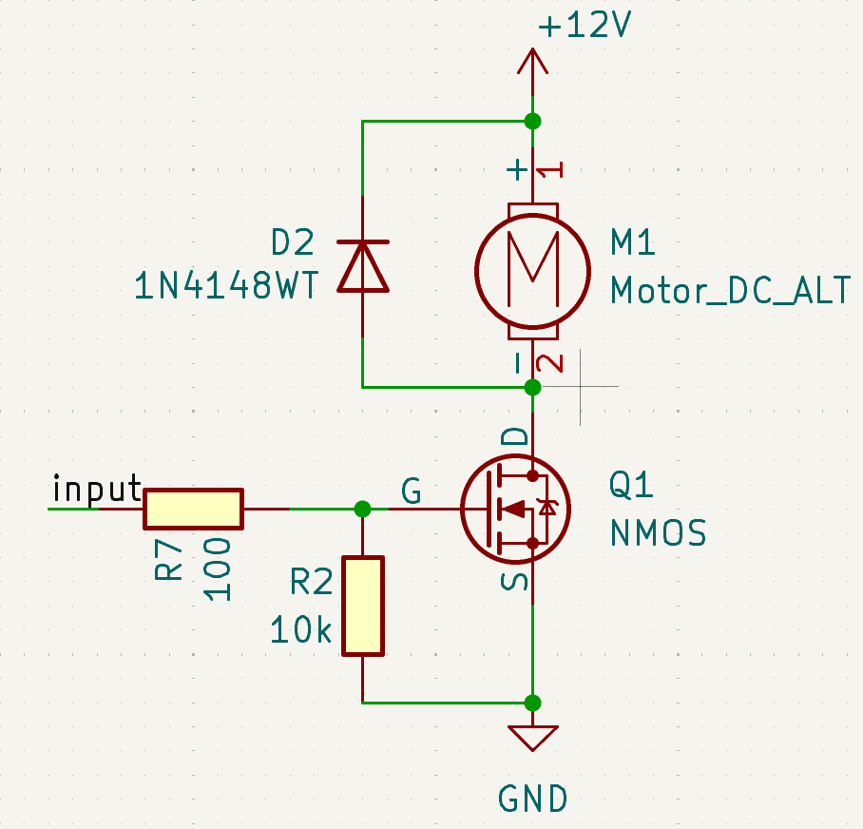
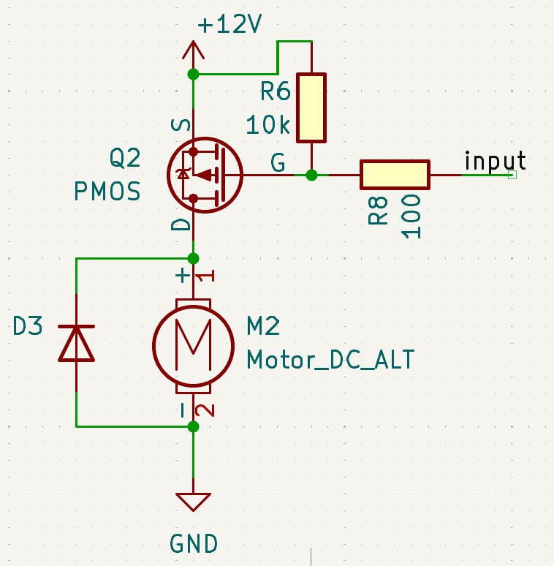
pull-up/down resistors keep the device off at rest.
Input resistors reduce inrush current.
Voltage spikes arise from inductive loads
V=L*dI/dT
Careful!
Flyback diode
Signal
here
Limits inrush
Keeps it off!

Slide 44
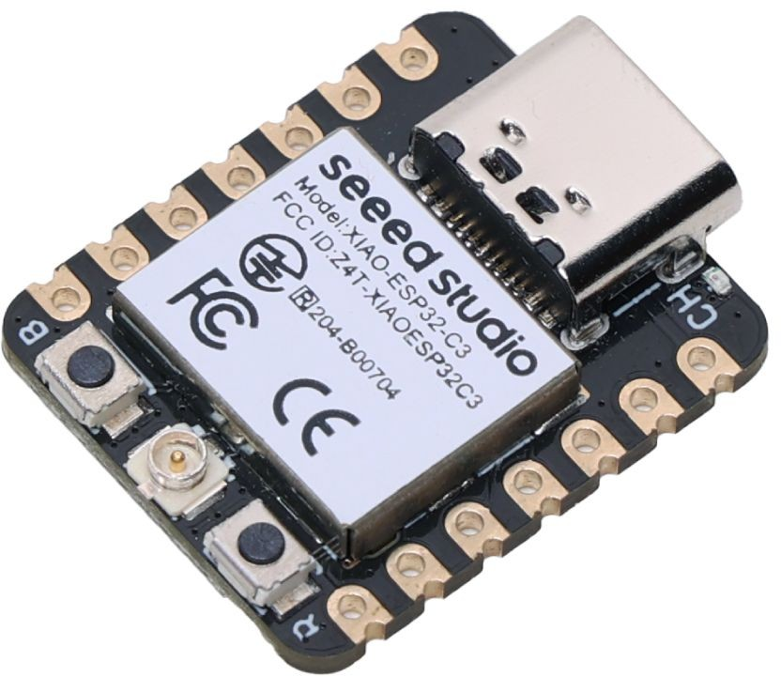
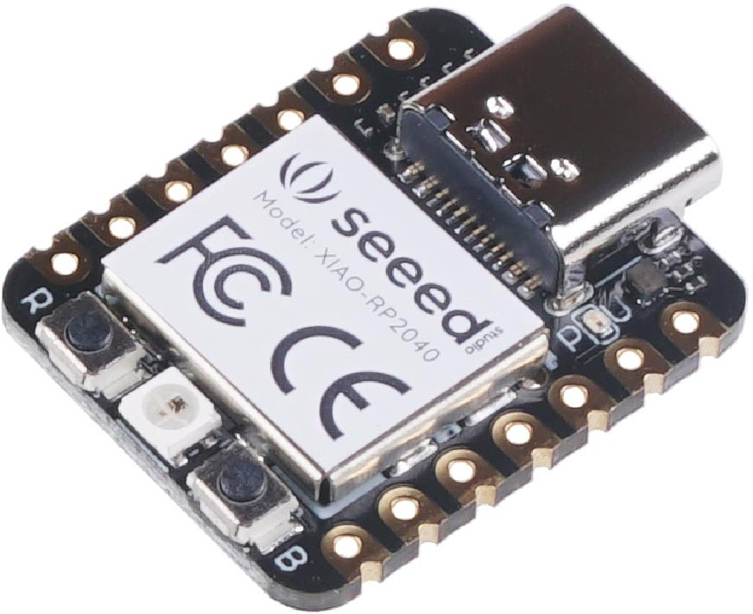
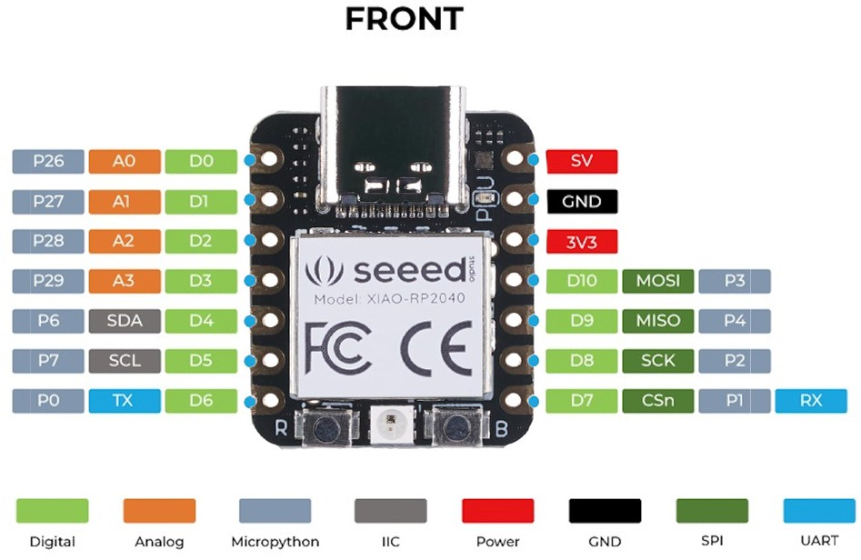
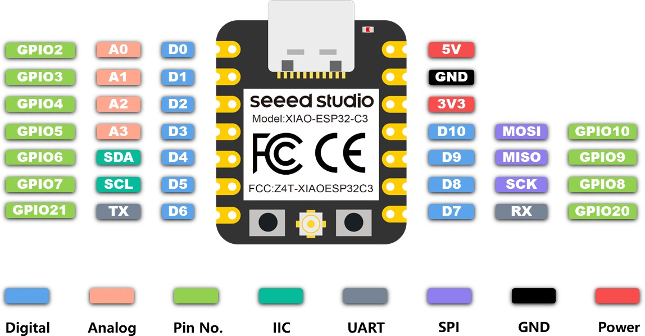
Seeed XIAO ("小": means "small")
RP2040
ESP32C3

Slide 45
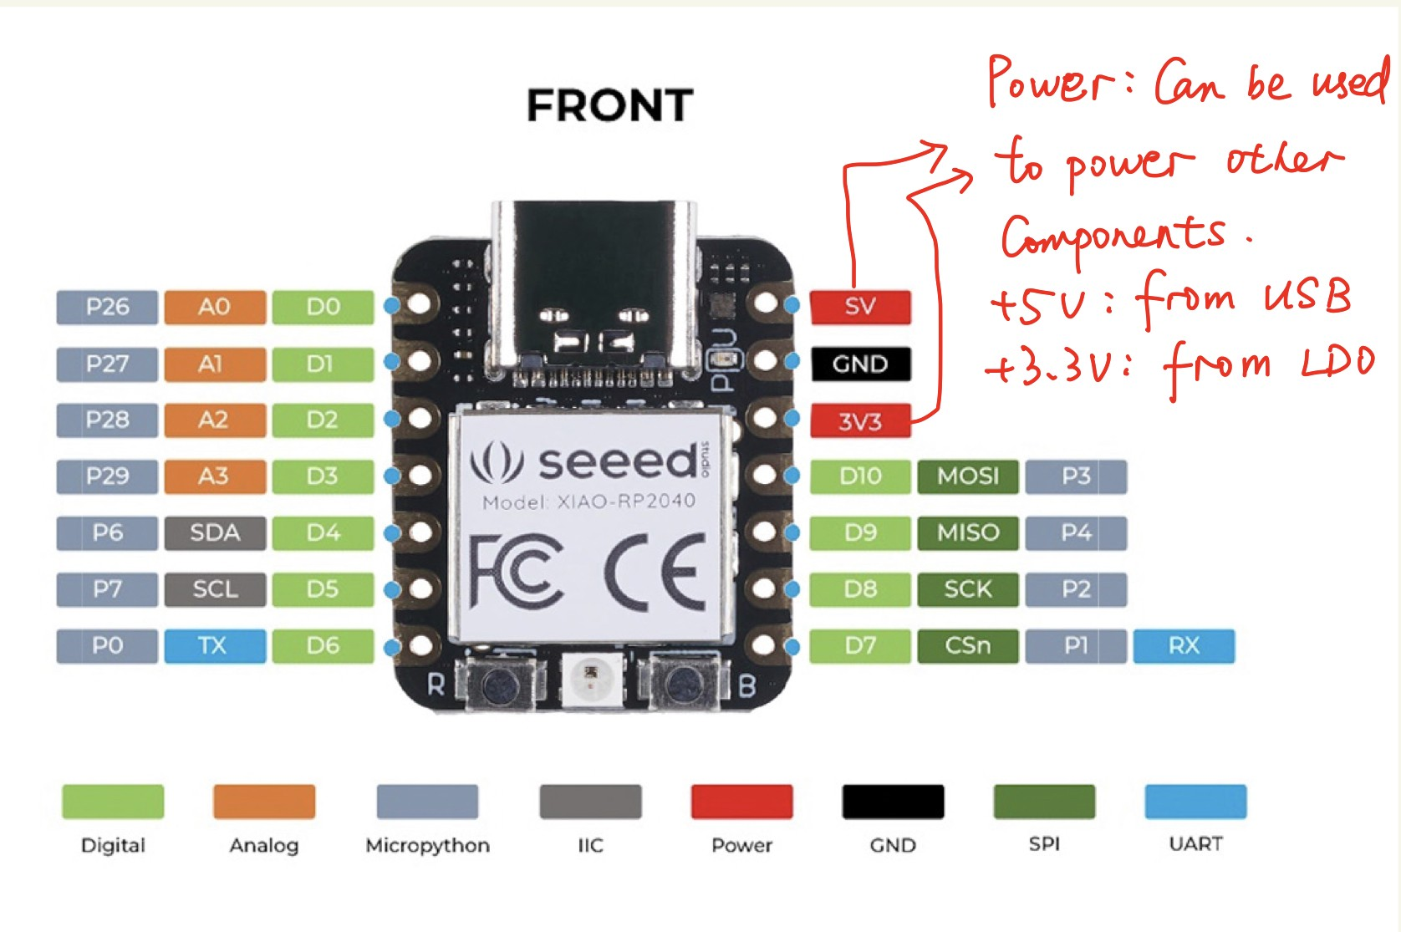
Seeed XIAO ("小": means "small")

Slide 46
Simulation in Wokwi vs Falstad
Wokwi Falstad
Pros
Easy
Intuitive
Pretty
Large libraries
Has Wifi implemented*
Cons
No notion of voltage, current, power, etc. can lead to blown components
Bigger/private projects want the paid tier
Pros
Actually powerful
Graphs of voltage current power etc
Cons
Has that opensource look (like my slides)
Less widely used
No Wifi

Slide 47

Digital Simulation in Wokwi/Falstad

Slide 48
Link1
Link2
Link3
Notes:
26 microwatts consumed by that LED, you’ll never see that. Weirdly the arduino simulation in Falstad is actually just a plugin directly from Wokwi!

