Slide 1


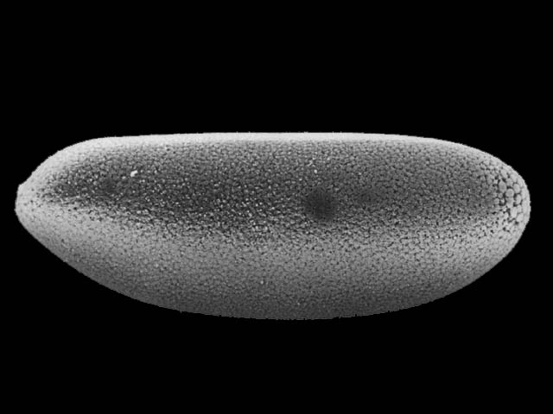
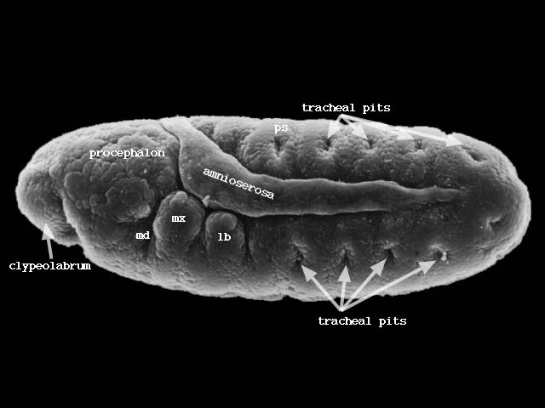
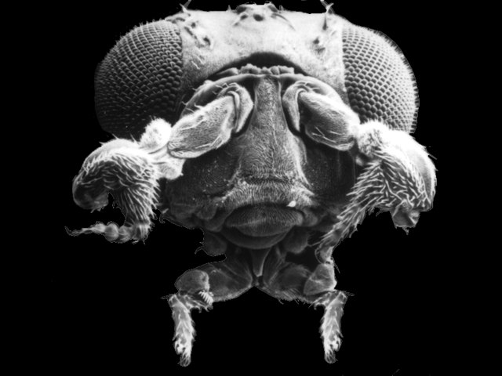
Biological Processes
MAS.S62 FAB²
24/2 = 12
How Biology Builds and … How to Build with Biology
Outline:
Programming Biology
Hierarchy of Complexity
Building Biology
DNA Origami
Synthetic Organisms
J. Jacobson
jacobson@media.mit.edu

Slide 2
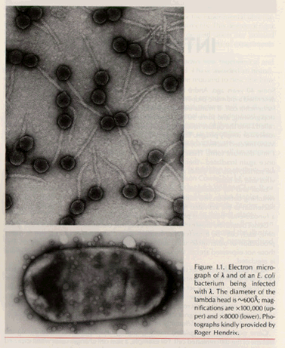
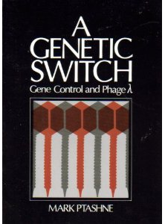
A Genetic Switch
Ref: Ptashne-
The Genetic Switch

Slide 3
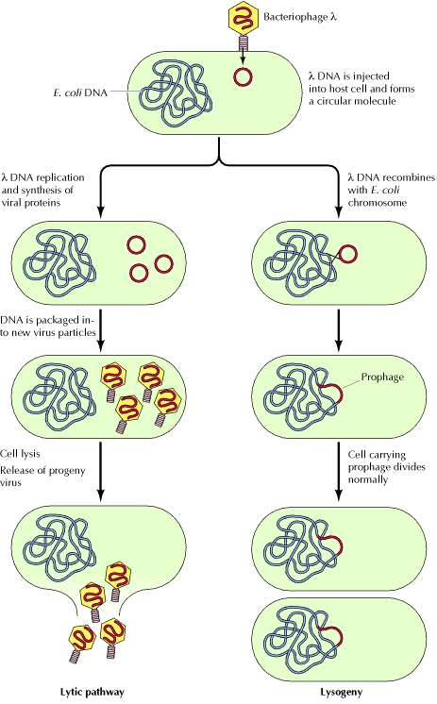
http://www.ncbi.nlm.nih.gov/books/NBK9937/

Slide 4
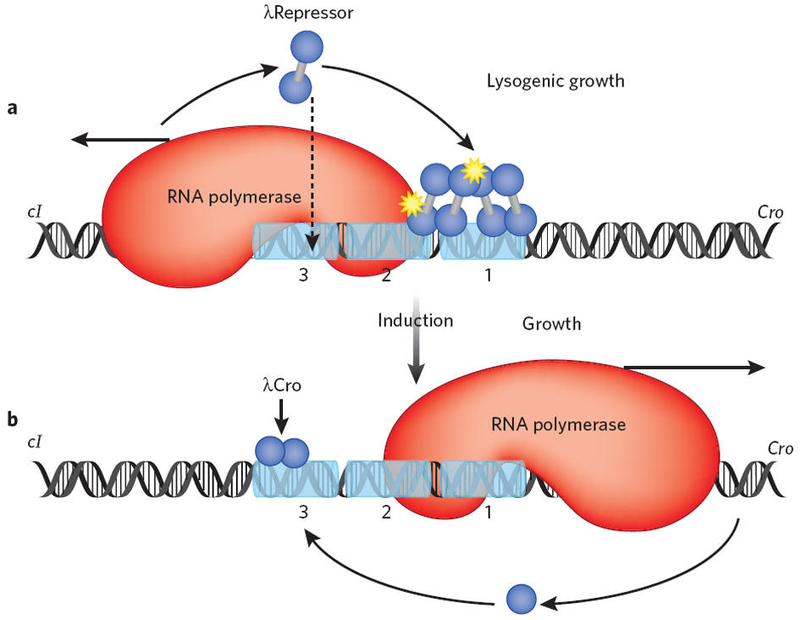
http://www.amolf.nl/research/biochemical-networks/research-activities/rare-events/

Slide 5
Polymerase
http://www.youtube.com/watch?v=I9ArIJWYZHI

Slide 6
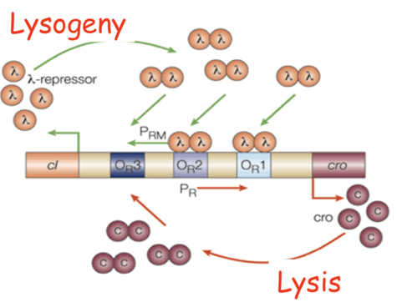

Slide 7
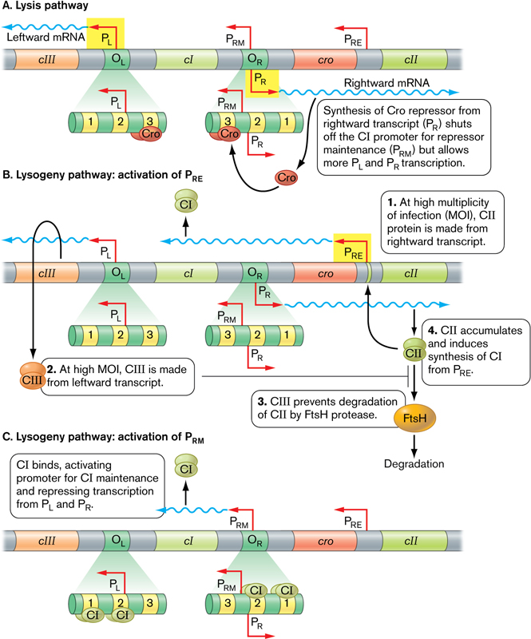
http://www.wwnorton.com/college/biology/microbiology2/img/eTopics/sfmb2e_eTopic_1003_2.jpg

Slide 8
Cooperativity
-Monomer + Monomer -> Dimer
-Dimer-Dimer Interaction
-Dimer – Polymerase Interaction

Slide 9
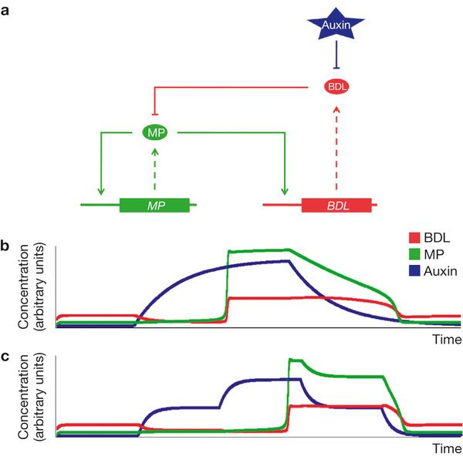
Auxin triggers a genetic switch
Steffen Lau,
Ive De Smet,
Martina Kolb,
Hans Meinhardt
& Gerd Jürgens
Affiliations
Contributions
Corresponding author
  Nature Cell Biology
  13,
  611–615
  (2011)
  doi:10.1038/ncb2212
Received
  28 June 2010
Accepted
  20 January 2011
Published online
  10 April 2011

Slide 10
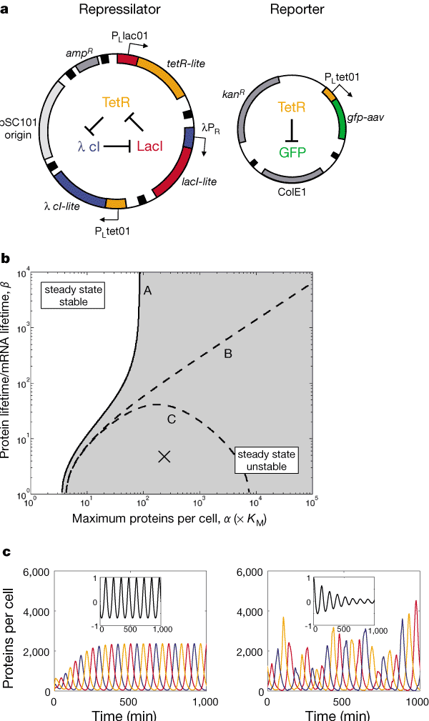
Figure 1 Construction, design and simulation of the repressilator. a, The repressilator network. The repressilator is a cyclic negative-feedback loop composed of three repressor genes and their corresponding promoters, as shown schematically in the centre of the left-hand plasmid. It uses P _{L}lacO1 and P_{L}tetO1, which are strong, tightly repressible promoters containing lac and tet operators, respectively⁶, as well as P_{R}, the right promoter from phage (see Methods). The stability of the three repressors is reduced by the presence of destruction tags (denoted 'lite'). The compatible reporter plasmid (right) expresses an intermediate-stability GFP variant¹¹ (gfp-aav). In both plasmids, transcriptional units are isolated from neighbouring regions by T1 terminators from the E. coli rrnB operon (black boxes). b, Stability diagram for a continuous symmetric repressilator model (Box 1). The parameter space is divided into two regions in which the steady state is stable (top left) or unstable (bottom right). Curves A, B and C mark the boundaries between the two regions for different parameter values: A, n = 2.1, ₀ = 0; B, n = 2, ₀ = 0; C, n = 2, ₀/ = 10⁻³. The unstable region (A), which includes unstable regions (B) and (C), is shaded. c, Oscillations in the levels of the three repressor proteins, as obtained by numerical integration. Left, a set of typical parameter values, marked by the 'X' in b, were used to solve the continuous model. Right, a similar set of parameters was used to solve a stochastic version of the model (Box 1). Colour coding is as in a. Insets show the normalized autocorrelation function of the first repressor species.

Slide 11
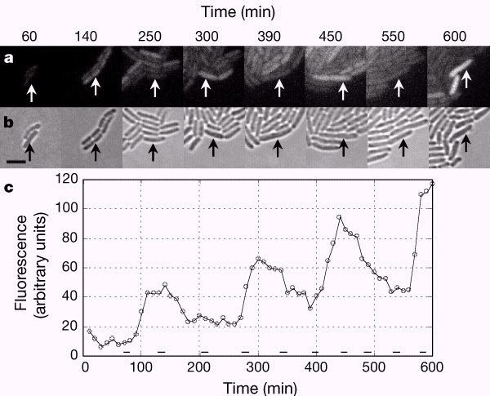
Figure 2 Repressilation in living bacteria. a, b, The growth and timecourse of GFP expression for a single cell of E. coli host strain MC4100 containing the repressilator plasmids (Fig. 1a). Snapshots of a growing microcolony were taken periodically both in fluorescence (a) and bright-field (b). c, The pictures in a and b correspond to peaks and troughs in the timecourse of GFP fluorescence density of the selected cell. Scale bar, 4 µm. Bars at the bottom of c indicate the timing of septation events, as estimated from bright-field images.

Slide 12
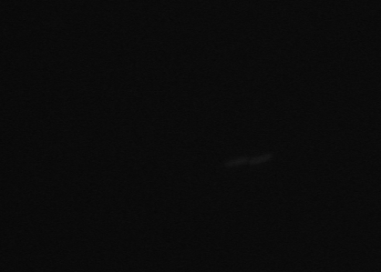
Bacterial Ring Oscillator
http://elowitz.caltech.edu/

Slide 13
A Synchronized Ring Oscillator
BBa_R0051
BBa_R0040
BBa_R0010
P
RBS
tetR
T
T’
P
RBS
lacI
T
T’
P
RBS
cI
T
T’
BBa_C0040
BBa_C0012
BBa_C0051
BBa_R0063
BBa_R0051
BBa_R0010
P
RBS
luxR
T
T’
P
RBS
luxI
T
T’
P
RBS
aiiA
T
T’
BBa_C0062
BBa_C0061
BBa_C0060
BBa_R0040
P
RBS
cfp
T
T’
ori
backbone plasmid
res
BBa_E0022
BBa_B0001
RBS
BBa_B0030
BB prefix
BBa_B0010
BB suffix
T
T’
BBa_B0012

Slide 14
Hasty Group – UCSD
Synchronized Repressilator
http://vimeo.com/23292033

Slide 15
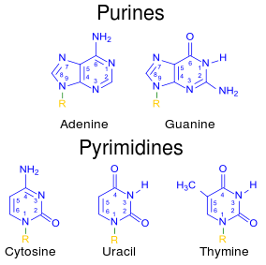
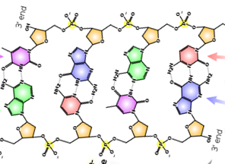
Complexities in Biochemistry
Atoms: ~ 10
Complexion: W~3¹⁰
Complexity ξ = 15.8
Atoms: ~ 8
Complexion: W~3⁸
Complexity ξ = 12.7
DNA N-mer
Types of Nucleotide Bases: 4
Complexion: W=4^{N}
Complexity ξ = 2 N
Complexity Crossover: N>~8

Slide 16
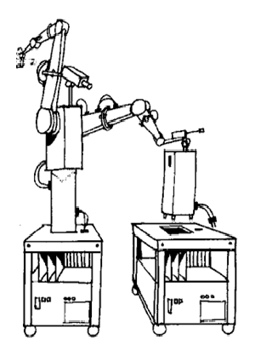
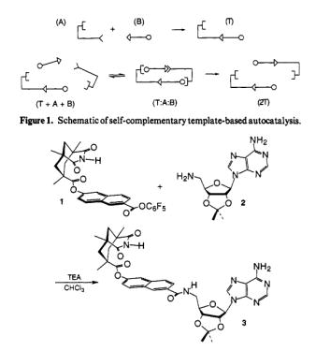
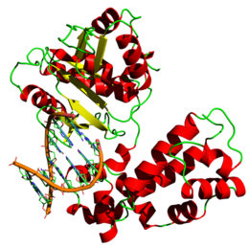
Synthetic Complexities of Various Systems
Atoms: ~ 20 [C,N,O]
Complexion: W~ 3²⁰
ξ = 32
Complexity (uProcessor/program):
ξ ~ 1K byte = 8000
Nucleotides: ~ 1000
Complexion: W~4¹⁰⁰⁰
ξ = 2000 = 2Kb
DNA Polymerase
Product: C = 4 states
ξ = 2
Product: C = 4 states
ξ = 2
Product: 10⁷ Nucleotides
ξ = 2x10⁷
ξ[Product / Parts] =~ .00025
ξ[Product / Parts] =~ .0625
ξ[Product / Parts] =10⁴
ξ >1 Product has sufficient complexity to encode for parts / assembler

Slide 17
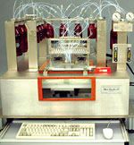
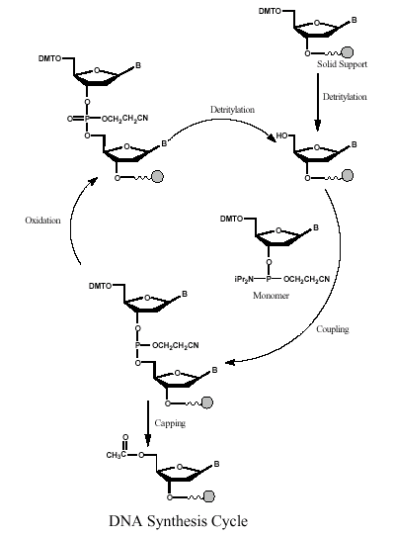
Caruthers Synthesis
Biochemical Synthesis of DNA
Error Rate:
1: 10²
300 Seconds
Per step
http://www.med.upenn.edu/naf/services/catalog99.pdf

Slide 18
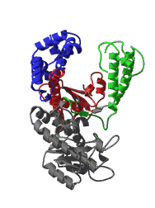
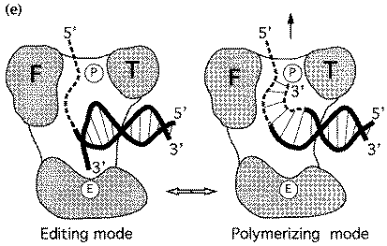
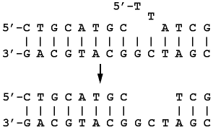
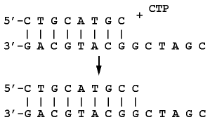
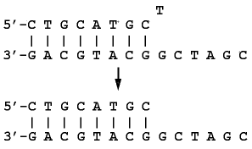
Replicate Linearly with Proofreading and Error Correction
Fold to 3D Functionality
Error Rate:
1: 10⁸
100 Steps per second
template dependant 5'-3'
primer extension
3'-5' proofreading
exonuclease
5'-3' error-correcting
exonuclease
        Beese et al. (1993), Science, 260, 352-355.
http://www.biochem.ucl.ac.uk/bsm/xtal/teach/repl/klenow.html

Slide 19
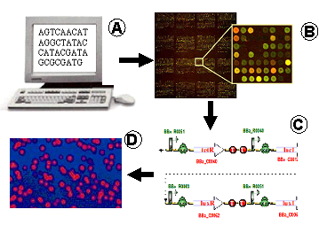
BioFAB - From Bits to Cells
Schematic of BioFab Computer to Pathway. A. Gene pathway sequence. B. Corresponding array of overlapping oligonucleotides C. Error correcting assembly in to low error rate pathways. D. Expression in cells

Slide 20
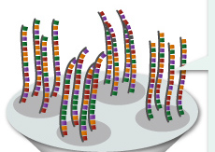
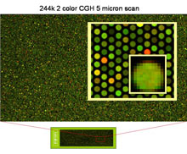
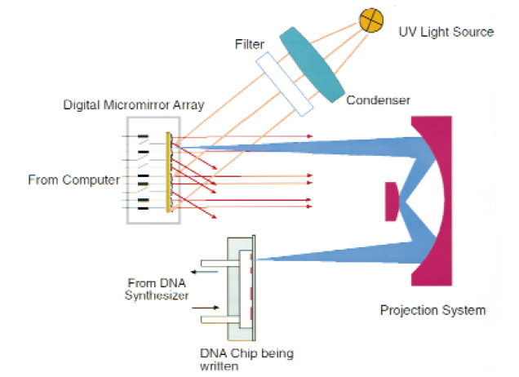
~ 1M Oligos/Chip
60 Mbp for ~ $1K
Chip Based Oligo Nucleotide Synthesis
~1000x Lower Oligonucleotide Cost
http://learn.genetics.utah.edu/content/labs/microarray/analysis/
http://www.technologyreview.com/biomedicine/20035/
Tian, Gong, Church, Nature 2005

Slide 21
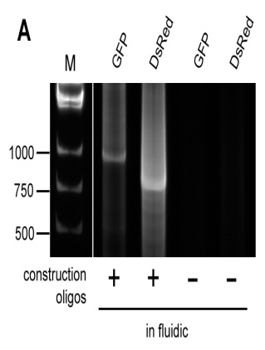
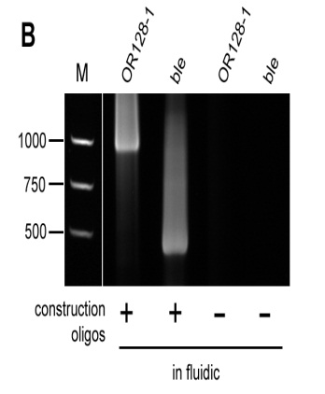
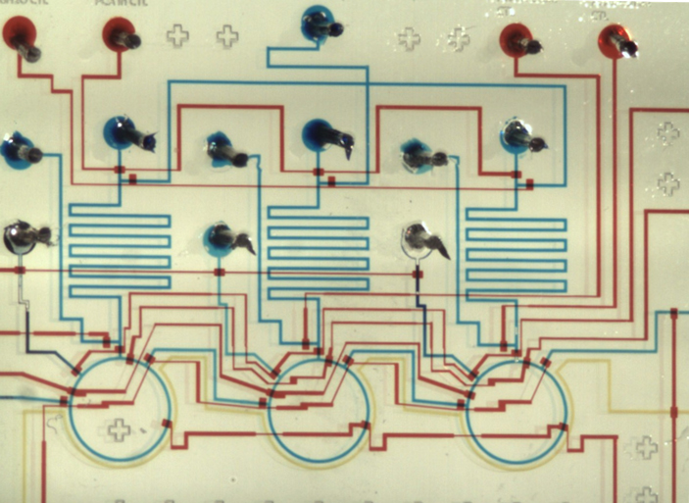
MicroFluidic Gene and Protein Synthesis
oligos →→ gene →→ protein
45 nL gene synthesis reactors x3
First successful gene synthesis in a microfluidic environment at volumes at least an order of magnitude smaller than standard techniques
500 nL sufficient for read-out by direct sequencing, cloning, and gel electrophoresis
Error rates for microfluidic gene synthesis comparable to synthesis in macroscopic volumes
12 nL protein synthesis reactors x3
1 mm
Can we synthesize from oligos, in parallel, genes for three fluorescent proteins, then express them to assay their function in an integrated device?
Kong/Jacobson - MIT
Notes:
Non-fluorescence assays: Fraden, monitoring area of bubbles, since chamber height is fixed, can assess concentrations that way

Slide 22
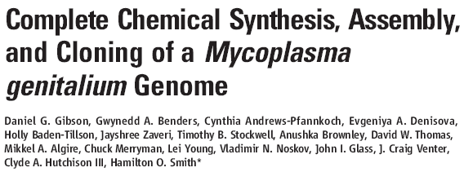
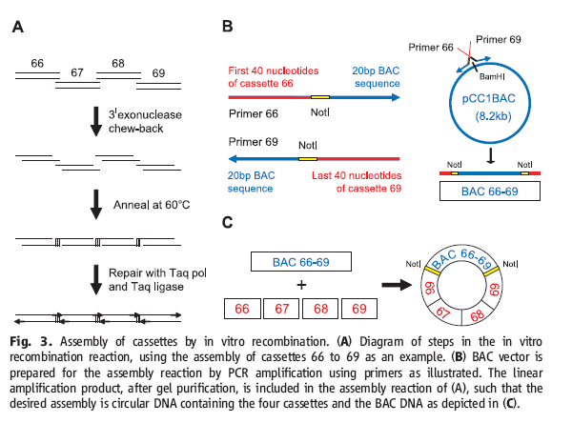

Slide 23
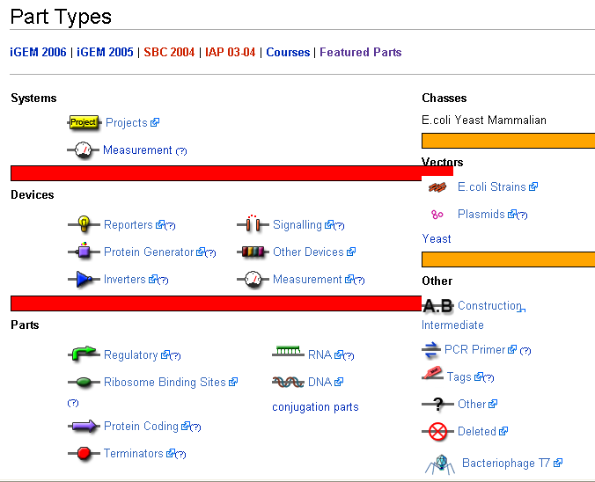

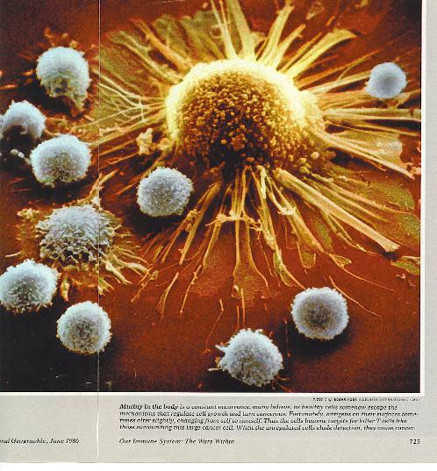
Bio Parts for Synthetic Biology
NSF - SynBERC
BioParts.mit.edu

Slide 24
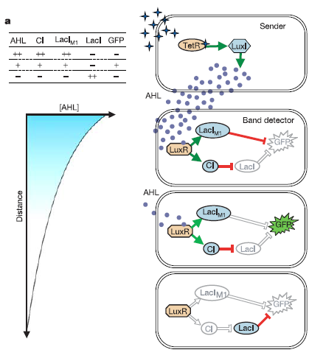
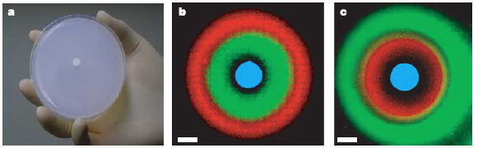
Patterning Multicellular Organisms
A synthetic multicellular system for programmed pattern formation
S Basu, Y Gerchman, CH Collins, FH Arnold… - Nature, 2005

Slide 25
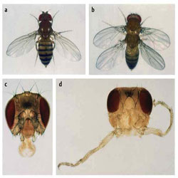
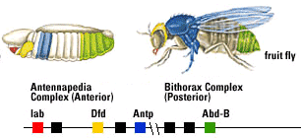
HomeoBox
Programming the Construction of New Organisms
http://www.landesbioscience.com/curie/chapter/3082/
http://www.biologycorner.com/APbiology/DNA/15_mutations.html

Slide 26
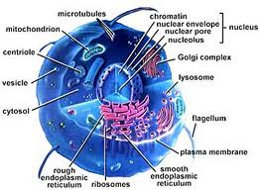
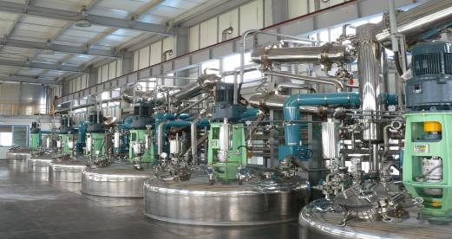
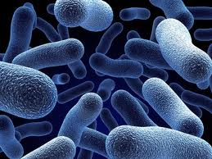
Cells as Chemical Factories
http://3rdpartylogistics.blogspot.com/2011/10/genetic-bacteria-genetic-modification.html
http://www.latonkorea.com/Plant.html

Slide 27
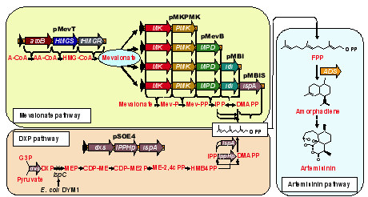
Artemisinin Pathway
http://www.lbl.gov/LBL-Programs/pbd/synthbio/pathways.htm

Slide 28
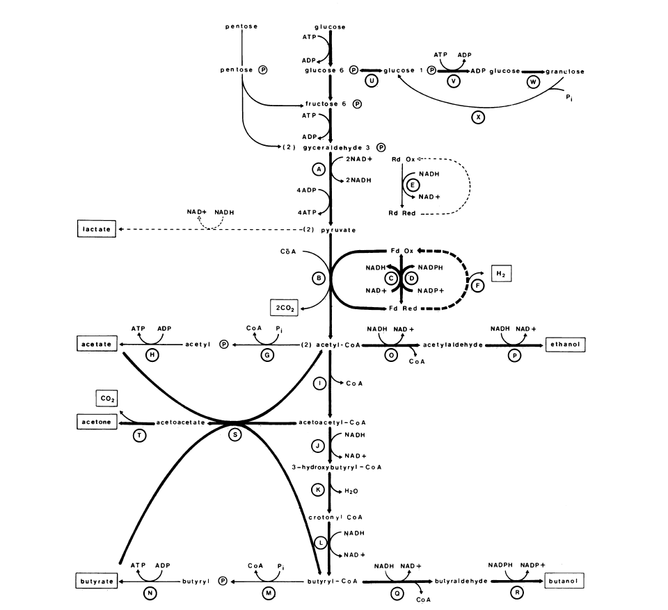
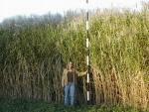
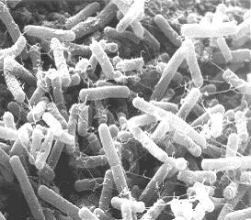
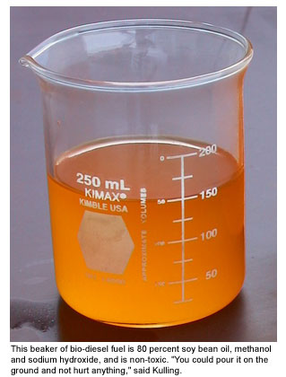
Butanol – Next Gen BioFuel
C. acetobutylicum
 | Wiezmann | GMO
A:B:E | 3:6:1 | 0:10:0
Yield | 1.4G /Bushell | 2.5 G/ Bushell
Toxicity | 1-2% | ?
Production | 4.5 g/L/h | 9 g/L/h
Jones and Woods, Microbiological Reviews 1986

Slide 29
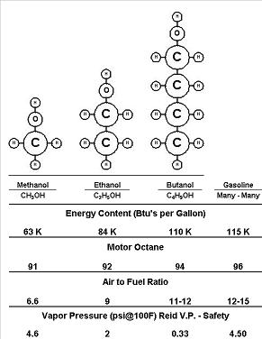



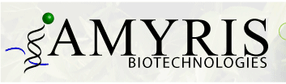


Butanol – Next Gen BioFuel
2008
Companies
ButylFuel LLC
Pilot 5,000 GPY
Hull Production Plant
$400M / 110M GPY

Slide 30



History of BioFuels
Founded by Chaim Weizmann in 1916
clostridium acetobutylicum
1918
6 Million Gallons of Butanol / Year
1950 0

Slide 31



Whole Genome Engineering
rE.coli – Rewriting the Genetic Code
Peter Carr
Joe Jacobson
MIT
Farren Isaacs
George Church
Harvard Medical School

Slide 32
Artemisinin Pathway
http://www.lbl.gov/LBL-Programs/pbd/synthbio/pathways.htm

Slide 33

Fabricational Complexity
Application: Why Are There 20 Amino Acids in Biology?
(What is the right balance between Codon code redundancy and diversity?)
Question: Given N monomeric building blocks of Q different types, what is the optimal number of different types of building blocks Q which maximizes the complexity of the ensemble of all possible constructs?
N Blocks of Q Types
The complexion for the total number of different ways to arrange N blocks of Q different types (where each type has the same number) is given by:
.
And the complexity is:
For a given polymer length N we can ask which Q* achieves the half max for complexity such that:

Slide 34


rE.coli - Recoding E.coli
E. Coli
MG1655
4.6 MB
32 cell lines total, target
~10 modifications per cell line
oligo shotgun:
parallel cycles
32
16
8
4
2
1

Slide 35

Conjugative Assembly Genome Engineering (CAGE)
Precise manipulation of chromosomes in vivo enables genome-wide codon replacement
SJ Hwang, MC Jewett, JM Jacobson, GM Church - Science, 2011

Slide 36



Conjugation

Slide 37

Conjugative Assembly Genome Engineering (CAGE)
Precise manipulation of chromosomes in vivo enables genome-wide codon replacement
SJ Hwang, MC Jewett, JM Jacobson, GM Church - Science, 2011

Slide 38



Expanding the Genetic Code
Nonnatural amino acids
Nonnatural DNA bases
Mehl, Schultz et al. JACS (2003)
4-base codons
Geyer, Battersby, and Benner
Structure (2003)
Anderson, Schultz et al. PNAS (2003)

Slide 39


Approach 1b] Redundant Genomes
Deinococcus radiodurans
(3.2 Mb, 4-10 Copies of Genome )
[Nature Biotechnology 18, 85-90 (January 2000)]
Uniformed Services University of the Health
D. radiodurans: 1.7 Million Rads (17kGy) – 200 DS breaks
E. coli: 25 Thousand Rads – 2 or 3 DS breaks
http://www.ornl.gov/hgmis/publicat/microbial/image3.html

Slide 40
DNA ORIGAMI

Slide 41


Holliday Junctions
Nano Letters, 1 (1), 22 -26, 2001. 10.1021/nl000182v S1530-6984(00)00182-X

Slide 42


Holliday Junctions
http://seemanlab4.chem.nyu.edu/HJ.arrays.html

Slide 43
Self Assembly
Folding DNA to create nanoscale shapes
and patterns Paul W. K. Rothemund
NATURE|Vol 440|16 March 2006

Slide 44
Folding DNA to create nanoscale shapes and patterns Paul W. K. Rothemund NATURE|Vol 440|16 March 2006

Slide 45



Slide 47


Colloidially Decorated DNA
1.6 MOhm/u
length 12 u
Nature 391, 775 - 778 (1998) © Macmillan Publishers Ltd.
DNA-templated assembly and electrode attachment of a conducting silver wire
EREZ BRAUN*, YOAV EICHEN†‡, URI SIVAN*‡ & GDALYAHU BEN-YOSEPH*‡

Slide 48

DNA-Based Assembly of Gold Nanocrystals
Colin J. Loweth, W. Brett Caldwell, Xiaogang Peng,
A. Paul Alivisatos,* and Peter G. Schultz*
Angew. Chem. Int. Ed. 1999, 38, No.12

Slide 49

3D DNA Origami
Science 15 April 2011:
Vol. 332 no. 6027 pp. 342-346
DOI: 10.1126/science.1202998

Slide 50

DNA NANOROBOT
http://www.nature.com/news/dna-robot-could-kill-cancer-cells-1.10047
Douglas, S. M., Bachelet, I. & Church, G. M. Science 335, 831–834 (2012).

Slide 51



Nucleotides: ~ 150
Complexion: W~4¹⁵⁰
Complexity ξ = 300
Product: 7 Blocks
ξ = 7
The percentage of heptamers with the correct sequence is estimated to be 70%
ξ[Product / Parts] =.023
T Wang et al. Nature 478, 225-228 (2011) doi:10.1038/nature10500

Slide 52

Algorithmic Assembly
Algorithmic Self-Assembly
of DNA Sierpinski Triangles
Paul W. K. Rothemund1,2, Nick Papadakis2, Erik Winfree1,2*
PLoS Biology | www.plosbiology.org 2041 December 2004 | Volume 2 | Issue 12 | e424

Slide 53


Slide 55




Programmable Assembly
2D
3D
S. Griffith

Slide 56

Programmed Assembly 1D-2,3D Folding
Staphalococus Protein G – Segment 1: 56 Residues –
10 nS time slice
http://xray.bmc.uu.se/~michiel/research.php#Movie

Slide 57

Information Rich Replication
(Non-Protein Biochemical Systems)
J. Szostak, Nature,409, Jan. 2001

Slide 58


ATP Synthase
Molecular Architecture of the Rotary Motor in ATP Synthase
  Daniela Stock, Andrew G. W. Leslie, and John E. Walker
  Science Nov 26 1999: 1700-1705

Slide 59


