Slide 1


Self Replicating Chemical Systems
MAS.S62 FAB²
^{3.20.12}
0] Autocatalytic Reactions
1] Nucleotide Systems
2] Amino Acid systems
3] Organic Chemical Systems

Slide 2
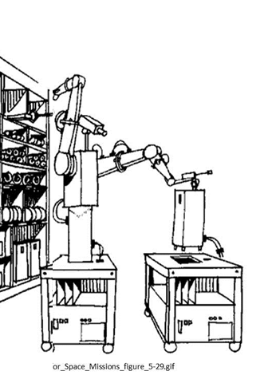
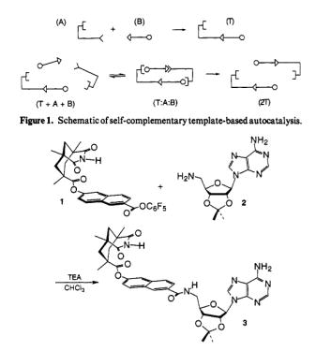
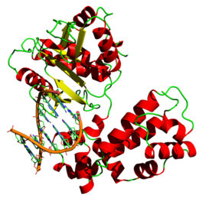
Synthetic Complexities of Various Systems
Atoms: ~ 20 [C,N,O]
Complexion: W~ 3²⁰
ξ = 32
Complexity (uProcessor/program):
ξ ~ 1K byte = 8000
Nucleotides: ~ 1000
Complexion: W~4¹⁰⁰⁰
ξ = 2000 = 2Kb
DNA Polymerase
Product: C = 4 states
ξ = 2
Product: C = 4 states
ξ = 2
Product: 10⁷ Nucleotides
ξ = 2x10⁷
ξ[Product / Parts] =~ .00025
ξ[Product / Parts] =~ .0625
ξ[Product / Parts] =10⁴
ξ >1 Product has sufficient complexity to encode for parts / assembler

Slide 3
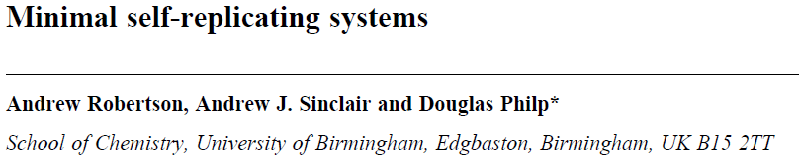

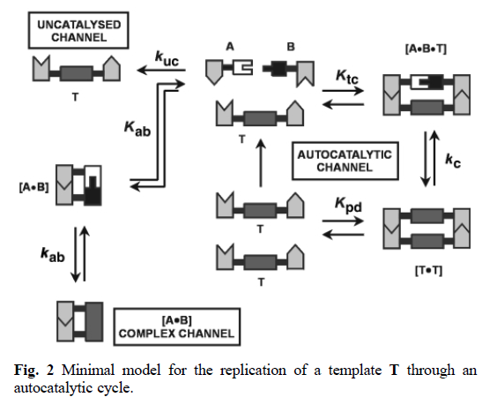
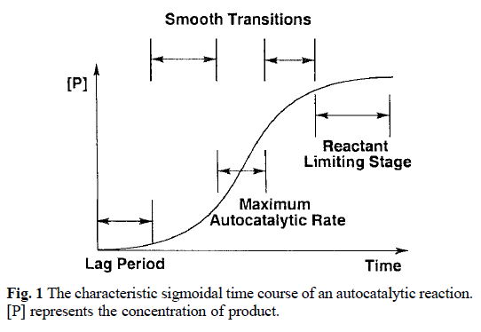

Slide 4
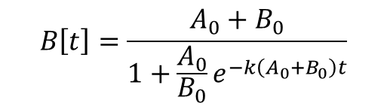
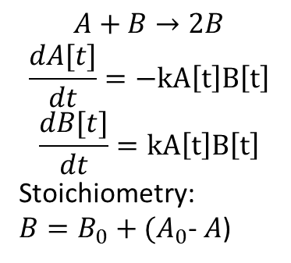


Autocatalytic Reactions
$$A+B→2B$$
$$\frac{dA[t]}{dt}=−kA\left[t\right]B\left[t\right]$$
$$\frac{dB[t]}{dt}=kA\left[t\right]B\left[t\right]$$
Stoichiometry:
$B=B_{0}+(A_{0}$- $A$)
$$B\left[t\right]=\frac{A_{0}+B_{0}}{1+\frac{A_{0}}{B_{0}}e^{−k\left(A_{0}+B_{0}\right)t}}$$
$$B[t]$$
$$t$$

Slide 5
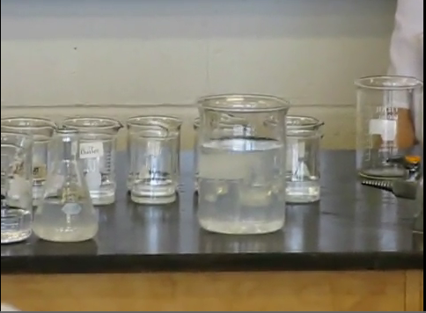
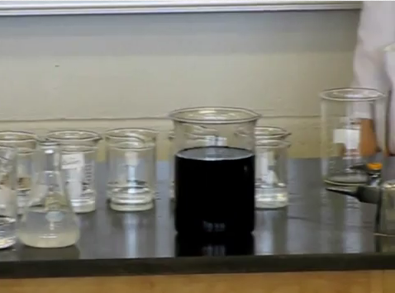
Clock Reactions

Slide 6
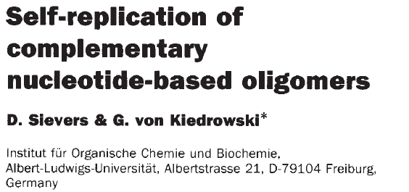
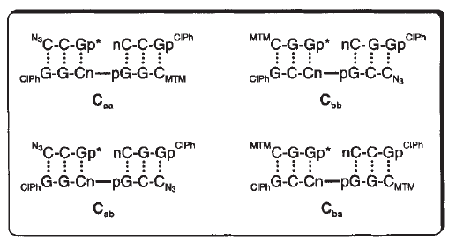
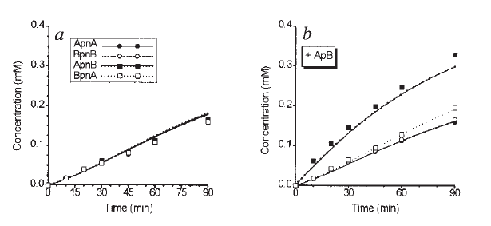


Slide 7
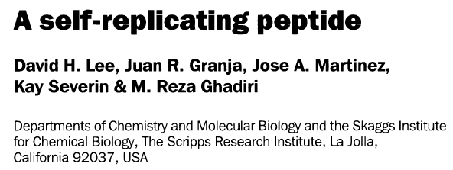
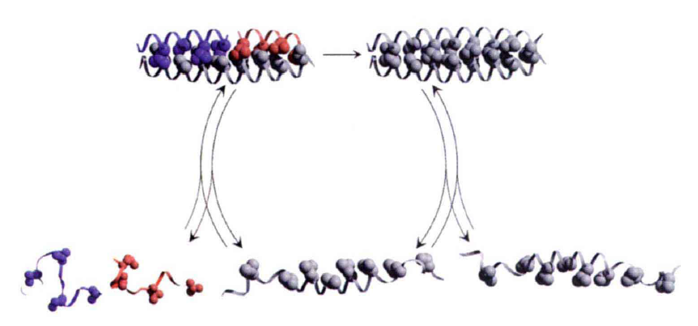
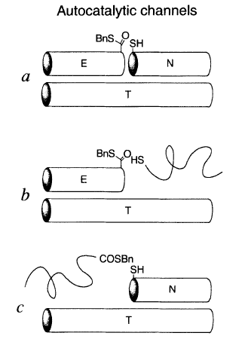
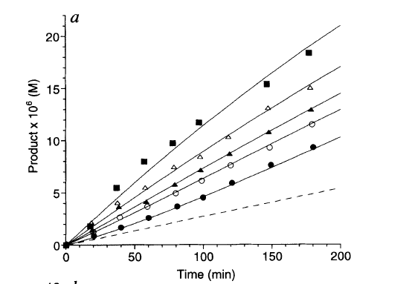
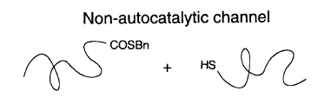

Slide 8
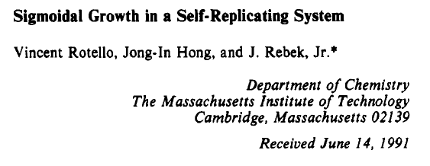
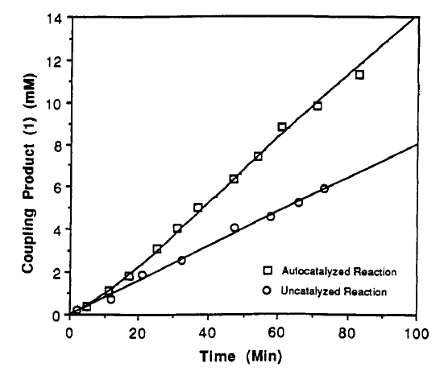

Slide 9
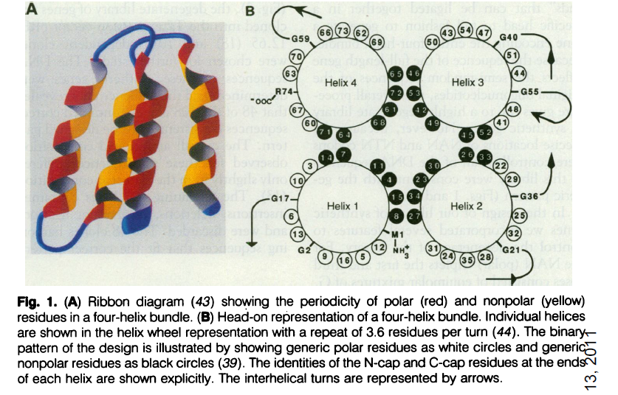
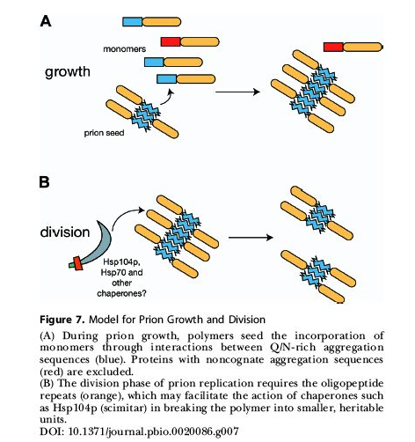
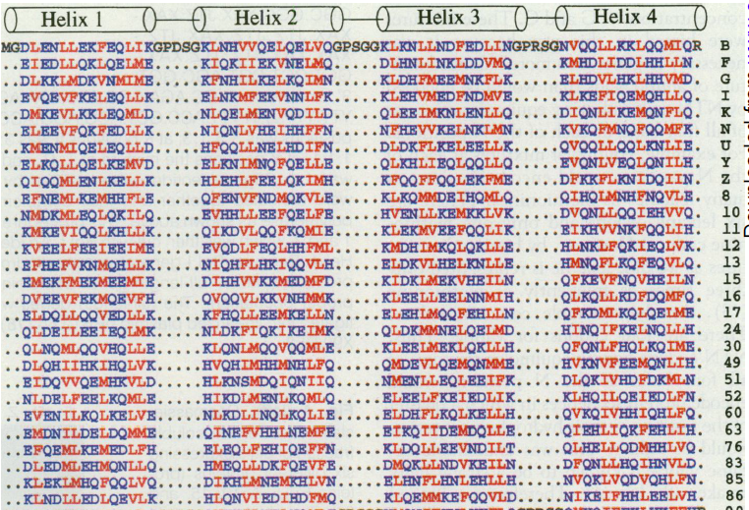
Prions
Hecht et. al. Rules for Protein solubility
http://www.sussex.ac.uk/Users/ctf20/dphil_2005/Thesis/Chapter1/prions.htm

Slide 10
