Slide 1
MAS.S62 FAB²
4.24.12
Error Correcting Systems
p
n
p
MAJ
p
p
p
MAJ
MAJ
p
p
p
MAJ
p
k
http://lslwww.epfl.ch/pages/embryonics/thesis/Chapter3.html

Slide 2
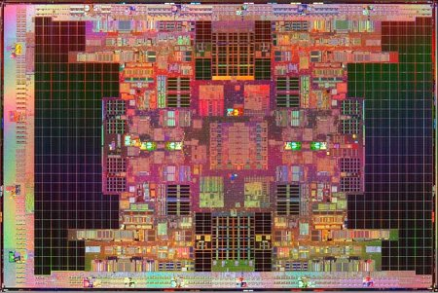
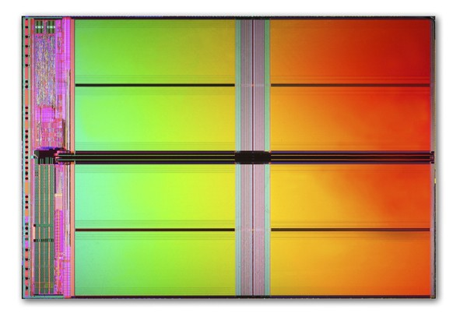
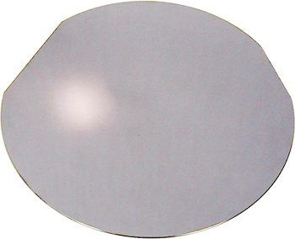
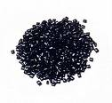
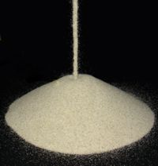
What governs the cost of placing atoms where we want them? What are the limits?
Itanium Quad Tukwila
Transistor Count: 2B
Cost: ~$100
Flash Memory
Transistor Count: 2B
Cost: ~$3
Si Wafer with Area sufficient for
2 Billion Transistors
Cost: ~$0.50
NetBook
Cost: ~$200
Sand (Chips and Screen)
Cost: ~$0
Plastic Resin / Metal Ore
Cost: ~$4

Slide 3
Threshold Theorem – Von Neumann 1956
p
n
p
MAJ
p
p
p
MAJ
MAJ
n=3
p
p
Recursion Level | P
K=1
K=2
K
p
MAJ
p
k
For circuit to be fault tolerant

Slide 4
Threshold Theorem - Winograd and Cowan 1963
p
A circuit containing N error-free gates can be simulated with probability of failure ε using O(N ⋅poly(log(N/ε))) error-prone gates which fail with probability p, provided p < pth, where pth is a constant threshold independent of N.
n
p
MAJ
p
p
p
MAJ
MAJ
p
p
p
MAJ
p
Number of gates consumed:
k
Find k such that
Number of Gates Consumed
Per Perfect Gate is

Slide 5
Threshold Theorem – Generalized
p
n
p
p
p
p
p
p
MAJ
p
p
p
p
p
k
For circuit to be fault tolerant P<p
Total number of gates:

Slide 6
Scaling Properties of Redundant Logic (to first order)
P
A
Probability of correct functionality = p[A] ~ e A (small A)
Area = A
P₁ = p[A] = e A
P₂ = 2p[A/2](1-p[A/2])+p[A/2]²
= eA –(eA)²/4
Area = 2*A/2
Conclusion: P₁ > P₂

Slide 7
Scaling Properties of Majority Logic
n segments
Total Area = n*(A/n)
P
A
Probability of correct functionality = p[A]
To Lowest Order in A
Conclusion: For most functions n = 1 is optimal. Larger n is worse.

Slide 8
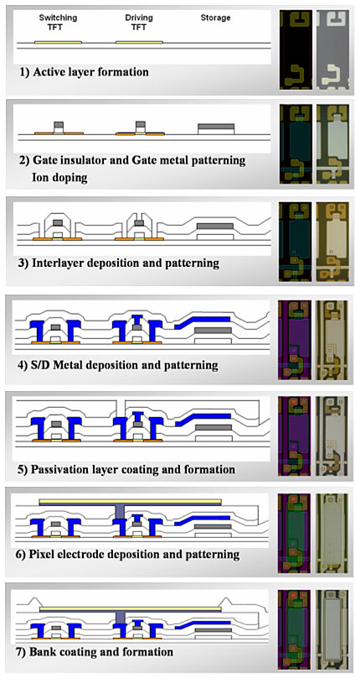
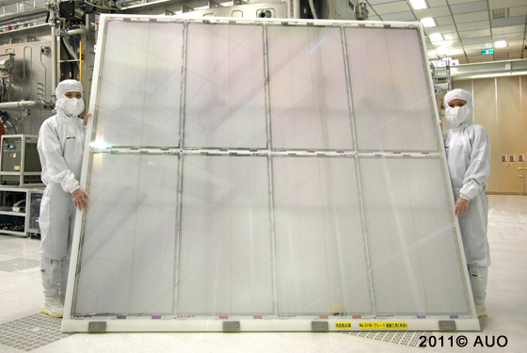
Fabrication Procedure of LTPS-TFT Array for AMOLED Backplane
http://www.sdtech.co.kr/device3.html

Slide 9
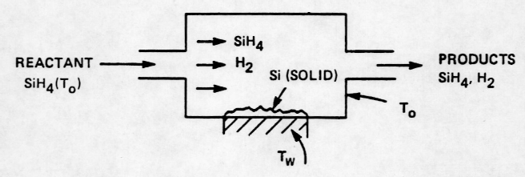
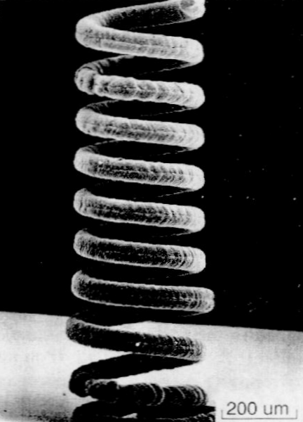
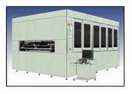
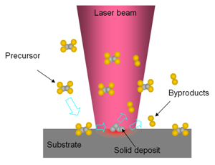
Laser CVD Repair

Slide 10
Yielding N Devices with Error Correction
(Why A Small Amount of Error Correction Has A Very Large Effect)
J. Jacobson 02/12/09
N Devices
A chip with N devices and per device yield of p has an overall perfect chip yield Y :
in which all N devices are functional.
If we now introduce a means of error correction such that N-M errors can be error corrected in reasonable time, then we have the generalized chip yield Y[M]:
Which is the fraction of chips with M or more perfect devices (i.e. N-M or fewer errors).
0.75 | 0.97 | 0.997 | 0.9998
0.5 | 0.85 | 0.97 | 0.99
0.25 | 0.60 | 0.84 | 0.95
0.1 | 0.33 | 0.60 | 0.80
0.01 | 0.06 | 0.16 | 0.32
Table 1. Yields as a function of the number of repaired errors.

Slide 11
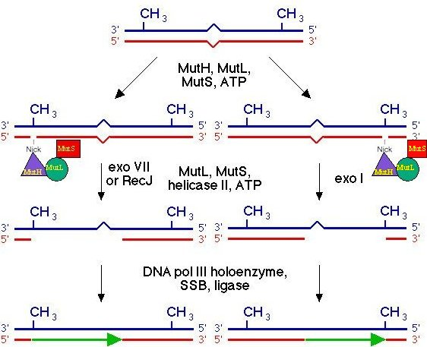
MutS Repair System

Slide 12
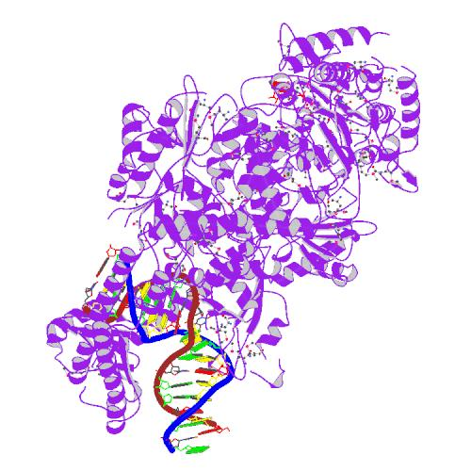
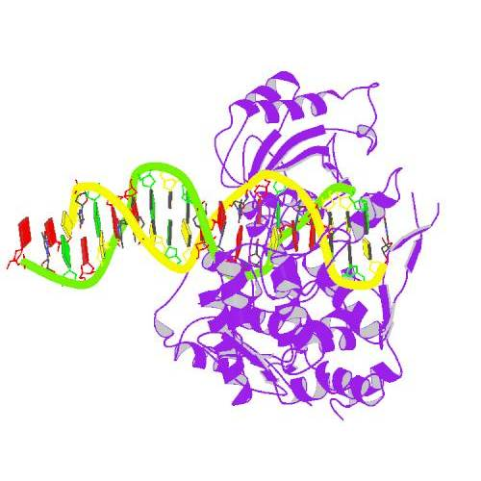
Design for a Mismatch Recognition Nuclease
amino
terminus
carboxy
terminus
Lamers et al. Nature 407:711 (2000)
Wah et al. Nature 388:97 (1997)
MutS (dimer) bound to a DNA mismatch
FokI nuclease bound to DNA (cleavage domain is below DNA)

Slide 13
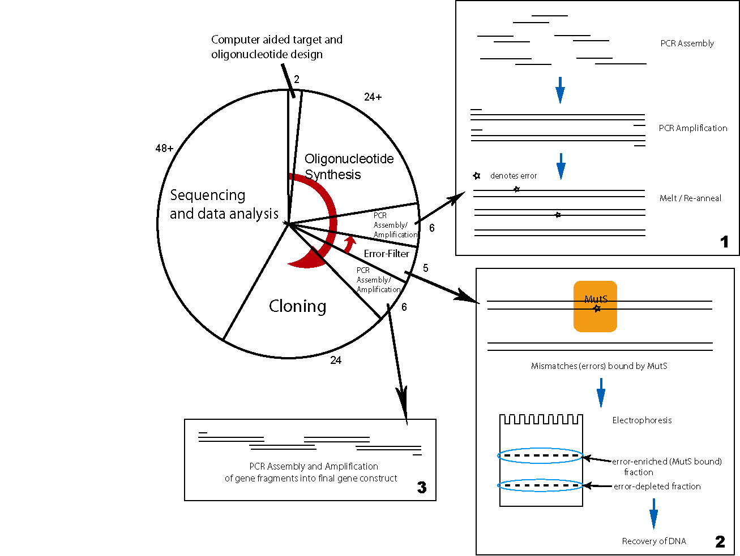
Gene Level Error Removal
Error Rate 1:10⁴
Nucleic Acids Research 2004 32(20):e162

Slide 14
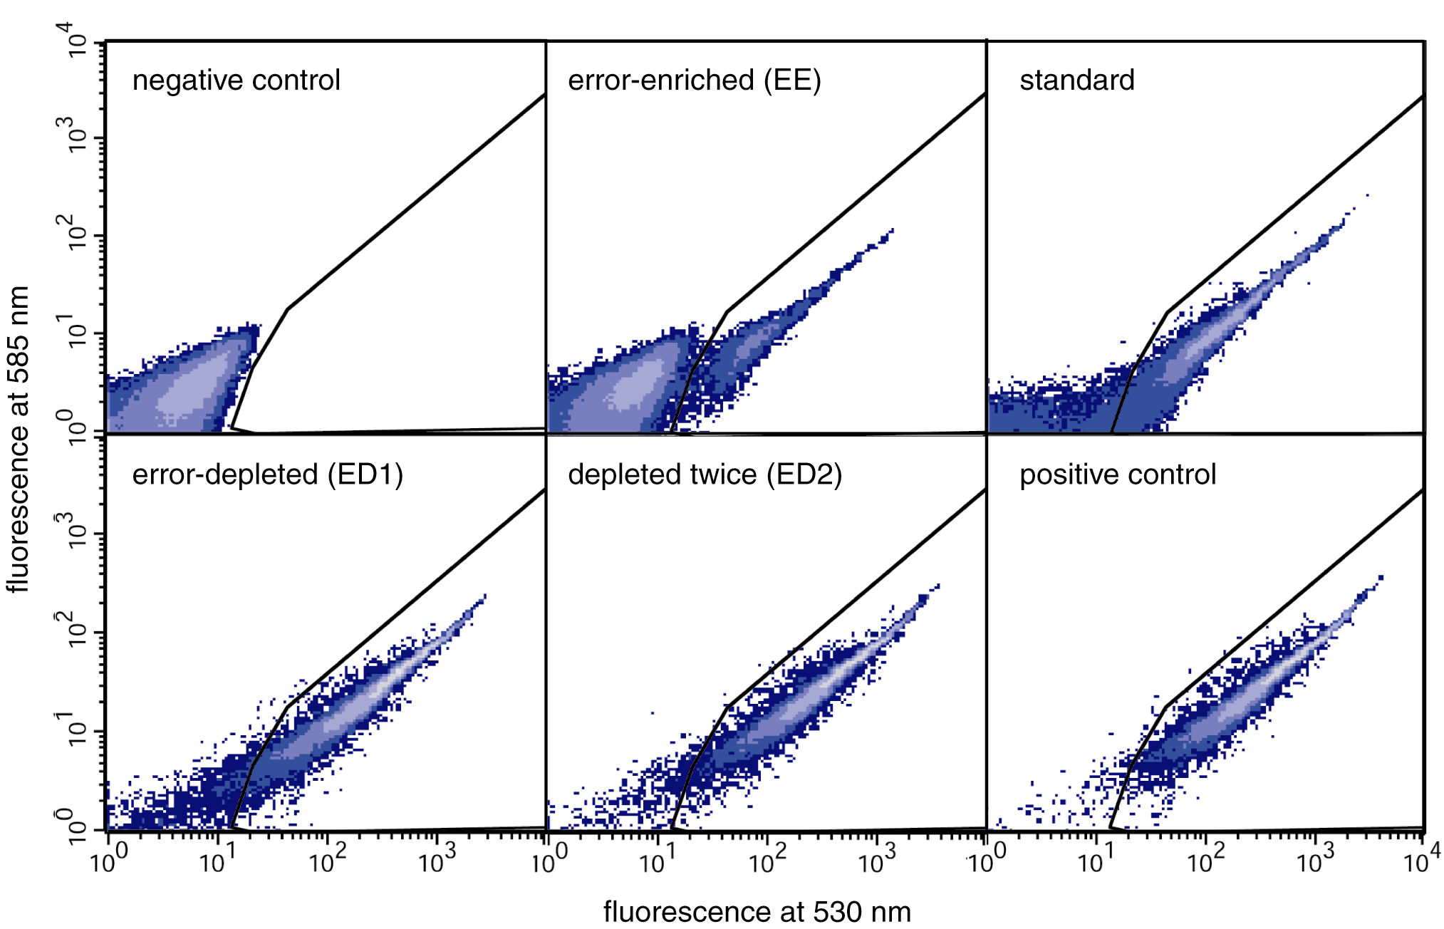
In Vitro Error Correction Yields >10x Reduction in Errors
Nucleic Acids Research 2004 32(20):e162

Slide 15
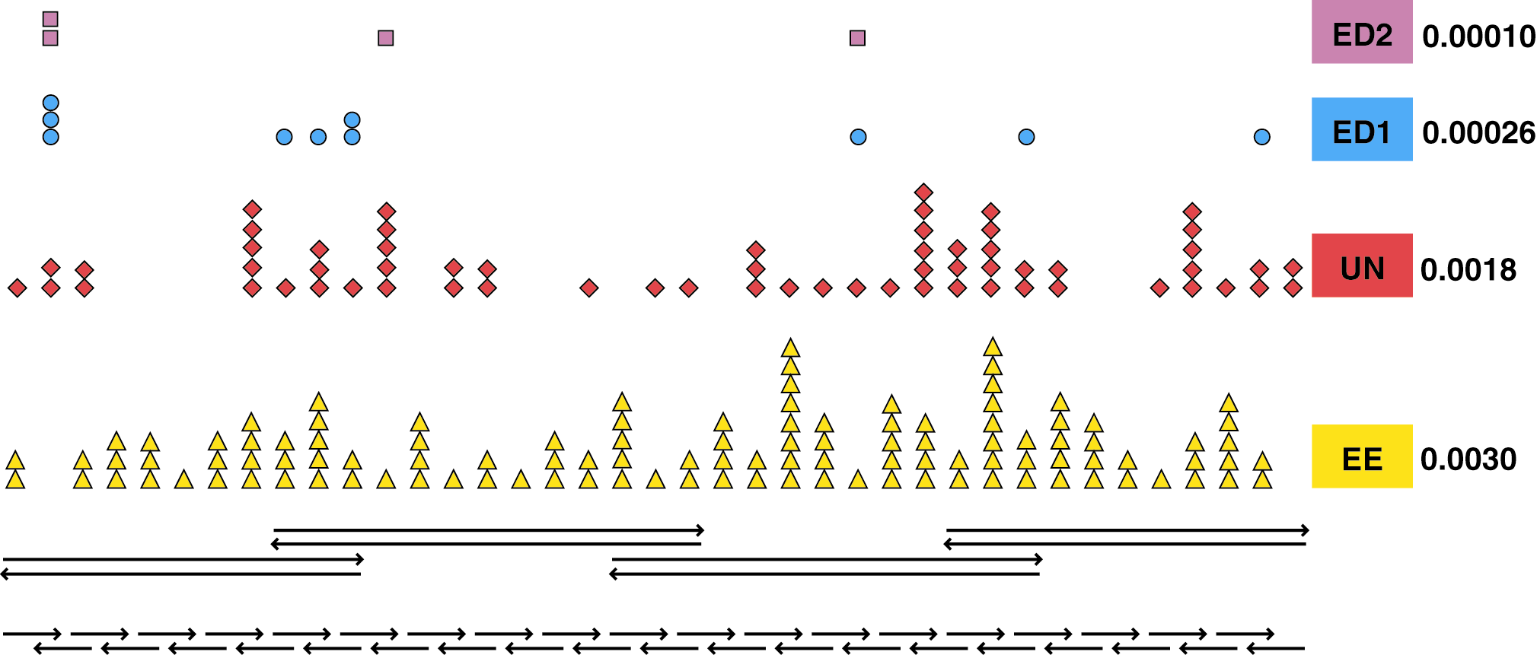
Error Reduction: GFP Gene synthesis
Nucleic Acids Research 2004 32(20):e162

Slide 16
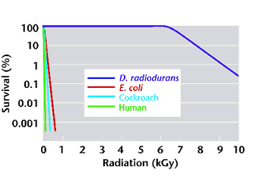
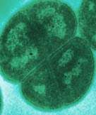
Deinococcus radiodurans
(3.2 Mb, 4-10 Copies of Genome )
[Nature Biotechnology 18, 85-90 (January 2000)]
Uniformed Services University of the Health
D. radiodurans: 1.7 Million Rads (17kGy) – 200 DS breaks
E. coli: 25 Thousand Rads – 2 or 3 DS breaks
http://www.ornl.gov/hgmis/publicat/microbial/image3.html

Slide 17
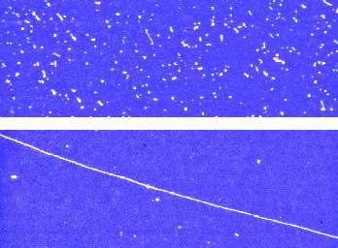
D. radiodurans 1.75 million rads, 0 h
D. radiodurans 1.75 million rads, 24 h
photos provided by David Schwartz (University of Wisconsin, Madison)]

Slide 18
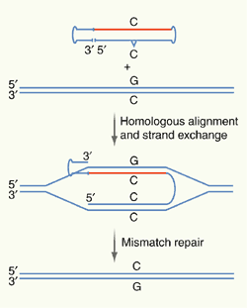
Error Correction in Biological Systems
Fault Tolerant Translation Codes (Hecht):
NTN encodes 5 different nonpolar residues
(Met, Leu, Ile, Val and Phe)
NAN encodes 6 different polar residues
(Lys, His, Glu, Gln, Asp and Asn)
Local Error Correction:
Ribozyme: 1:10³
Error Correcting Polymerase: 1:10⁸ fidelity
DNA Repair Systems:
MutS System
Recombination - retrieval - post replication repair
Thymine Dimer bypass.
Many others…
E. Coli Retrieval system - Lewin
Biology Employs Error Correcting Fabrication + Error Correcting Codes

Slide 19
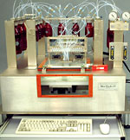
Caruthers Synthesis
DNA Synthesis
Error Rate:
1: 10²
300 Seconds
Per step
http://www.med.upenn.edu/naf/services/catalog99.pdf

Slide 20
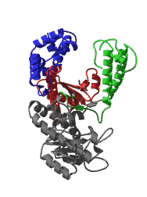
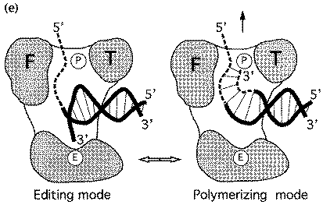
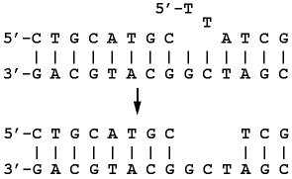
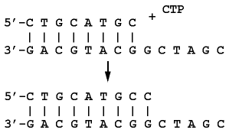
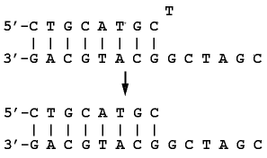
Replicate Linearly with Proofreading and Error Correction
Fold to 3D Functionality
Error Rate:
1: 10⁶
100 Steps per second
template dependant 5'-3'
primer extension
3'-5' proofreading
exonuclease
5'-3' error-correcting
exonuclease
Beese et al. (1993), Science, 260, 352-355.
http://www.biochem.ucl.ac.uk/bsm/xtal/teach/repl/klenow.html

Slide 21
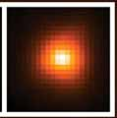
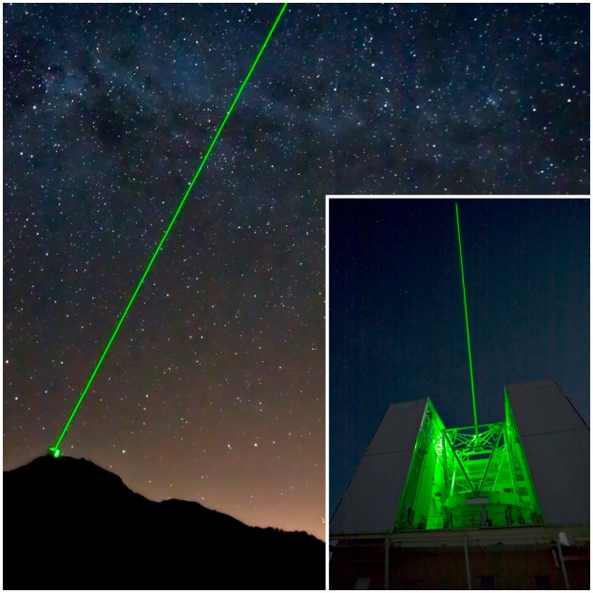
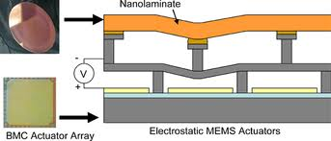
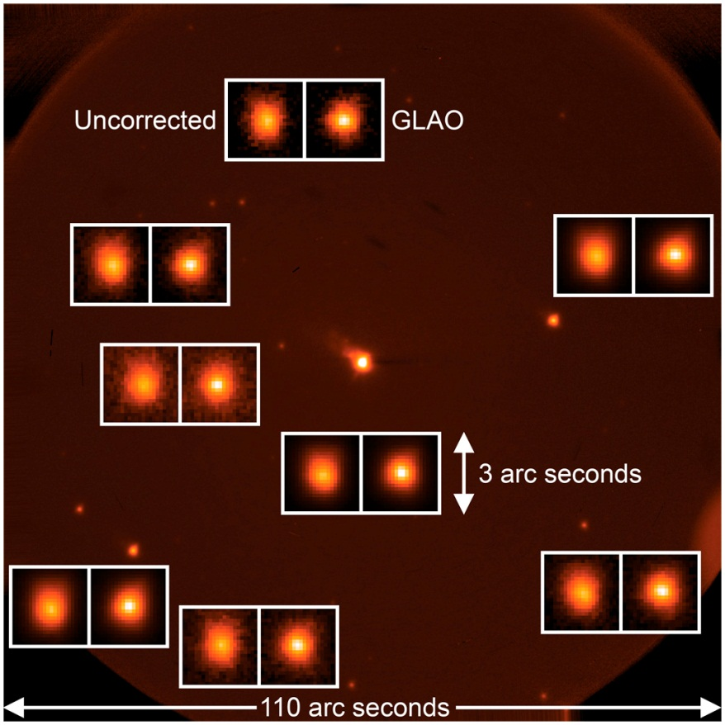
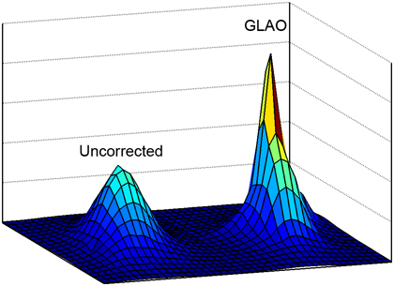
Laser Guide Star
http://spie.org/x34285.xml

Slide 22
Error Correcting Codes
Hamming code
Golay code
Reed-Muller code
Reed-Solomon code
Turbo code

Slide 23
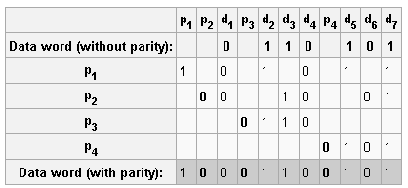
Hamming code
Hamming Algorithm::
All bit positions that are powers of two are used as parity bits. (positions 1, 2, 4, 8, 16, 32, 64, etc.)
All other bit positions are for the data to be encoded. (positions 3, 5, 6, 7, 9, 10, 11, 12, 13, 14, 15, 17, etc.)
Each parity bit calculates the parity for some of the bits in the code word. The position of the parity bit determines the sequence of bits that it alternately checks and skips.
Position 1(n=1): check 0 bit(n-1) ,skip 1 bit(n), check 1 bit(n), skip 1 bit(n), check 1 bit(n), etc.
Position 2(n=2): check 1 bit(n-1), skip 2 bits(n), check 2 bits(n), skip 2 bits(n), check 2 bits(n), etc.
Position 4(n=4): check 3 bits(n-1), skip 4 bits(n), check 4 bits(n), skip 4 bits(n), check 4 bits(n), etc.
Position 8(n=8): check 7 bits(n-1), skip 8 bits(n), check 8 bits(n), skip 8 bits(n), check 8 bits(n), etc.
Position 16(n=16): check 15 bits(n-1), skip 16 bits(n), check 16 bits(n), skip 16 bits(n), check 16 bits(n), etc.
Position 32(n=32): check 31 bits(n-1), skip 32 bits(n), check 32 bits(n), skip 32 bits(n), check 32 bits(n), etc.
And so on.
(11,7) Code

Slide 24
Hamming code-Error Correction

Slide 25
Homework
I] Nanotech Design:
Find an error function for which it is optimal to divide a logic area A into more than one redundant sub-Areas.
II] Design Life:
Design a biological system which self replicates with error correction (either genome copy redundancy with majority voting or error correcting coding). Assume the copying of each nucleotide is consumptive of one unit of energy. Show the tradeoff between energy consumption and copy fidelity.
Comment on the choice biology has taken (64 -3 nucleotide) codons coding for 20 amino acids. Why has biology chosen this encoding? What metric does it optimize? Could one build a biological system with 256 – 4 bit codons?
Questions: jacobson@media.mit.edu

