Slide 1
Growing->Living->Self Replicating Hardware MAS.S62 FAB² ^{3.13.12}
1] Self Repairing Hardware
Exponential Increase in Yield
2] Growing Hardware
Geometric Speed Up in Manufacturing Time:
Define Points (serial) –
Fill in space by growing (Parallel)

Slide 2
Self Repairing Hardware

Slide 3
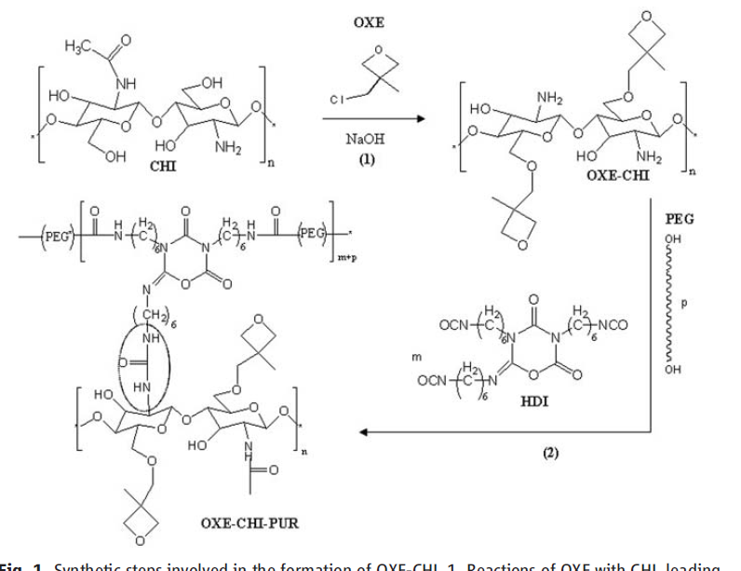
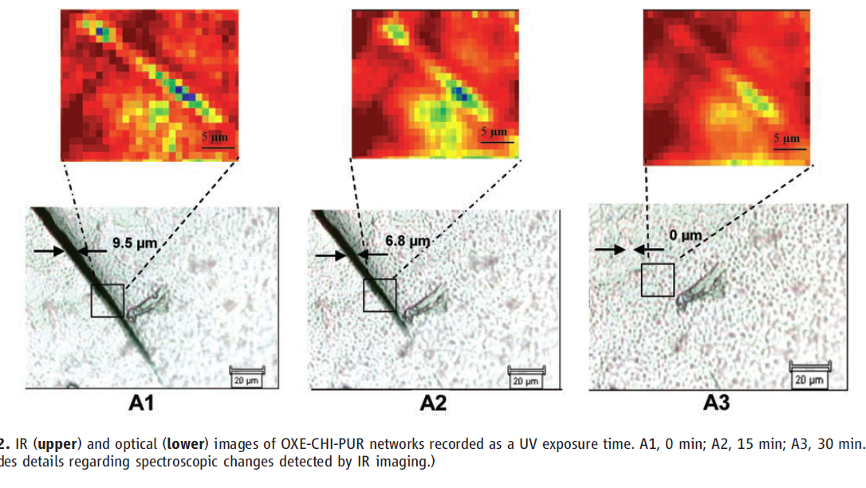
http://www.youtube.com/watch?v=Kp2uVMrXTyY

Slide 4
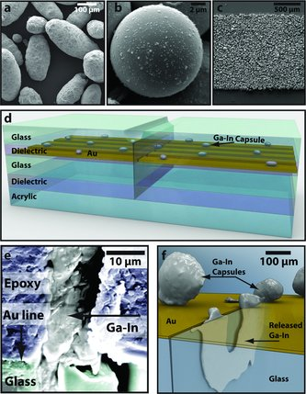
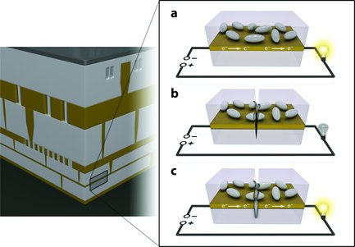
Self Repairing Hardware
http://www.physorg.com/news/2012-01-battery-thyself-self-repairing-batteries.html
Wiley Online Library

Slide 5
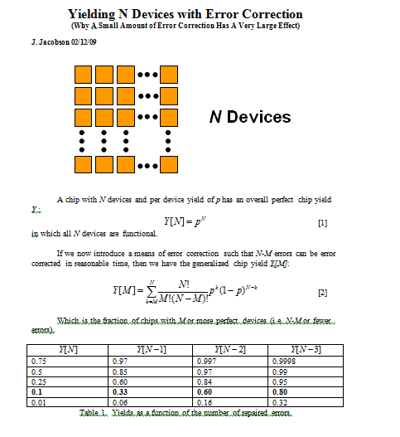

Slide 6
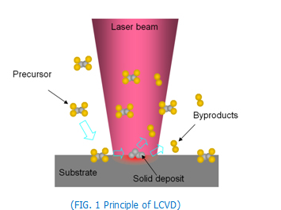
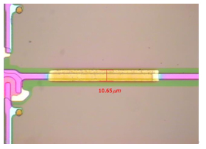
LASER CVD TFT REPAIR
http://laser.gist.ac.kr/board/bbs/board.php?bo_table=rese_02

Slide 7
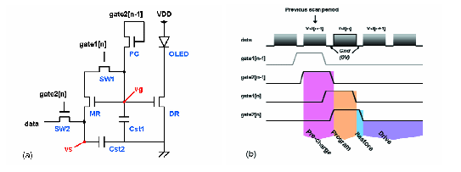
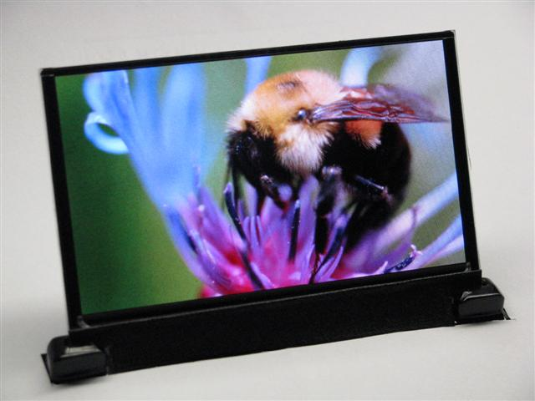
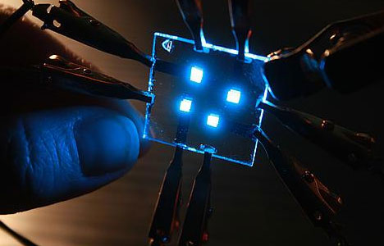
Self-Compensating OLED TFT
http://www.treehugger.com/clean-technology/blue-oled-efficiency-boosted-25.html
http://www.informationdisplay.org/article.cfm?year=2007&issue=08&file=art10
http://www.zdnet.com/blog/gadgetreviews/bigger-cheaper-oled-displays-dupont-can-print-them/14843

Slide 8
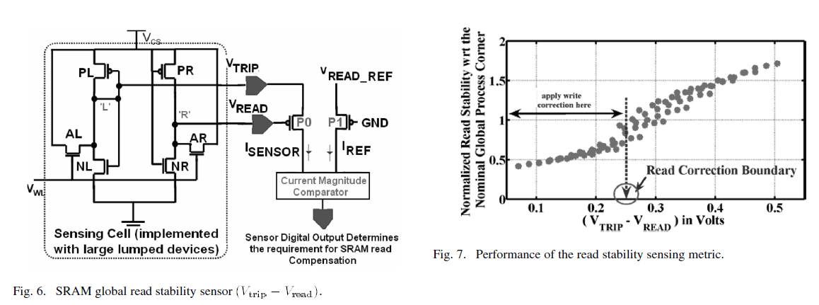
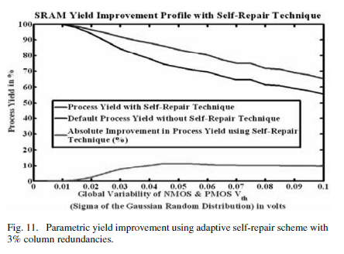

Slide 9
Growing Hardware

Slide 10
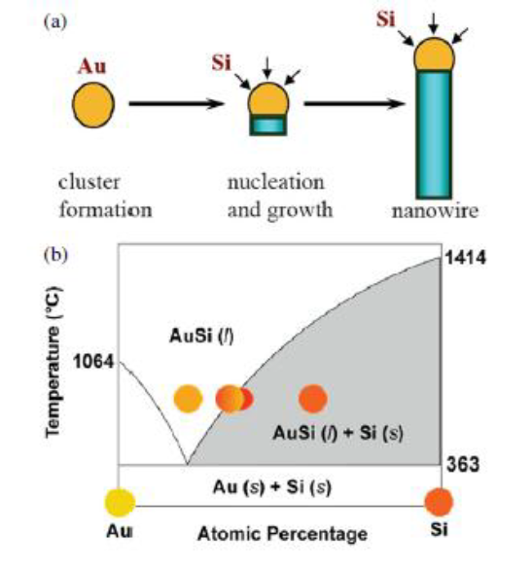
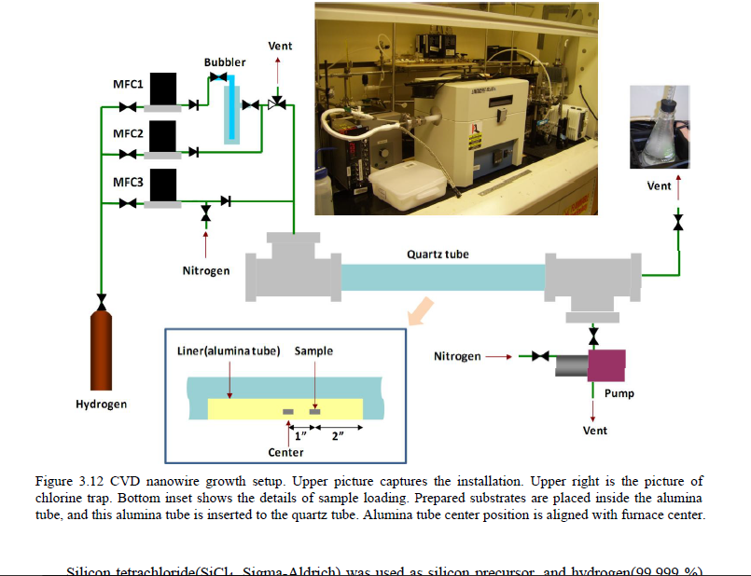
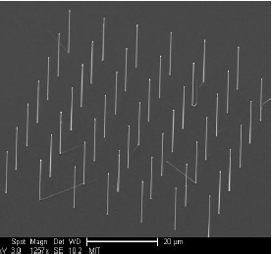
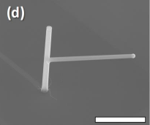
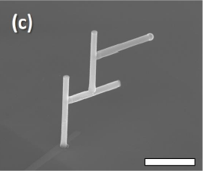
Programmable NanoWire Growth
http://dspace.mit.edu/bitstream/handle/1721.1/69240/775669073.pdf?sequence=1

Slide 11
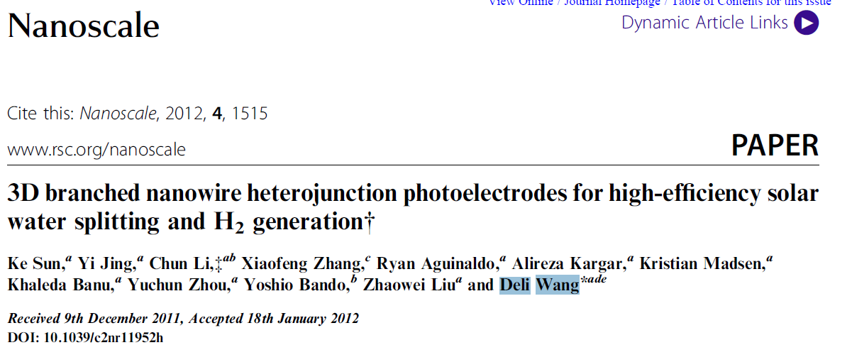
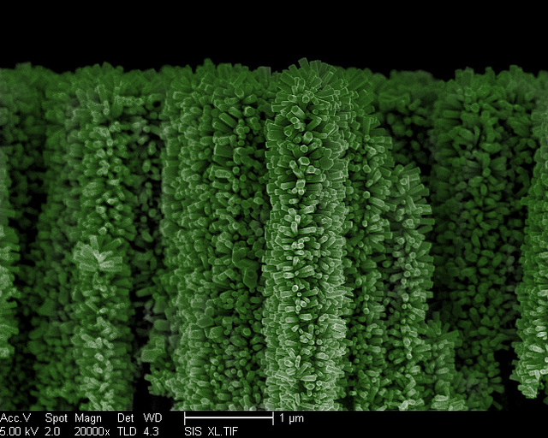

Slide 12
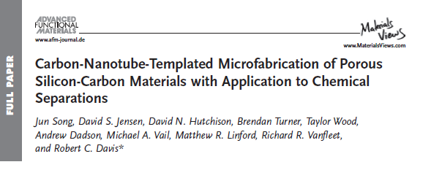
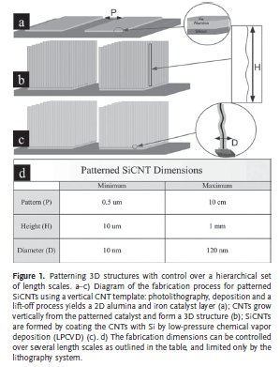
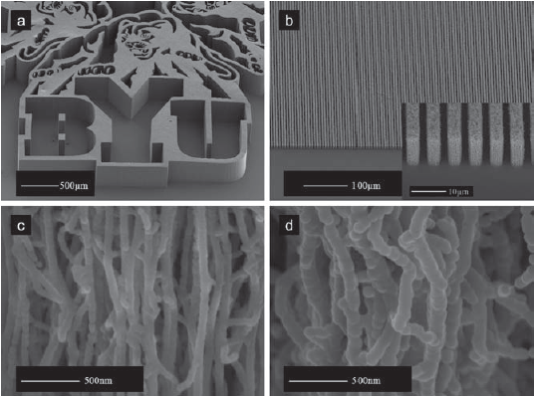

Slide 13
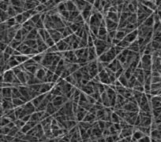
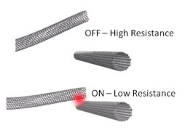
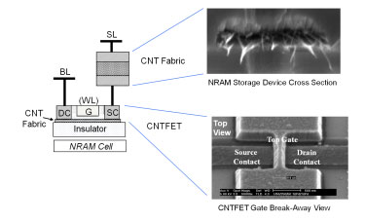
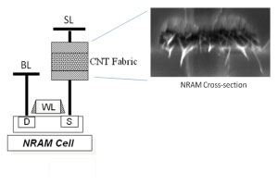

Slide 14
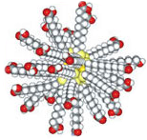
Nanopearls
Toward Direct Synthesis and Programmed Assembly of Nanocrystals

Slide 15
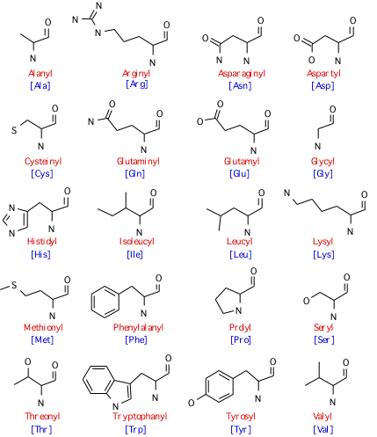
Nanocrystal Building Blocks
COOH
COOH
NH₂
NH₂
COOH
COOH
NH₂
COOH
NH₂
NH₂
Amino acid-nanocrystals
Natural amino acids

Slide 16
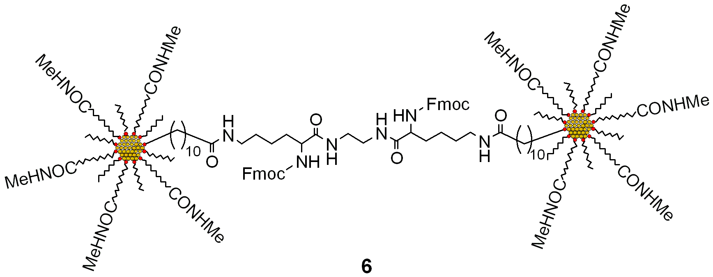
Identification of Monofunctionalized Nanocrystals
Nanocrystal Dimers
10 nm
At least 60% of Nanocrystals are monofunctionalized.
Ethylene Diamine bridge created with coupling reagent diisopropylcarbodiimide

Slide 17
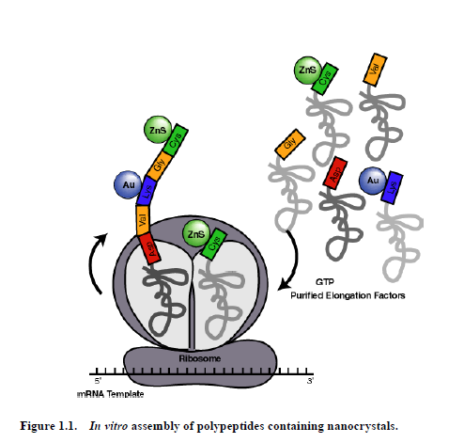
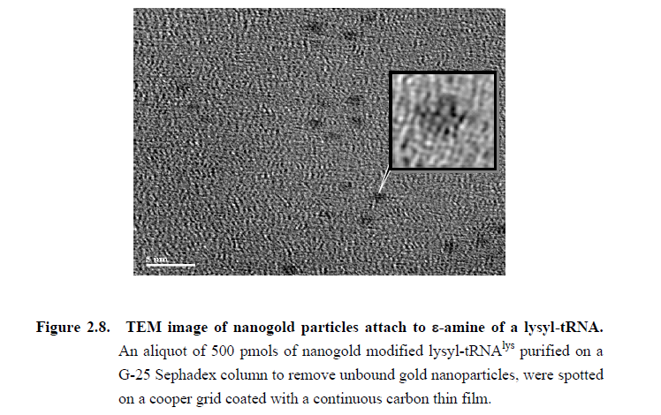
Ribosome Assembly of Au Nanoparticles
https://www.lib.utexas.edu/etd/d/2005/paveld16453/paveld16453.pdf

Slide 18
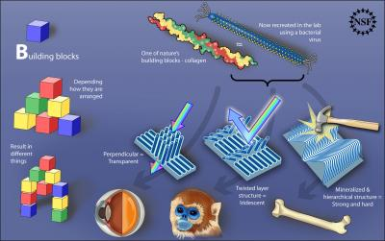
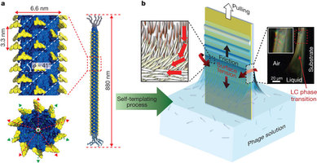
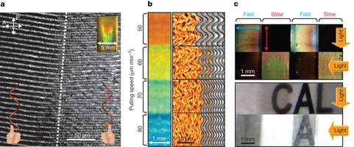
http://www.nature.com/nature/journal/v478/n7369/extref/nature10513-s2.mov

Slide 19
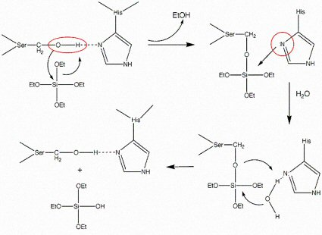
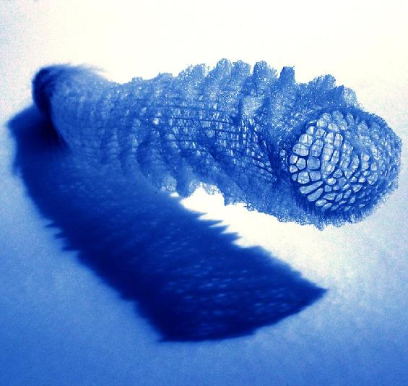
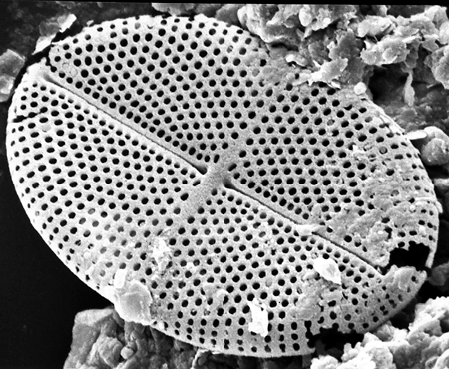
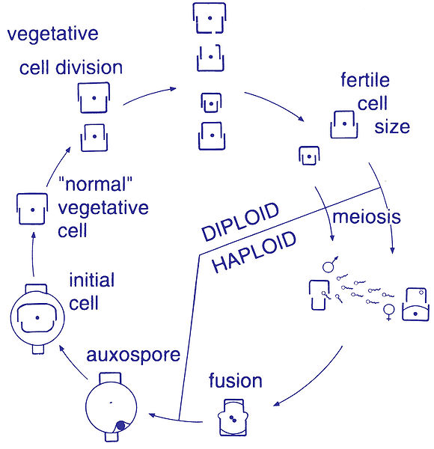
http://www.ucl.ac.uk/GeolSci/micropal/diatom.html
Silicateins
http://staff.science.uva.nl/~jaapk/BIOMINTEC.html
http://www.princeton.edu/~cml/html/research/silicatein.html

Slide 20
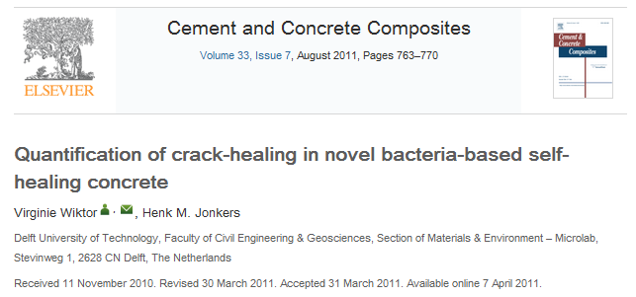
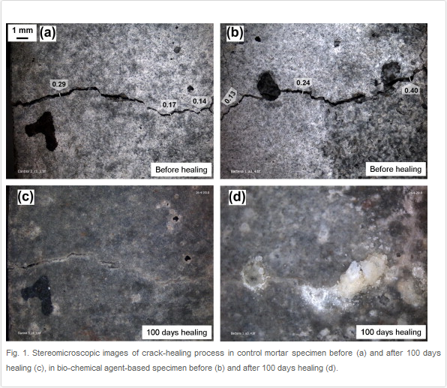

Slide 21
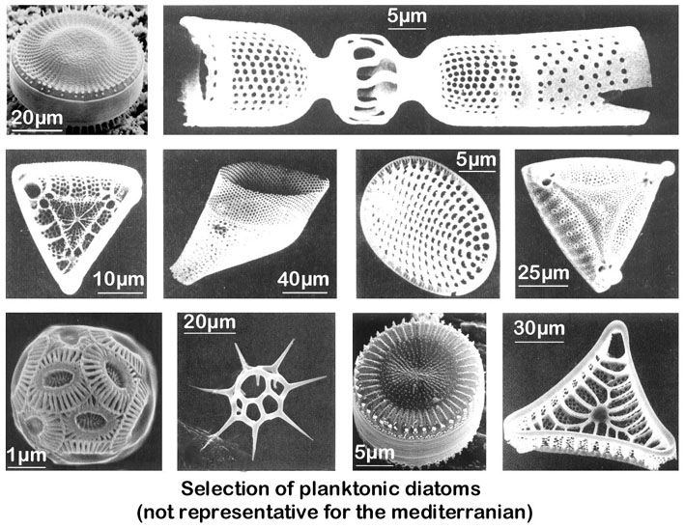
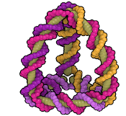
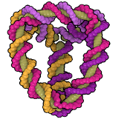
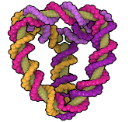
Arbitrarily Programmable Synthetic Diatoms
Idea 1:
Shapes governed by protein phase separations. Limited programmability of shape.
Genomic DNA (or mRNA) is structured as DNA Origami.
Proteins(e.g.silacateins,phytochelatans) direct the assembly of inorganic materials (e.g. silica , nanoparticles at particular points on the DNA lattice.
E. Coli: ~ 1 polymerase per 80,000 bases
Phusion: 66 bases / second. Kapa2G 1000 bases per second. Structures 1.5-20 minutes.

Slide 22
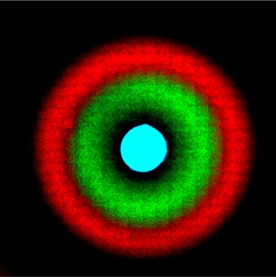
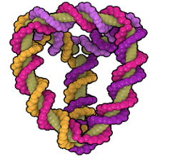
Proposal
DNA as structural material
MultiCellular Structures
DNA Origami + Fastest polymerases
Idea 2:
Weiss Lab
2 MB per um³ of volume
Structure
Metallization

Slide 23
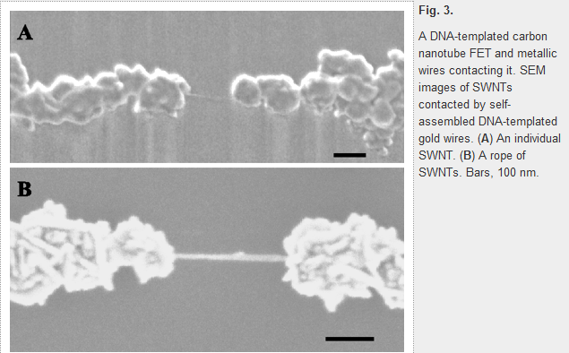
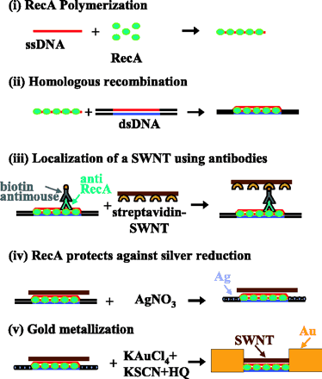
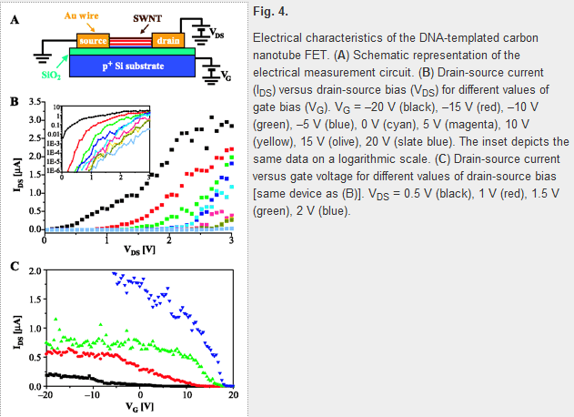

Slide 24
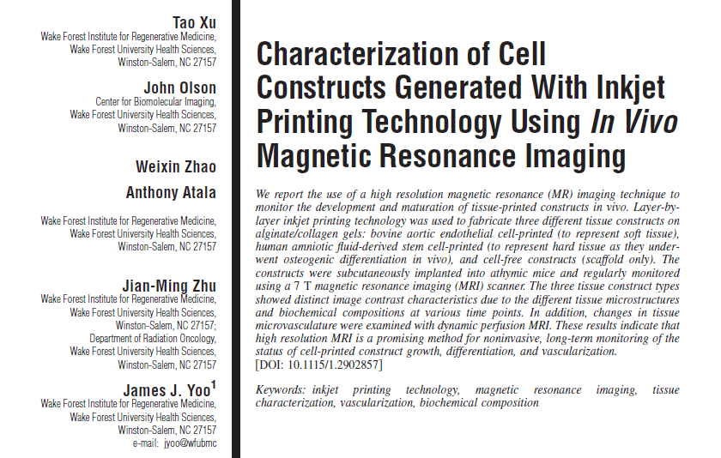
Tissue Printing
http://www.makerbot.com/blog/2011/03/08/3d-printing-an-organ-live-onstage-at-ted/
http://www.massgeneral.org/research/researchlab.aspx?id=1129

Slide 25
What Biology Does
Self Replicating
Exponential Growth
Solar Powered
What Milli-Biology Does
Programmable Folding
Can We Combine
the Two?
Jacobson/Gershenfeld
Millibiology

Slide 26
Can We Program the Growth of Plants?

Slide 28
http://www.galenfrysinger.com/Photos/australia48.jpg

Slide 30
http://www.trak.co.za/Baobab_Tree_-_Pub_Entrance.JPG

Slide 31
Fab Tree Hab
Massachusetts Institute of Technology Team H.E.D. [Human Ecology Design] Mitchell Joachim, Ph.D. Lara Greden, Ph.D. Javier Arbona, M.S.

Slide 32
Hybrid Bio-Silicon Seeds

Slide 33
Bamboo – MilliBio Bot Hybrid
Bamboo: Growth Rate - 2 Inches per hour!
Millibot

Slide 34
Thank You

Slide 35
Self Repairing Wall
http://www.youtube.com/watch?v=WHw0XVLI0a8

Slide 36
Quine
http://www.nyx.net/~gthompso/quine.htm#variations

