Slide 1


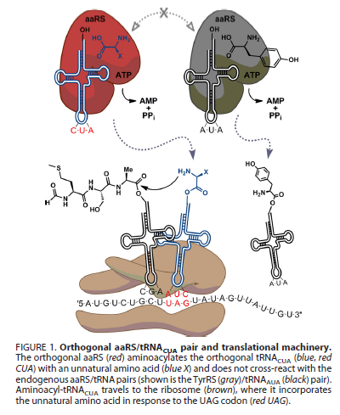
MAS.S62 FAB2
5.8.12
Synthetic Organisms and Novel Genetic Codes
-Expanding the Genetic Code
-Minimal Genomes
-Genome Scale Engineering

Slide 2
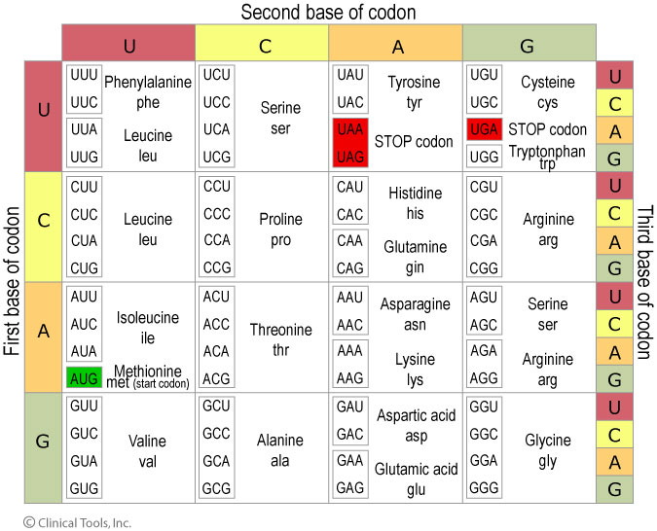
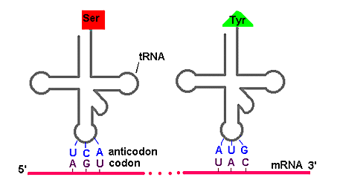
Codon Table
http://www.accessexcellence.org/RC/VL/GG/genetic.php
http://www2.le.ac.uk/departments/genetics/vgec/schoolscolleges/topics/dna-genes-chromosomes

Slide 3
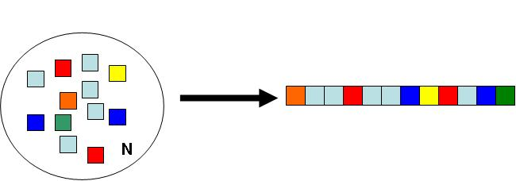
Fabricational Complexity
Application: Why Are There 20 Amino Acids in Biology?
(What is the right balance between Codon code redundancy and diversity?)
Question: Given N monomeric building blocks of Q different types, what is the optimal number of different types of building blocks Q which maximizes the complexity of the ensemble of all possible constructs?
N Blocks of Q Types
The complexion for the total number of different ways to arrange N blocks of Q different types (where each type has the same number) is given by:
.
And the complexity is:
For a given polymer length N we can ask which Q* achieves the half max for complexity such that:
J. Jacobson

Slide 4
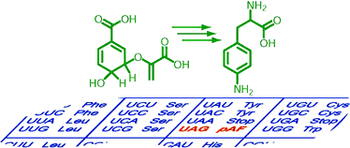
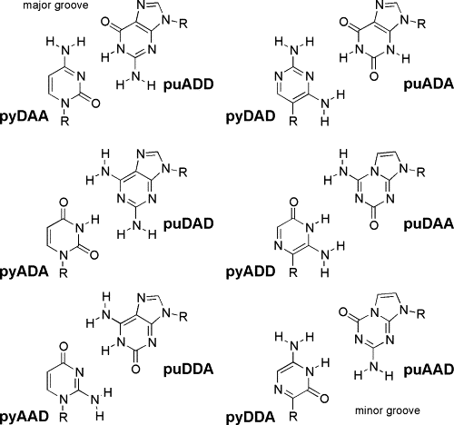
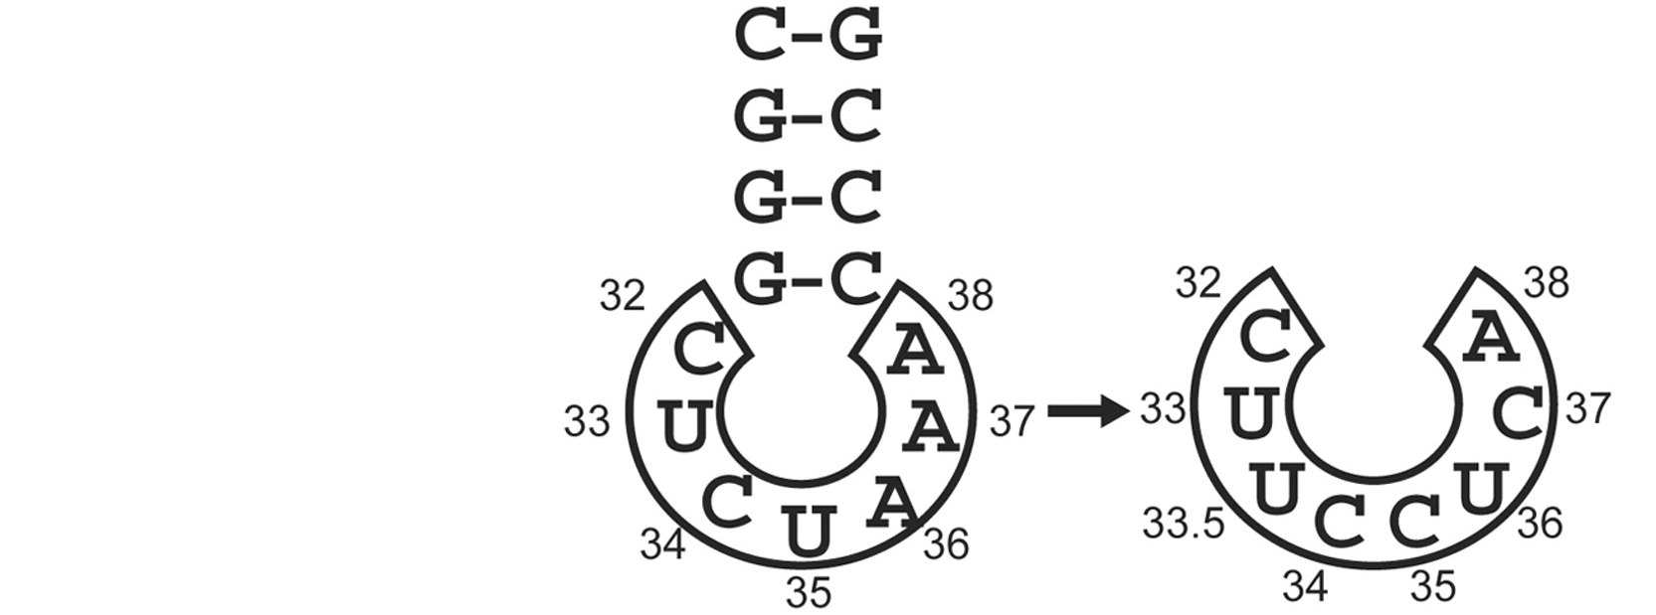
Expanding the Genetic Code
Nonnatural amino acids
Nonnatural DNA bases
Mehl, Schultz et al. JACS (2003)
4-base codons
Geyer, Battersby, and Benner
Structure (2003)
Anderson, Schultz et al. PNAS (2003)

Slide 5
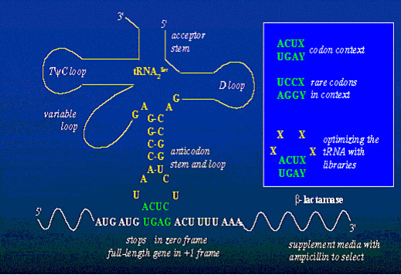
4 Base Parity Genetic Code
Let A=0, U,T=1, G=2, C=3
Use 3+1 base code
XYZ Sum(X+Y+Z, mod 4)
Leu: UUA -> UUAG
http://schultz.scripps.edu/Research/UnnaturalAAIncorporation/research.html

Slide 6
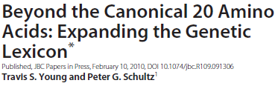
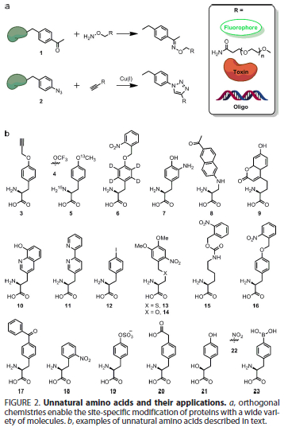

Slide 7
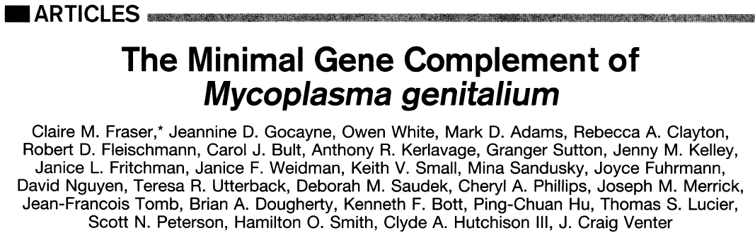
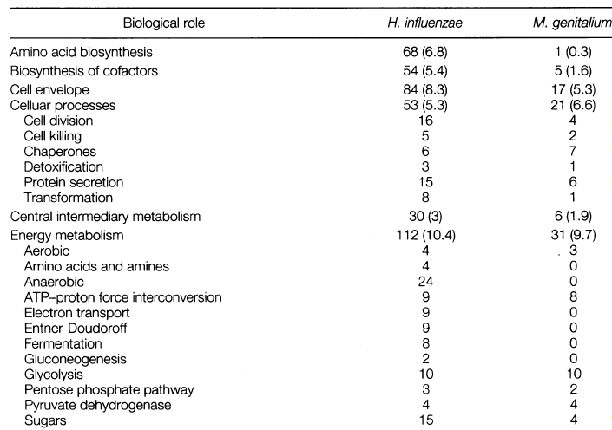
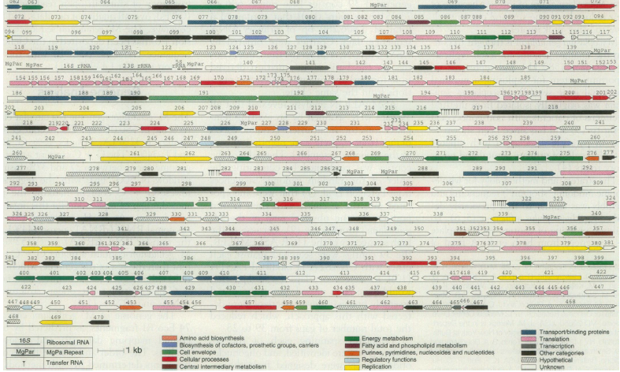
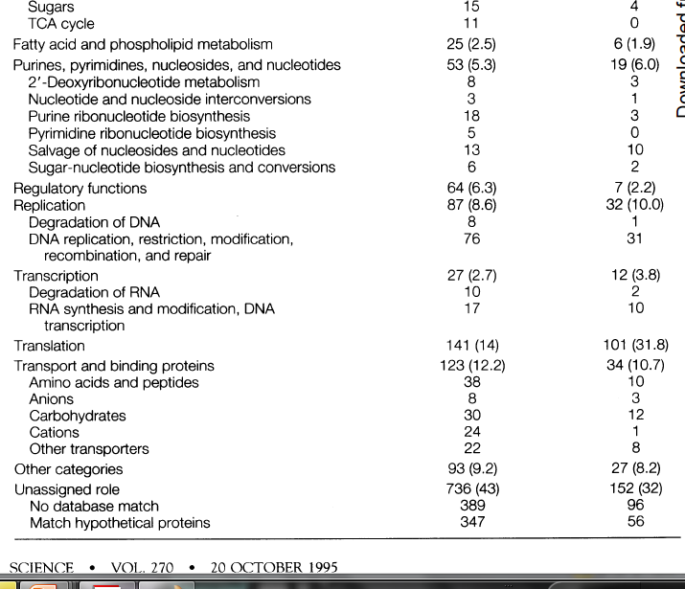

Slide 8
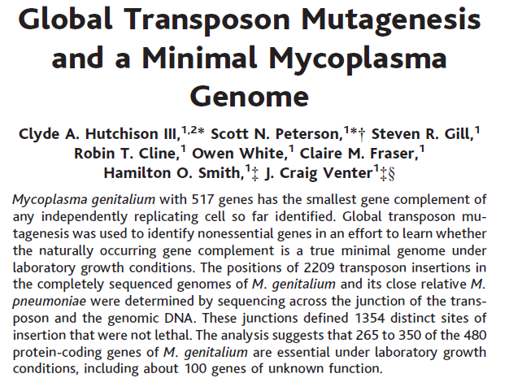
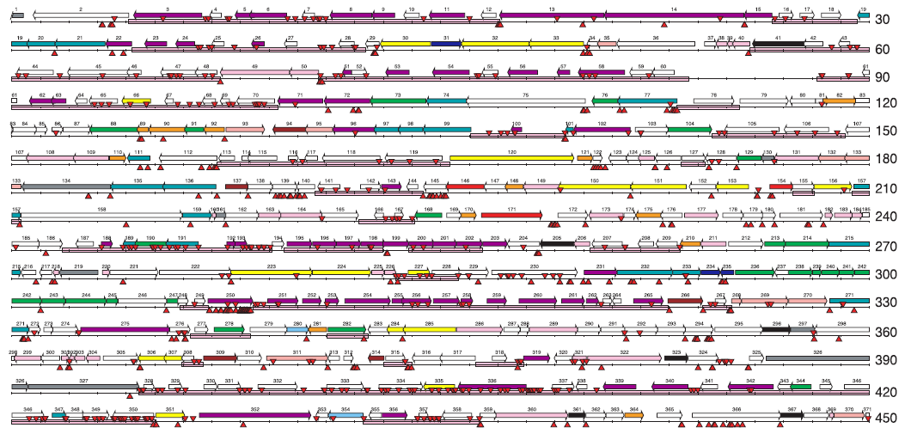
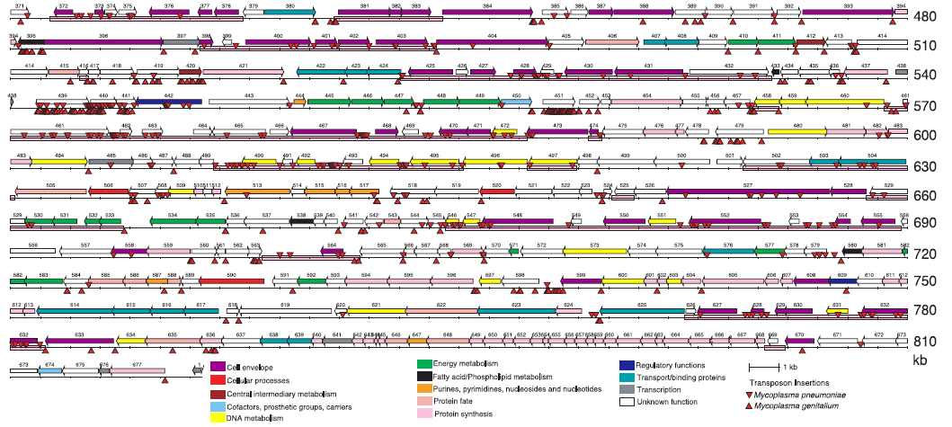
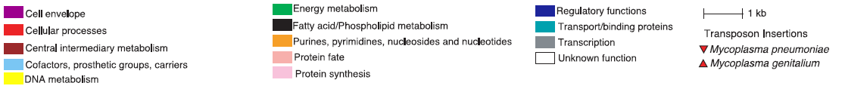

Slide 9
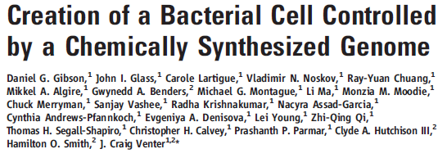
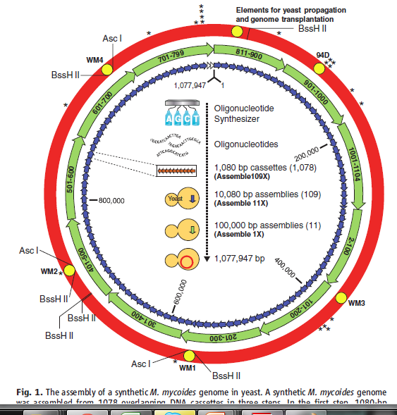
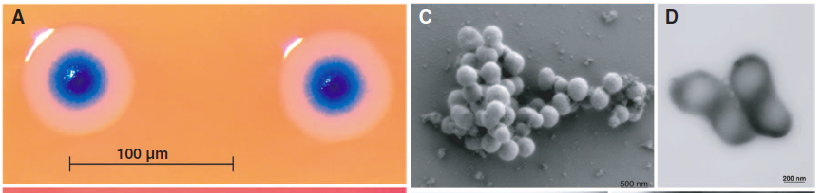

Slide 10
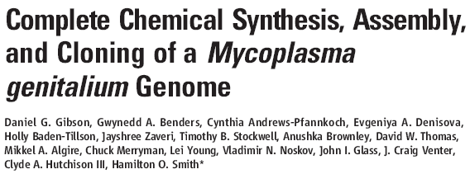
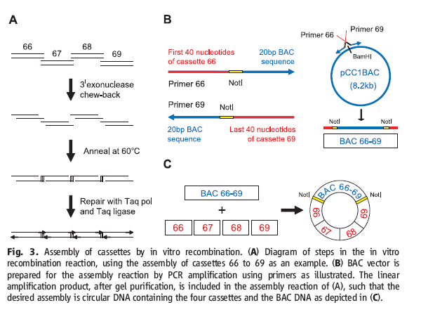
Whole Genome Synthesis

Slide 11
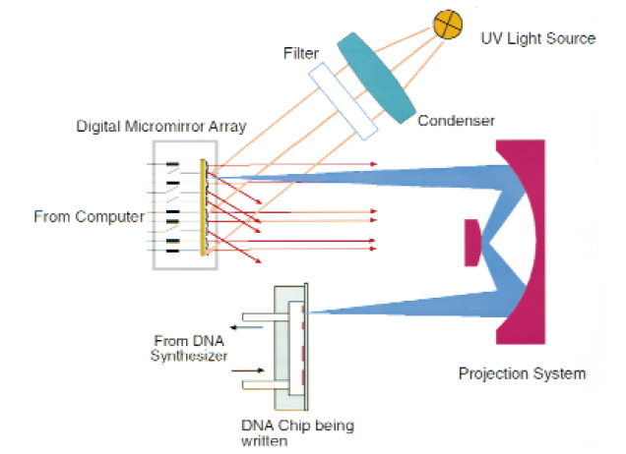
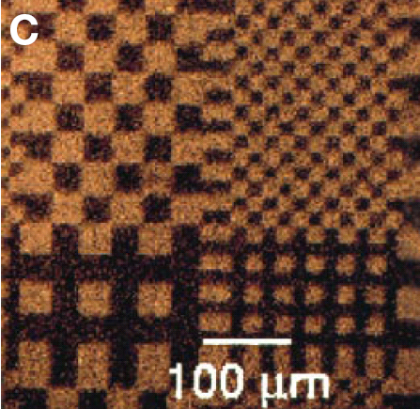
Up to 1M Oligos/Chip
Inventing a Better Future
Chip Based Oligo Nucleotide Synthesis
F. Cerrina et. al Nature Biotech 1999 p. 974

Slide 12

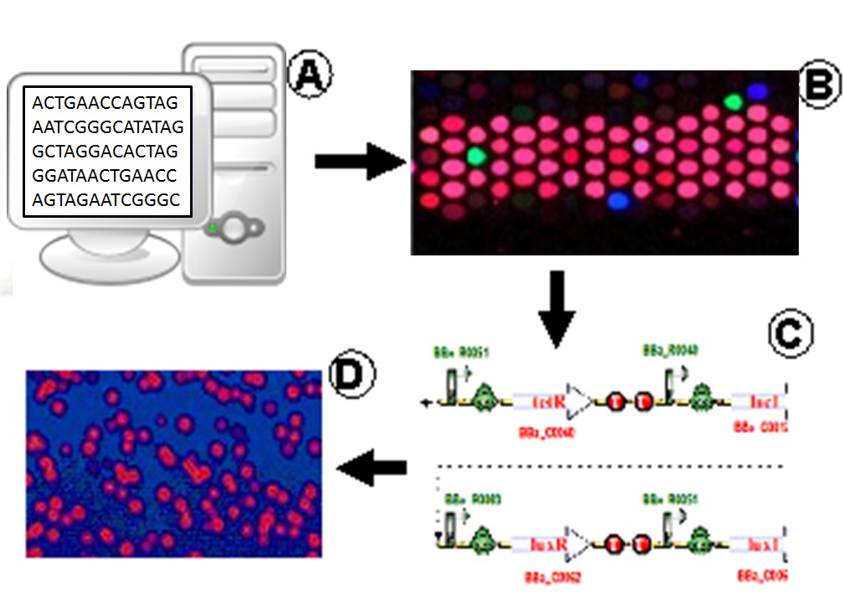
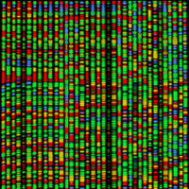
Inventing a Better Future
From Bits to Cells
Molecular Machine
(Jacobson) Group
MIT
Schematic of BioFab Computer to Pathway. A. Gene pathway sequence. B. Corresponding array of overlapping oligonucleotides C. Error correcting assembly in to low error rate pathways. D. Expression in cells

Slide 13

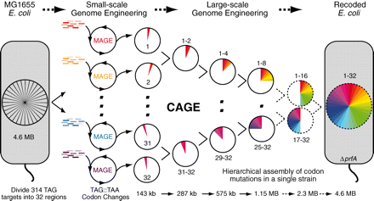
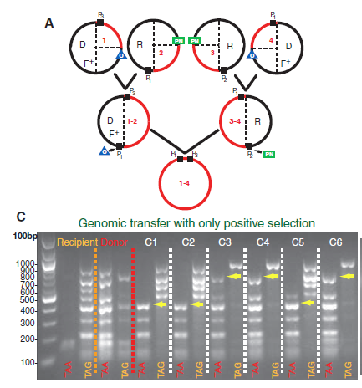
rE.coli
Engineering The First Organisms with Novel Genetic Codes
http://www2.le.ac.uk/departments/genetics/vgec/education/post18/topics/dna-genes-chromosomes
Precise manipulation of chromosomes in vivo enables genome-wide codon replacement
Farren J. Isaacs, Peter A. Carr, Harris H. Wang,…JM Jacobson, GM Church - Science, 2011

Slide 14
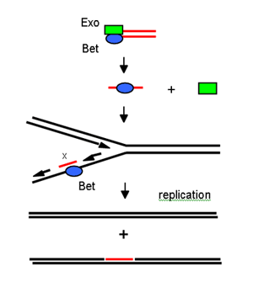
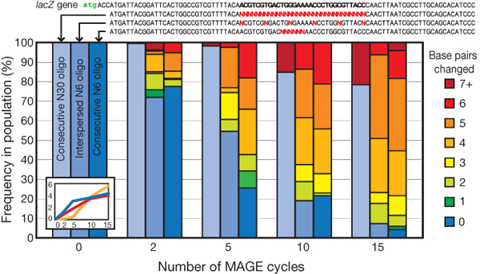
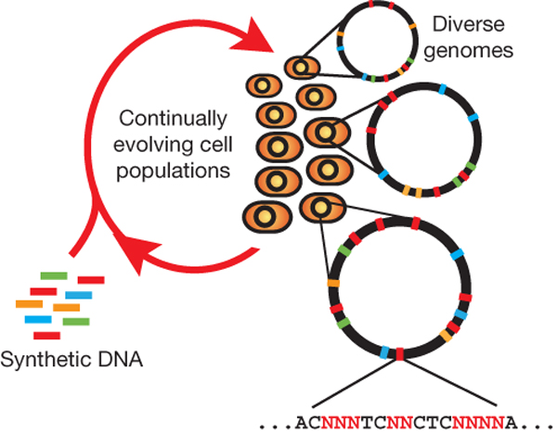
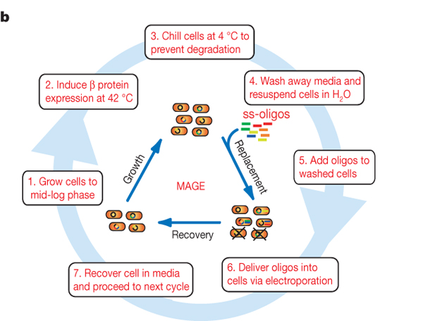
Programming cells by multiplex genome engineering and accelerated evolution
Harris H. Wang, Farren J. Isaacs, Peter A. Carr, Zachary Z. Sun, George Xu, Craig R. Forest & George M. Church Nature 460, 894-898(13 August 2009)
http://profiles.umassmed.edu/profiles/ProfileDetails.aspx?From=SE&Person=240

Slide 15
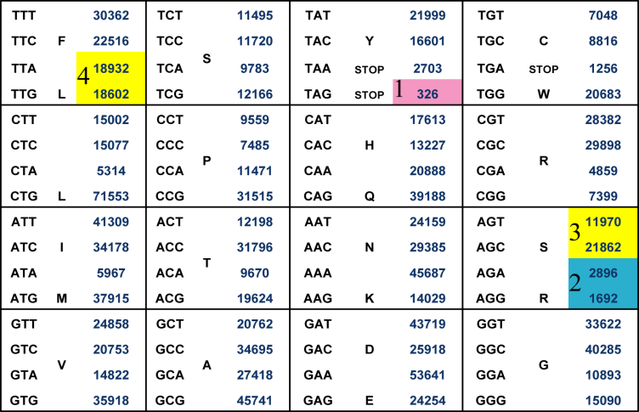


rE.coli - Recoding E.coli
E. Coli
MG1655
4.6 MB
32 cell lines total, target
~10 modifications per cell line
oligo shotgun:
parallel cycles
32
16
8
4
2
1

Slide 16
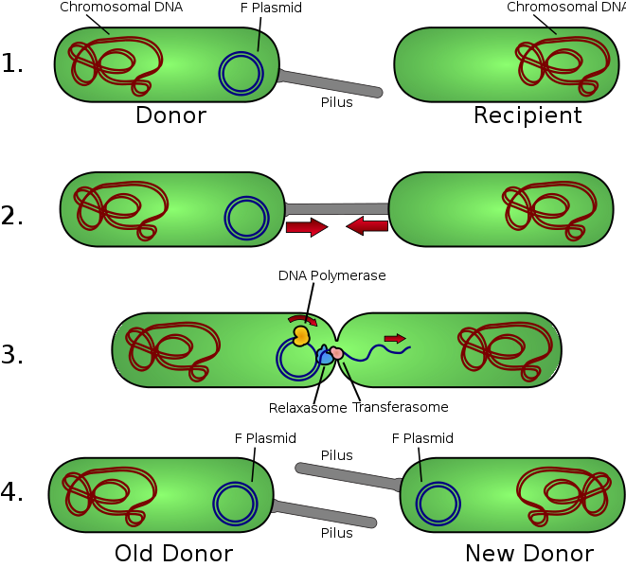
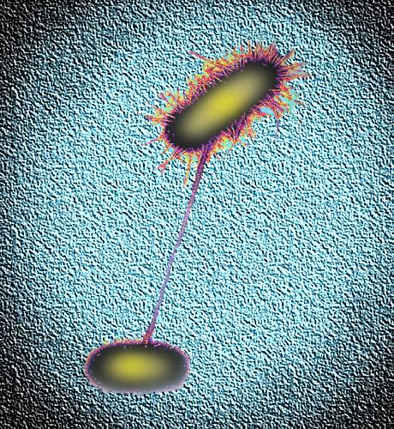
Bacterial Conjugation
http://www.flickr.com/photos/ajc1/1103490291/
http://en.wikipedia.org/wiki/File:Conjugation.svg

Slide 17
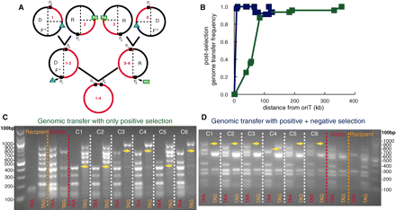
Conjugative Assembly Genome Engineering (CAGE)
Precise manipulation of chromosomes in vivo enables genome-wide codon replacement
SJ Hwang, MC Jewett, JM Jacobson, GM Church - Science, 2011

