Slide 1


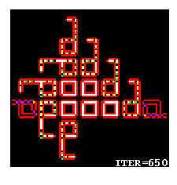
MAS.S62 FAB²
2.28.12
The Threshold for Life
http://lslwww.epfl.ch/pages/embryonics/thesis/Chapter3.html

Slide 2
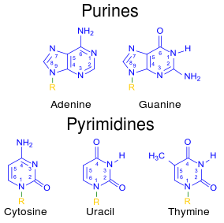
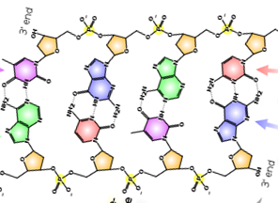
Complexities in Biochemistry
Atoms: ~ 10
Complexion: W~3¹⁰
Complexity ξ = 15.8
Atoms: ~ 8
Complexion: W~3⁸
Complexity ξ = 12.7
DNA N-mer
Types of Nucleotide Bases: 4
Complexion: W=4^{N}
Complexity ξ = 2 N
Complexity Crossover: N>~8

Slide 3
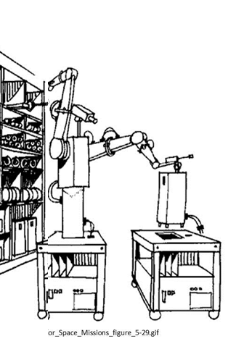
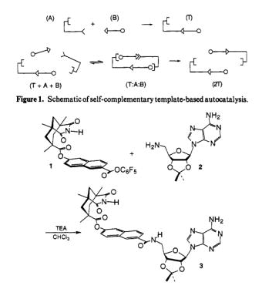
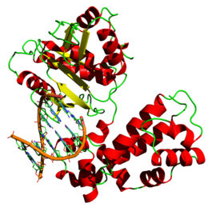
Synthetic Complexities of Various Systems
Atoms: ~ 20 [C,N,O]
Complexion: W~ 3²⁰
ξ = 32
Complexity (uProcessor/program):
ξ ~ 1K byte = 8000
Nucleotides: ~ 1000
Complexion: W~4¹⁰⁰⁰
ξ = 2000 = 2Kb
DNA Polymerase
Product: C = 4 states
ξ = 2
Product: C = 4 states
ξ = 2
Product: 10⁷ Nucleotides
ξ = 2x10⁷
ξ[Product / Parts] =~ .00025
ξ[Product / Parts] =~ .0625
ξ[Product / Parts] =10⁴
ξ >1 Product has sufficient complexity to encode for parts / assembler

Slide 4
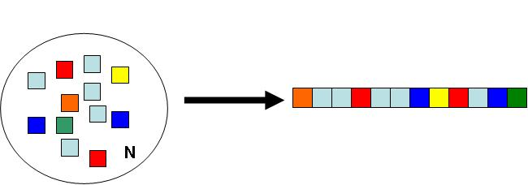
Complexity
Application: Why Are There 20 Amino Acids in Biology?
(What is the right balance between Codon code redundancy and diversity?)
Question: Given N monomeric building blocks of Q different types, what is the optimal number of different types of building blocks Q which maximizes the complexity of the ensemble of all possible constructs?
N Blocks of Q Types
The complexion for the total number of different ways to arrange N blocks of Q different types (where each type has the same number) is given by:
.
And the complexity is:
For a given polymer length N we can ask which Q* achieves the half max for complexity such that:

Slide 5
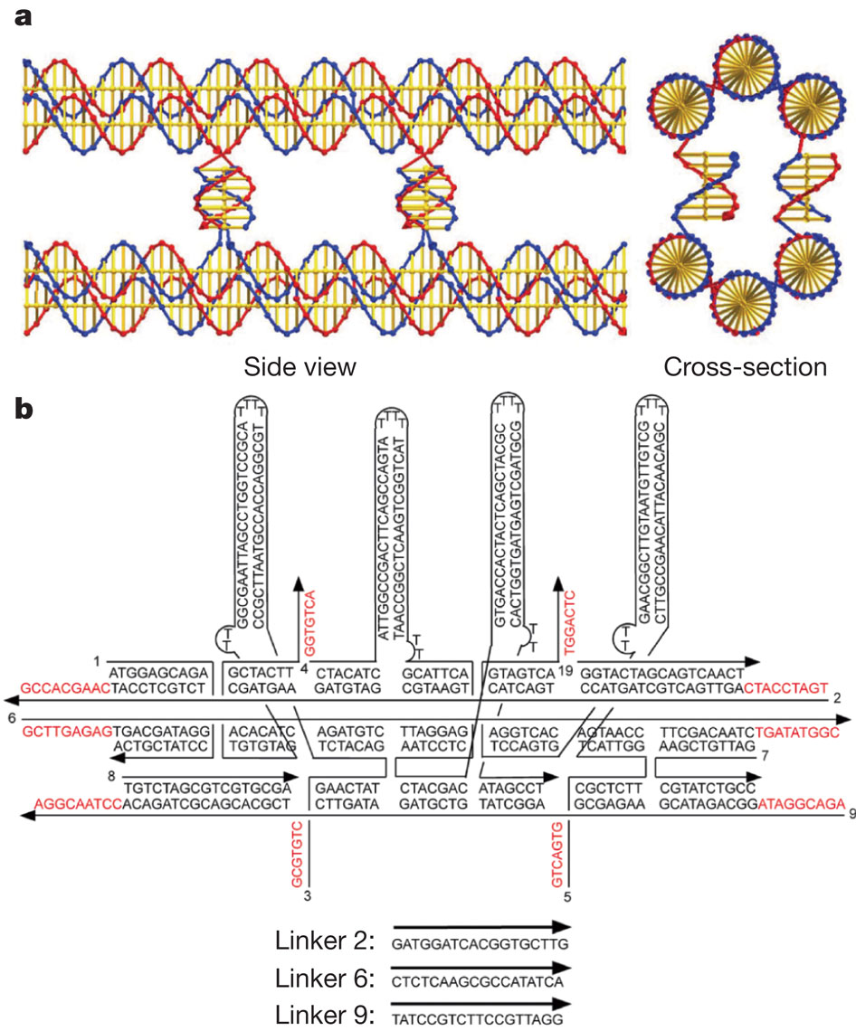
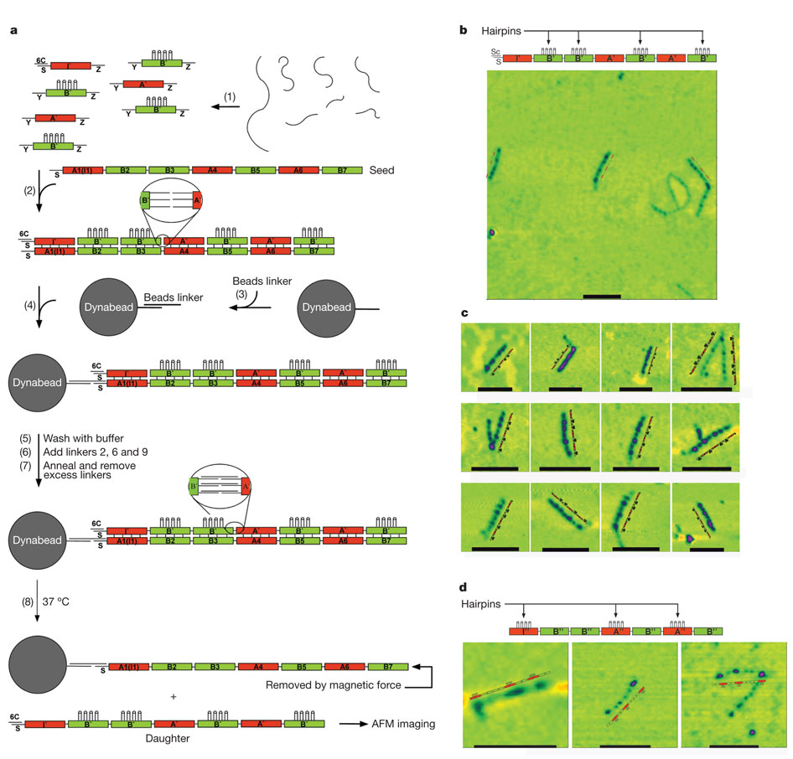

Nucleotides: ~ 150
Complexion: W~4¹⁵⁰
Complexity ξ = 300
Product: 7 Blocks
ξ = 7
The percentage of heptamers with the correct sequence is estimated to be 70%
ξ[Product / Parts] =.023
T Wang et al. Nature 478, 225-228 (2011) doi:10.1038/nature10500

Slide 6
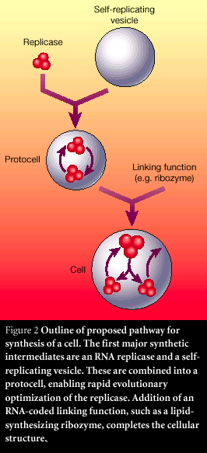
Information Rich Replication
(Non-Protein Biochemical Systems)
J. Szostak, Nature,409, Jan. 2001

Slide 7
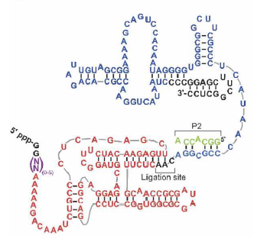
Selection of an improved RNA polymerase ribozyme
with superior extension and fidelity
HANI S. ZAHER and PETER J. UNRAU
ξ[Product / Parts] =~ .1
20 NT Extension
RNA (2007), 13:1017–1026. Published by Cold Spring Harbor Laboratory Press.

Slide 8

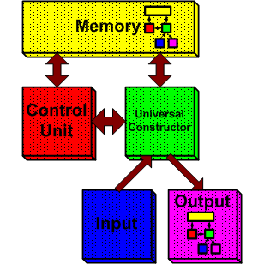
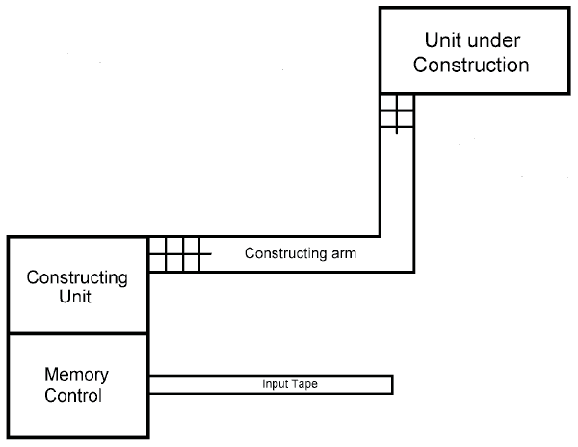
http://www.uncommondescent.com/biology/john-von-neumann-an-ider-ante-litteram/

Slide 9
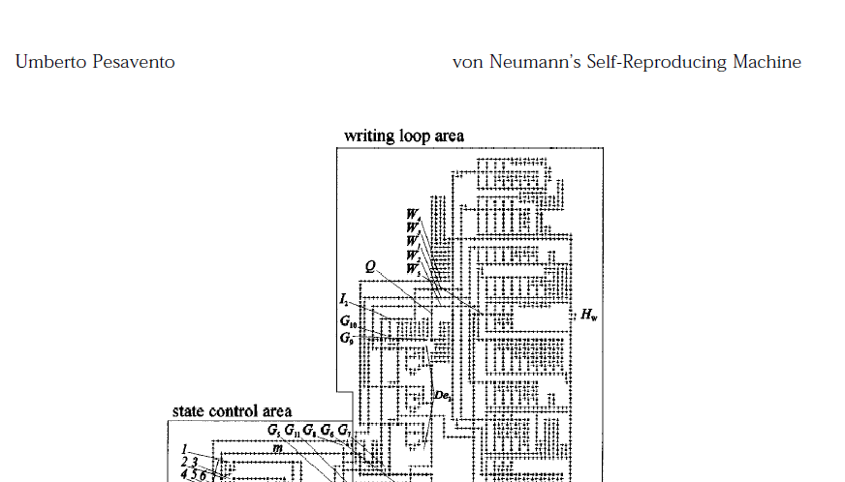
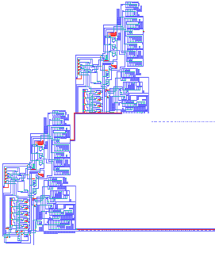
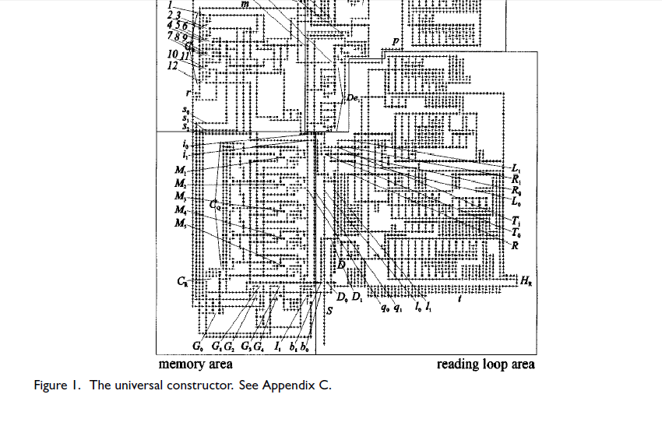
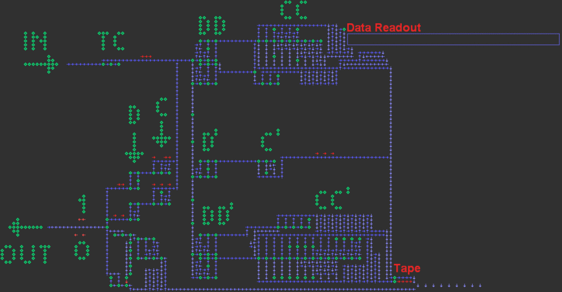
http://web.archive.org/web/20070418081628/http://dragonfly.tam.cornell.edu/~pesavent/pesavento_self_reproducing_machine.pdf
http://en.wikipedia.org/wiki/File:320_jump_read_arm.gif

Slide 10
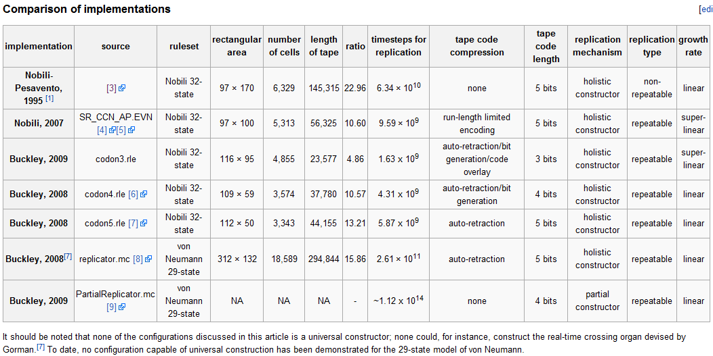
Implementations of Von Neumann’s Universal Constructor
http://en.wikipedia.org/wiki/Von_Neumann_universal_constructor

Slide 11
Self Replication Simulators
http://necsi.edu/postdocs/sayama/sdsr/java/#langton

Slide 12
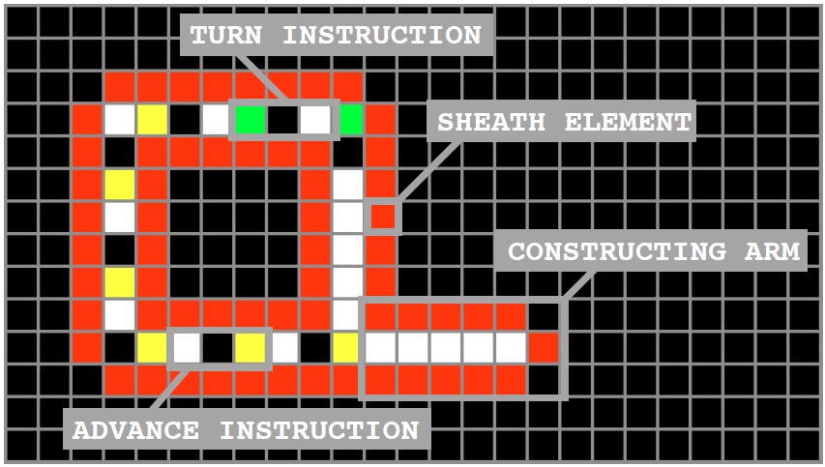
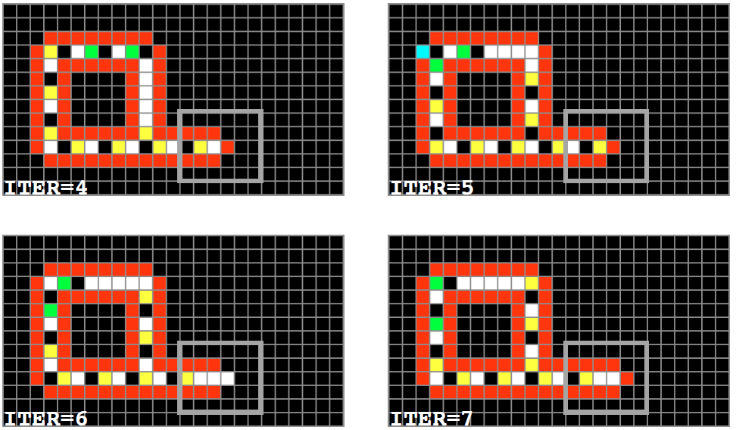
Langton Loops
http://carg2.epfl.ch/Teaching/GDCA/loops-thesis.pdf

Slide 13
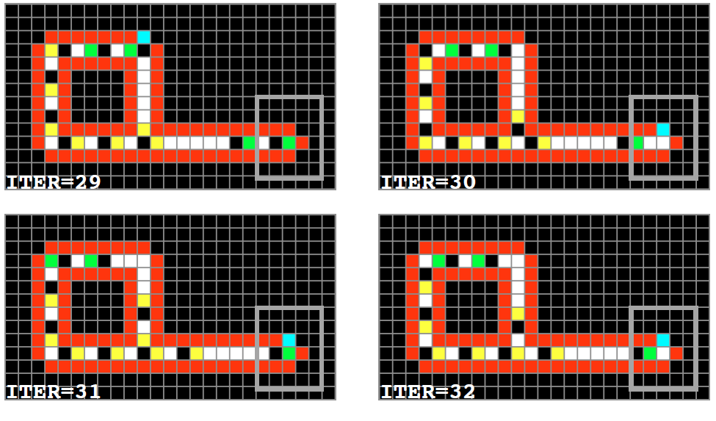
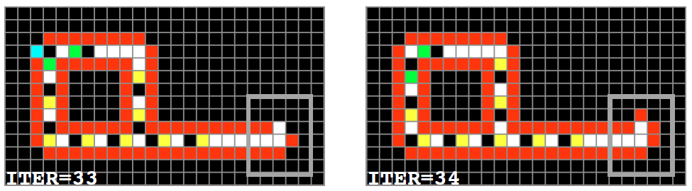
http://carg2.epfl.ch/Teaching/GDCA/loops-thesis.pdf

Slide 14
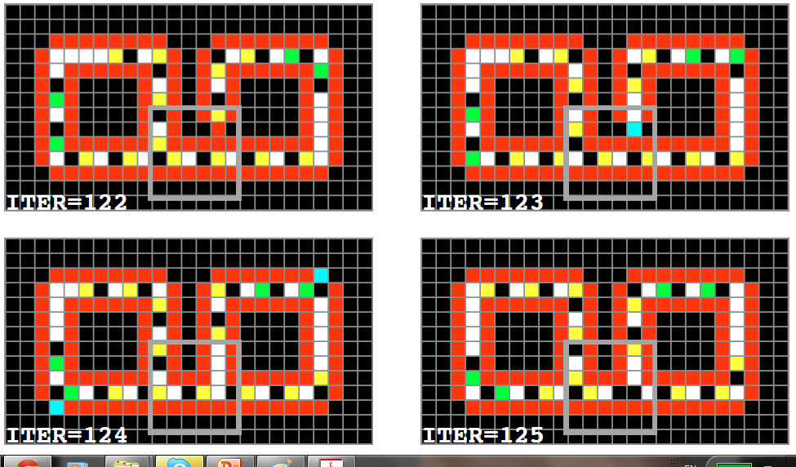
http://carg2.epfl.ch/Teaching/GDCA/loops-thesis.pdf

Slide 15
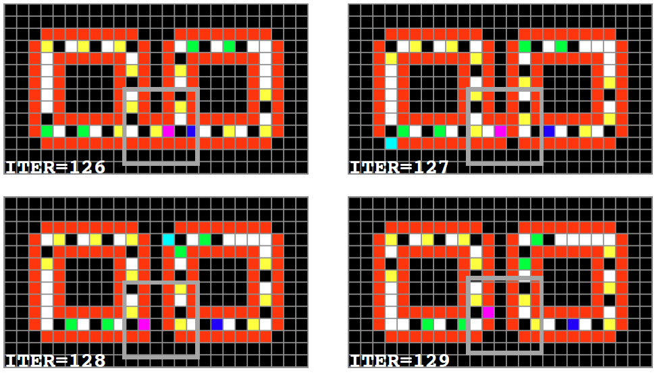
http://carg2.epfl.ch/Teaching/GDCA/loops-thesis.pdf

Slide 16







CA | Number of States | Neighborhood | Number of Cells (typical) | Replication Period (Typical) | Thumbnail
Langton's loops^{[3]} (1984): The original self-reproducing loop. | 8 | von Neumann | 86 | 151
Byl's loop^{[4]} (1989): By removing the inner sheath, Byl reduced the size of the loop. | 6 | von Neumann | 12 | 25
Chou-Reggia loop^{[5]} (1993): A further reduction of the loop by removing all sheaths. | 8 | von Neumann | 5 | 15
Tempesti loop^{[6]} (1995): Tempesti added construction capabilities to his loop, allowing patterns to be written inside the loop after reproduction. | 10 | Moore | 148 | 304
Perrier loop^{[7]} (1996): Perrier added a program stack and an extensible data tape to Langton's loop, allowing it to compute anything computable. | 64 | von Neumann | 158 | 235
SDSR loop^{[8]} (1998): With an extra structure-dissolving state added to Langton's loops, the SDSR loop has a limited lifetime and dissolves at the end of its life cycle. | 9 | von Neumann | 86 | 151
Evoloop^{[9]} (1999): An extension of the SDSR loop, Evoloop is capable of interaction with neighboring loops as well as of evolution..^{[10]} | 9 | von Neumann | 149 | 363

Slide 17
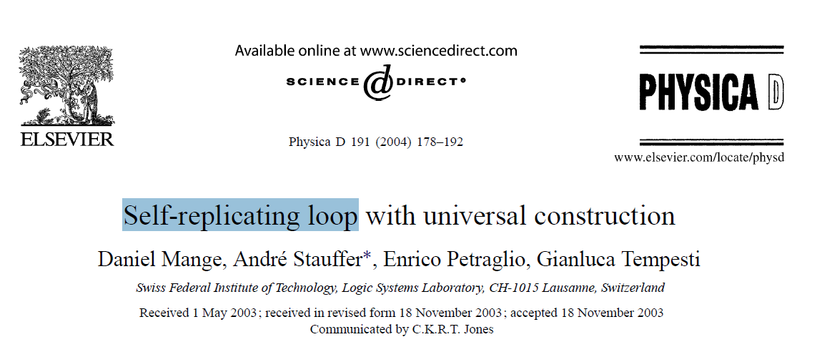
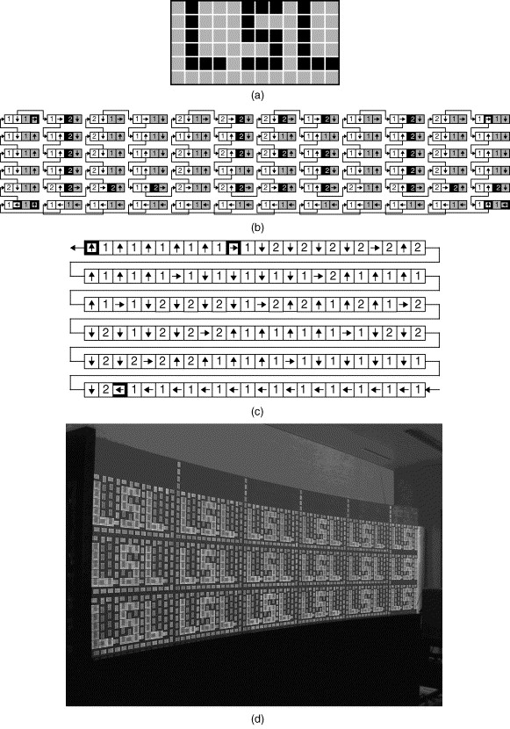

Slide 18
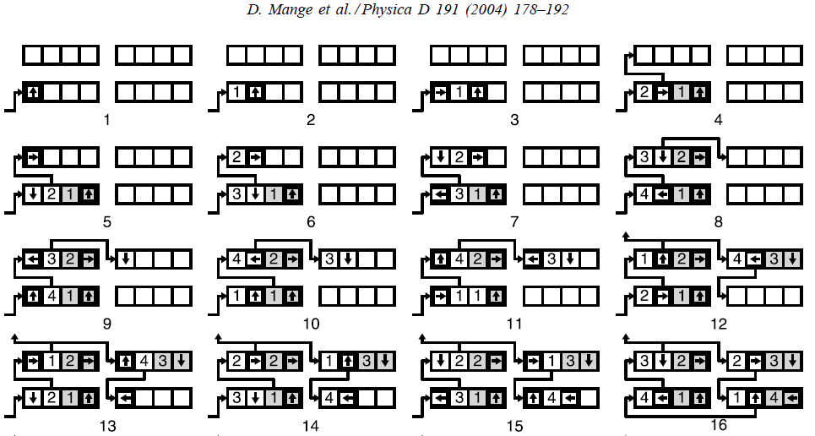
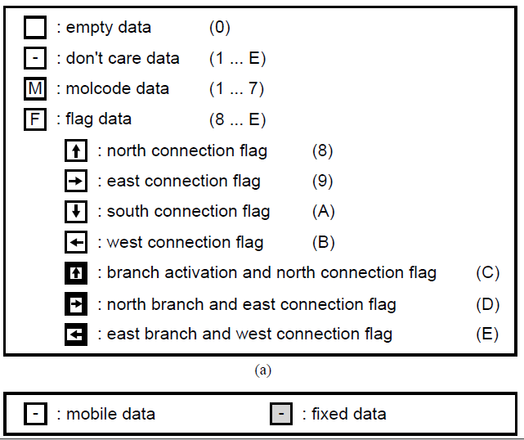

Slide 19
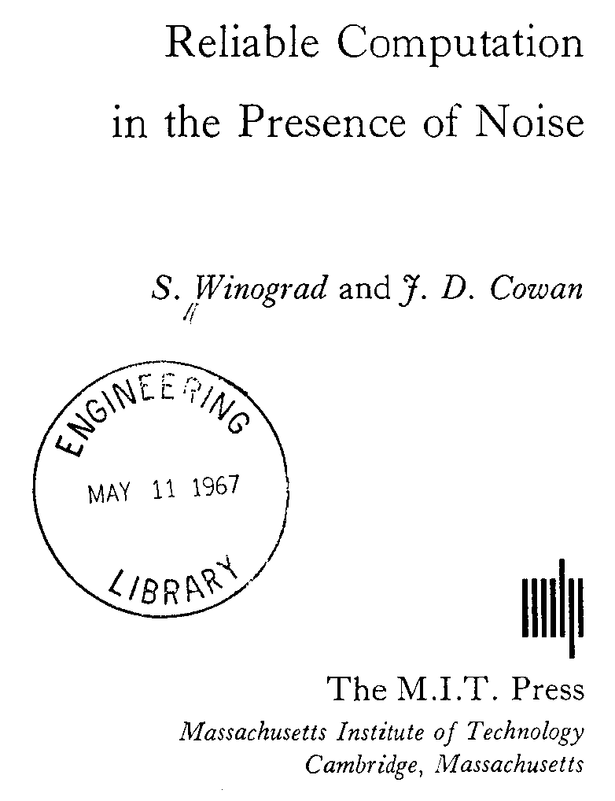
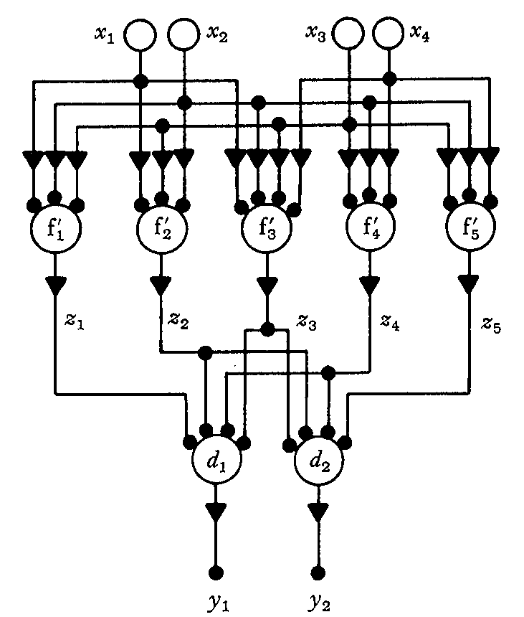
Fault-Tolerant Circuits

Slide 20
Threshold Theorem – Von Neumann 1956
p
n
p
MAJ
p
p
p
MAJ
MAJ
n=3
p
p
Recursion Level | P
K=1
K=2
K
p
MAJ
p
k
For circuit to be fault tolerant

Slide 21
Threshold Theorem - Winograd and Cowan 1963
p
A circuit containing N error-free gates can be simulated with probability of failure ε using O(N ⋅poly(log(N/ε))) error-prone gates which fail with probability p, provided p < pth, where pth is a constant threshold independent of N.
n
p
MAJ
p
p
p
MAJ
MAJ
p
p
p
MAJ
p
Number of gates consumed:
k
Find k such that
Number of Gates Consumed
Per Perfect Gate is

Slide 22
Threshold Theorem – Generalized
p
n
p
p
p
p
p
p
MAJ
p
p
p
p
p
k
For circuit to be fault tolerant P<p
Total number of gates:

Slide 23
Scaling Properties of Redundant Logic (to first order)
P
A
Probability of correct functionality = p[A] ~ e A (small A)
Area = A
P₁ = p[A] = e A
P₂ = 2p[A/2](1-p[A/2])+p[A/2]²
= eA –(eA)²/4
Area = 2*A/2
Conclusion: P₁ > P₂

Slide 24
Scaling Properties of Majority Logic
n segments
Total Area = n*(A/n)
P
A
Probability of correct functionality = p[A]
To Lowest Order in A
Conclusion: For most functions n = 1 is optimal. Larger n is worse.

Slide 25
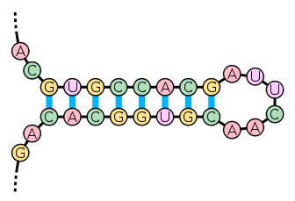
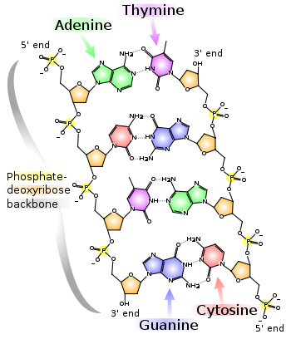
Definition: Rich Self Replication
[1] Autonomous
>
Complexity of Individual
Building Blocks
[2] Complexity of Final Product
Example: DNA
Complexity of Oligonucleotide:
N ln 4
Complexity of Nucleotide (20 atoms):
Assuming atoms are built from C,O,N,P periodic table: 4 ln 20
Therefore: Rich Self Replication Occurs in DNA
If the final product is a machine which can self replicate itself and if N > ~ 9 bases.

Slide 26
The Self Replication Cycle
Parts
+
+
+
Template
p per base
p’ per base
+
+
+
Machine
Step 1
Step 2
Step 3

Slide 27
Selection of an improved RNA polymerase ribozyme
with superior extension and fidelity
HANI S. ZAHER and PETER J. UNRAU
ξ[Product / Parts] =~ .1
20 NT Extension
RNA (2007), 13:1017–1026. Published by Cold Spring Harbor Laboratory Press.

Slide 28
Fabricational Complexity
N
A
G
T
C
G
C
A
A
T
Fabricational Complexity for N-mer or M Types =
Fabricational Cost for N-mer =
Where is the yield per fabricational step
Fabricational Complexity Per Unit Cost
Complexity Per Unit Cost
Complexity Per Unit Time*Energy

Slide 29
Fabricational Complexity
Application: Identifying New Manufacturing Approach for Semiconductors
…Can we use this map as a guide towards future directions in fabrication?

Slide 30
Fabricational Complexity Per Unit Cost
2 Ply Error Correction
Non Error Correcting:
A
G
T
C
2Ply Error Correcting:
A
G
T
C
A
G
T
C
p=0.99

Slide 31
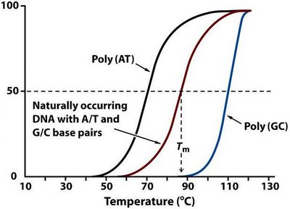

Threshold for Life
What is the Threshold for Self Replicating Systems?
Measurement Theory
Replication Cycle
DNA
Parts
+
+
+
Template
Error Correcting
Exonuclease
(Ruler)
+
+
+
Machine
Step 1
Watson Crick
.18 nm
Step 2
Step 3
/sandwalk.blogspot.com/2007/12/dna-denaturation-and-renaturation-and.html
http://en.wikipedia.org/wiki/File:Stem-loop.svg
How Well Can N Molecules Measure Distance?
Probability of Self Replication
J. Jacobson 2/28/12
Number of Nucleotides

Slide 32
Assignment Option #1
Design a Rich Self Replicator
Propose a workable self replicating system with enough detail that it could be built.
The Descriptional Complexity of the Final Product must exceed the The Descriptional Complexity of the Building Blocks (Feedstock)
Detail a mechanism for error correction sufficient that errors don’t accumulate from generation to generation.

Slide 33
Assignment Option #2
Design an Exponential Scaling Manufacturing Process
Design a manufacturing process such that on each iteration (e.g. each turn of a crank) the number of widgets produced grows geometrically.
Detail a mechanism for error correction such that later generations don’t have more errors than earlier ones.
Human intervention is allowed.
Proposal should be based on simple processes (e.g. printing).

